Slide 1

Utility Bills Instruction
Rhode Island Industrial Training and Assessment Center
Community College of Rhode Island

Slide 2
Why Utility Bills are essential
They directly tell us the energy usage patterns of our clients.
They help us identify the costs and rates of utilities including gas, electricity (kW and kWh), water, etc.
They help us find avoidable costs such as late fee, sales tax, power factor charges.
They help us identify billing errors such as overcharges, incorrect tariff rates, and discrepancies in meter readings.
They help us determine the optimal tariff rate for our clients!
They help us find out whether you receive gross tax credits!
This analysis can be done prior to the on-site visit, even prior to the preassessment meeting!
Therefore, the utility bills provide critical information about a facility’s energy consumption, costs, and usage patterns. This data is invaluable for identifying potential opportunities to reduce energy usage, lower costs, and improve overall energy efficiency!

Slide 3
The desired utility bills
A successful utility bill should deliver the following information to our team:
Statement date and billing period
Meter number and readings
Tariff rate
The utility consumption and charges of the current period
Breakdown consumption (on/off-peak consumption ) and detailed charges (generation charges, transmission charges, demand charges, customer service charge, FMCC charge, sales tax, and so on )
The bills from a third-party supplier (if the facility has a third-party as its energy supplier)

Slide 4
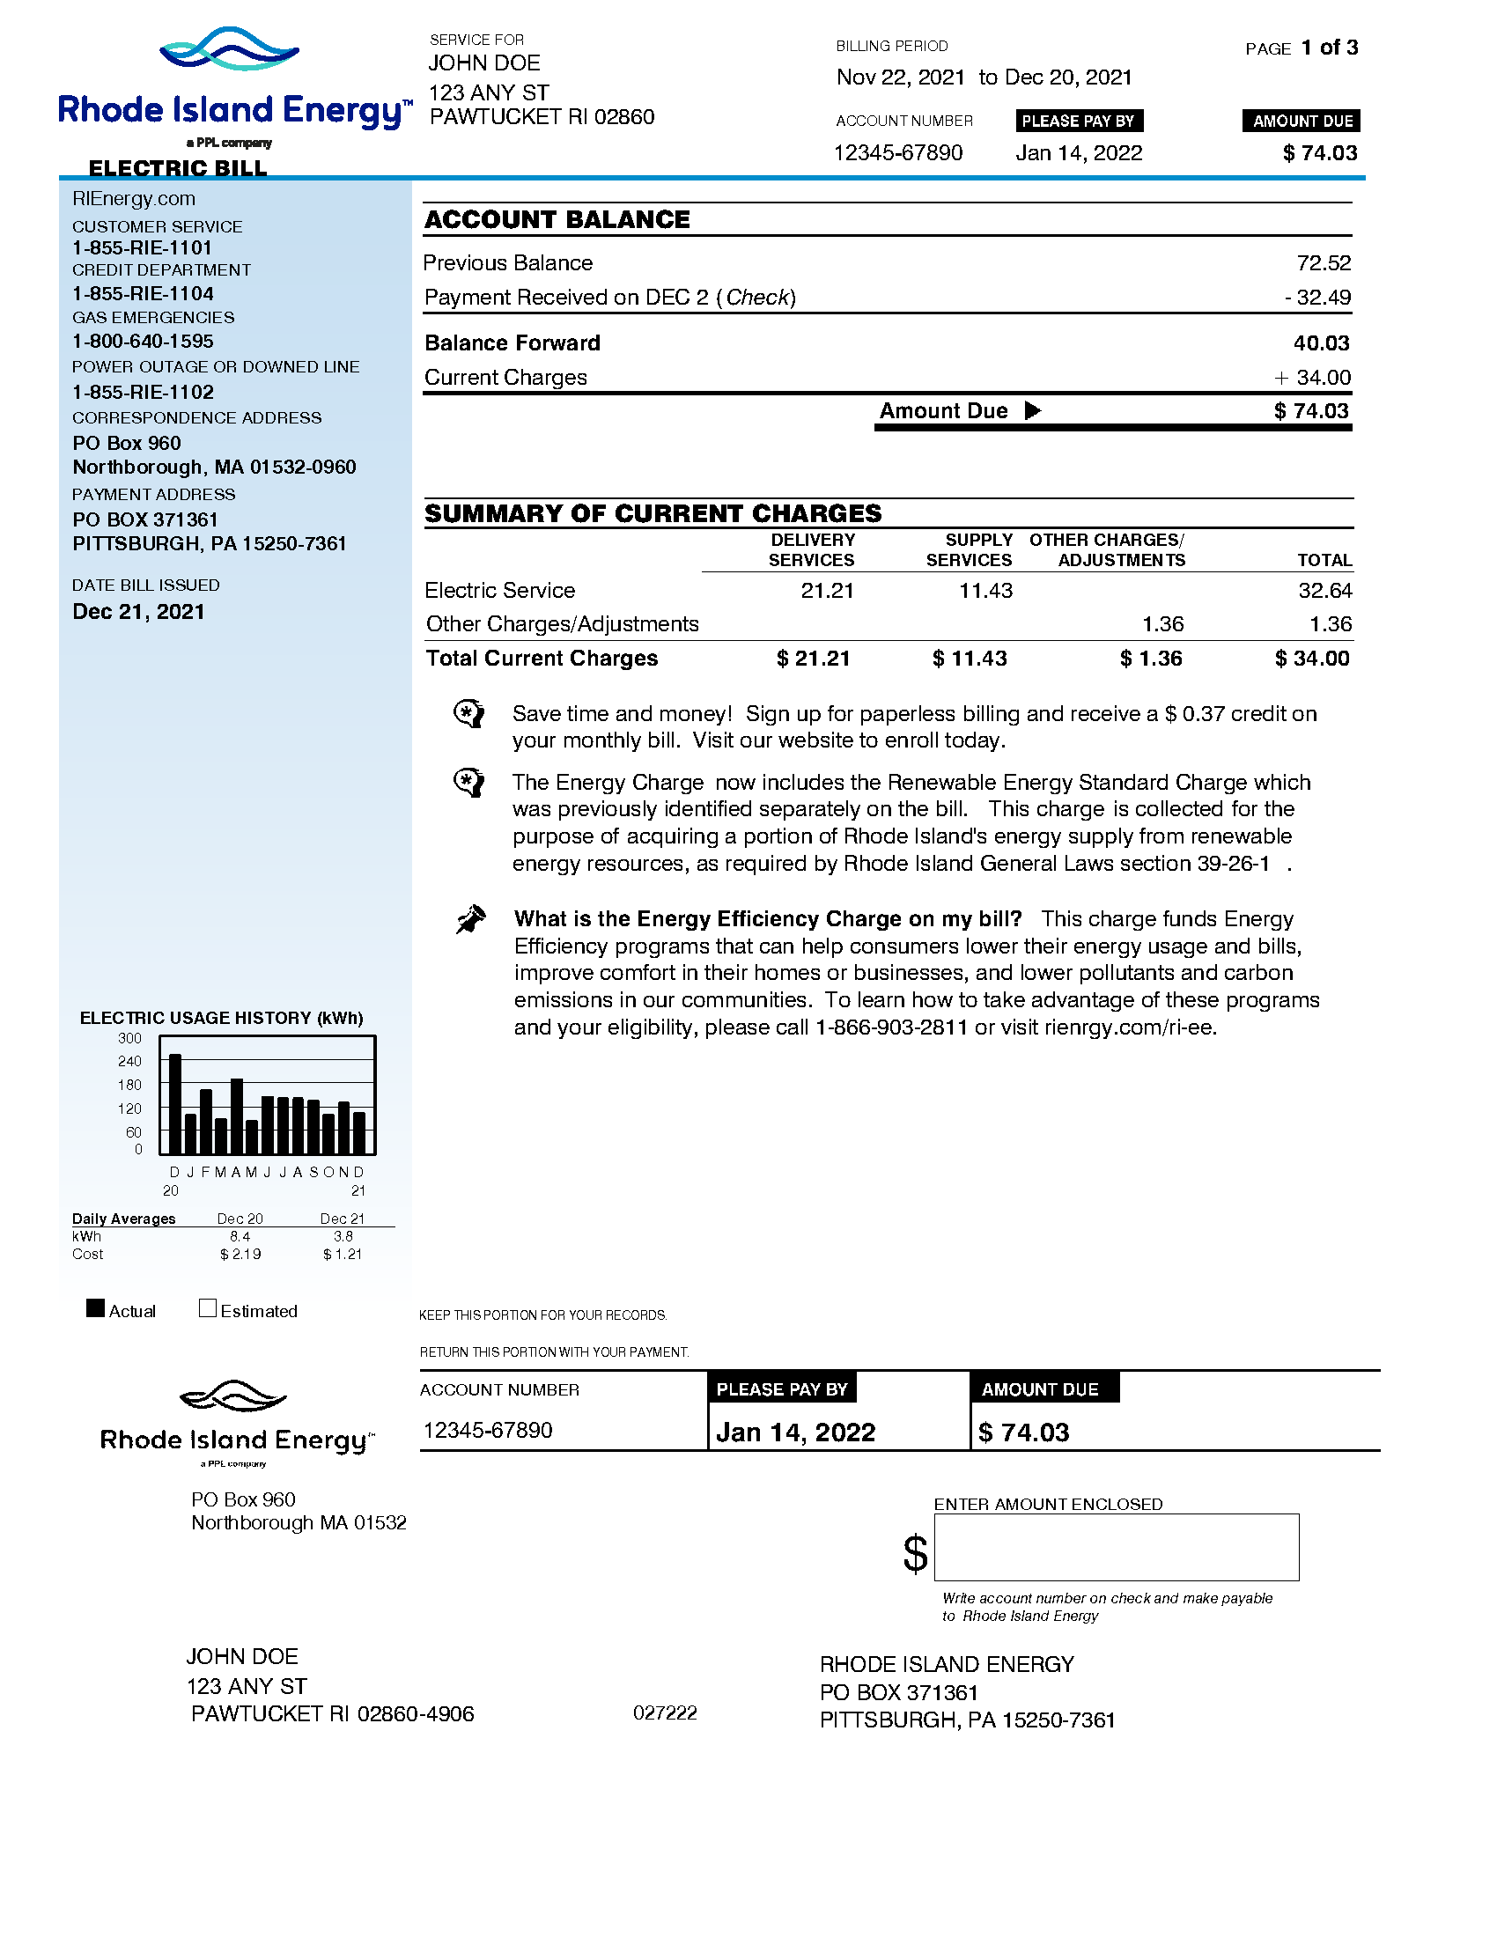
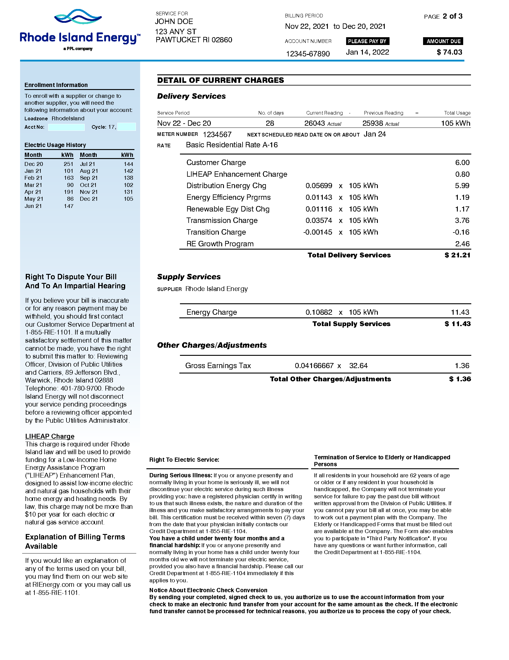
Sample bills (electricity)
The electricity bills typically have two pages
  The first page usually provides us the overall summary of charges.
  The second page has meter reading, service period, breakdown usage and charges.
Summary of Charges
Service Period and Meter Reading
Electricity Usage History
Usage and Charges Breakdown

Slide 5
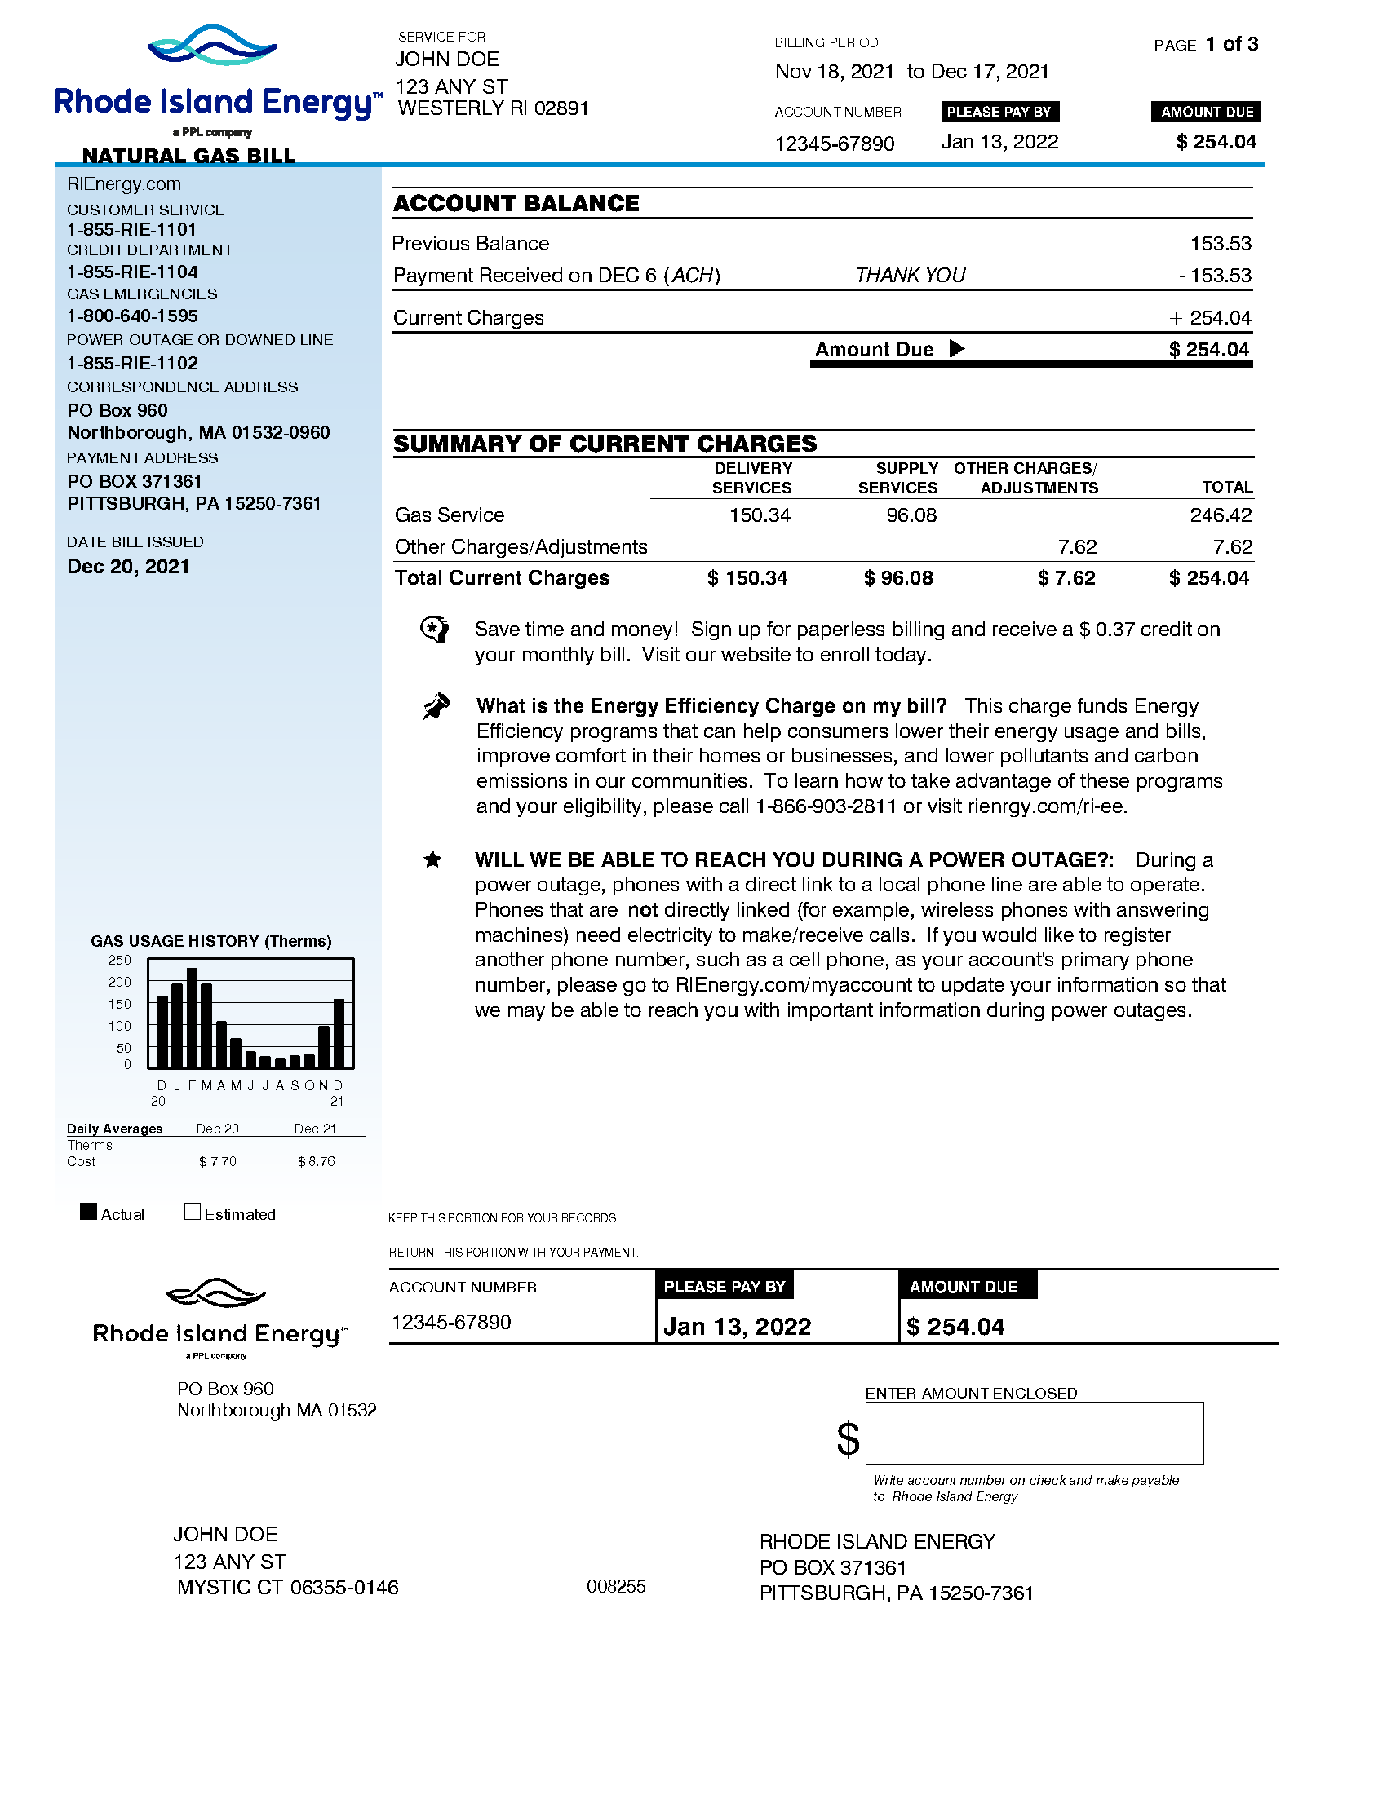
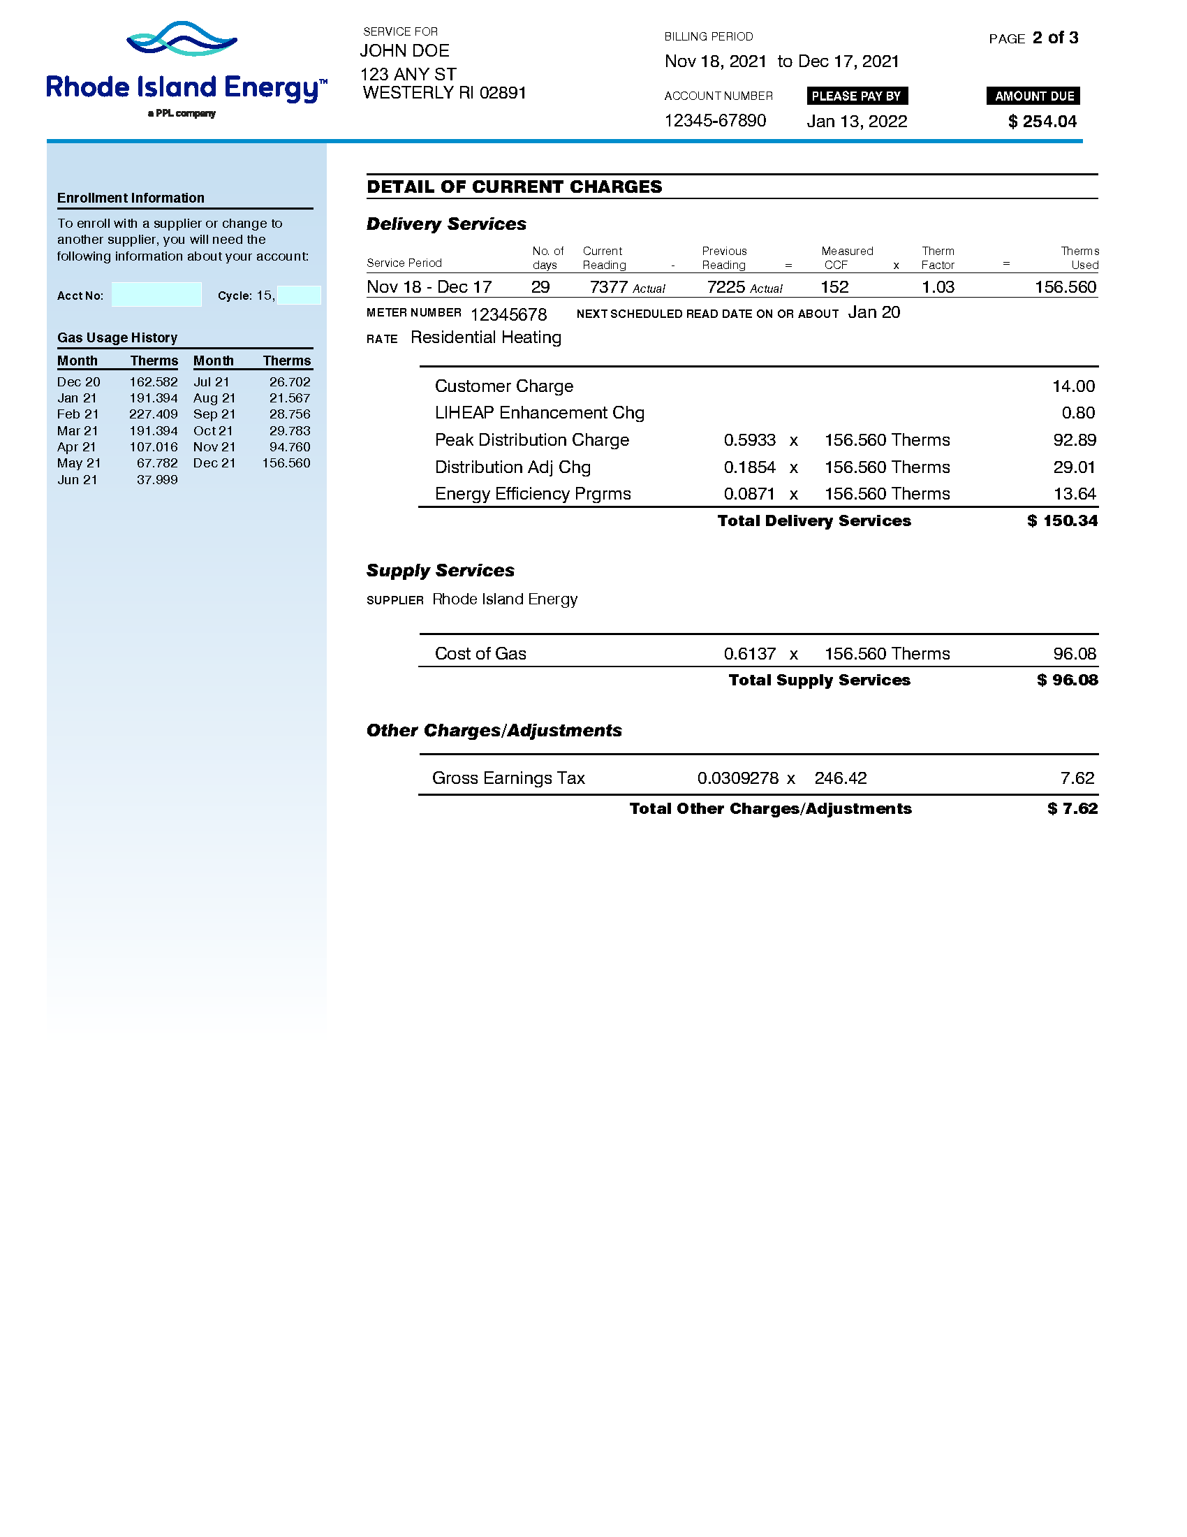
Sample bills (natural gas)
The natural gas bills are similar with the electricity ones
  The first page usually provides us the overall bill summary.
  The second page has meter reading, service period, breakdown usage and charges.
Summary of Charges
Service Period and Meter Reading
Gas Usage History
Usage and Charges Breakdown

Slide 6
Other utilities
For utilities such as propane, water, heating oil, and others, if the bills provide service period, usage, and detailed charges rather than a single number as the total amount due, the bills would be perfect enough to use.
Thanks for your collaboration!
By providing the desired utility bills, we can begin the process of reducing energy usage and cutting costs!

