Slide 1
Jérôme Jarre and Love Army
COLETTE/SAKINAH FLYNN - Elementary french ii - Culture project

Slide 2
Main points
Jérôme jarre
#lovearmy
Who is Jérôme Jarre ?
His startups
another project he has been involved in (liter of light)
What is Love army ?
What difference has #lovearmy made ?
What countries have #lovearmy gone to ?
How can you contribute ? (our class)

Slide 3
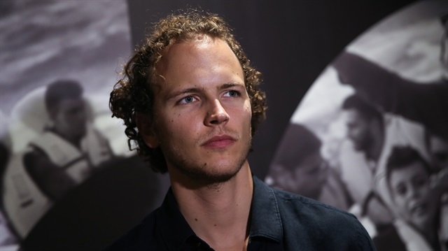
JÉRÔME JARRE

Slide 4
Background - who is Jérôme Jarre?
Jérôme JARRE IS A FRENCH ENTREPRENEUR, Social media personality, social activist, and humanitarian
He was born in Albertville, France on JUNE 12TH 1990 ( 28 YEARS OLD)
He was raised by his single mother agnes and has a younger brother
HE SPEAKS MULTIPLE LANGUAGES: French, English, Spanish, and Mandarin
He has been involved in some startup companies
HE WAS ONCE THE 5TH MOST FOLLOWED PERSON ON VINE
MORE RECENTLY HE HAS BEEN DOING HUMANITARIAN WORK
  #LOVEARMY

Slide 5
Startups
At the age of 19 Jérôme dropped out of Bordeaux Business School. “After 2 full years without hearing the word "entrepreneurship" "creation" or "personal growth", I dropped out and decided to move to China by myself.”
After he dropped out of business school and flew to china he started up a company
  Et LaChine - “a placement organisation for french students, providing internships across the Guangdong province of China.”

Slide 6
Startups cont.
After launching Et LaChine and gaining 200+ internships he launched Christopher Carmichael’s (his best friend’s) startup “buildmylanyard”
  Sold promotional custom lanyards for conferences and trade shows
  attracted clients such as P&G, Reed Expo, TED, EDF, Renault, Telus and RIM.
Jérôme joined his best friend again as the cofounder of Atendy
  “Atendy was an Event software aiming to connect attendees at event in a way never done before. Imagine going to an event and knowing exactly who are the biggest opportunities for you to meet in the room? That was our dream.”

Slide 7
Startups cont.
Atendy was struggling and Jérôme ultimately decided to step down from his position and start something new .
GrapeStory was “an influencer marketing agency and production company that focuses on recommending, sourcing, and activating micro-content creators for innovative brands to create engaging short stories.”
  founded by Gary Vaynerchuk, AJ Vaynerchuk, and Jérôme Jarre in 2013

Slide 8

VINE CAREER
Jérôme started using vine when it first launched in 2013
  He had about 8 million followers on vine before he left in 2015
  His vines have garnered over 1 billion views
Some of his vines

Slide 9
Jérôme quit Grapestory. In one of his youtube videos he turned down a deal because he said “it doesn’t feel right to me”

Slide 10
Jérôme jarre on quitting grapestory
“I loved creating this company with Gary V. Our agency signed all the best social media content creators of that time. This was fun because we were evolving on untouched territory. Vine was new. Snapchat was new. And we were the first one to advertise on it! It was fun making real money for the first time of my life. It took me 2 years to wake up, and realize what it meant to be part of the advertising industry. I don't feel comfortable selling sugared water to kids and pretending this is all cool and all good while I am only having organic green healthy food myself. it just feels wrong. There must be another way. A better way. Better for the talent. For the kids. For the brand. For everyone. Once I woke up and realized what we were doing I quit. Simple. I know I am one of best marketer in the world, But I won't use that gift to just sell sugared water.”- Jérôme Jarre

Slide 11
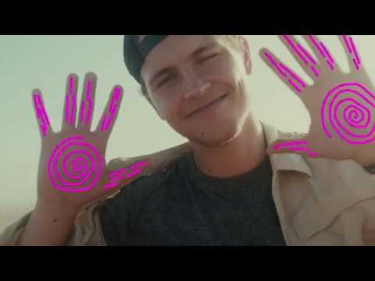
Everything you were told is wrong

Slide 12


Slide 13
Liter of Light
What is Liter of Light?
  “Liter of Light is a global, grassroots movement committed to providing affordable, sustainable solar light to people with limited or no access to electricity.” - liter of light
  https://literoflight.org/
In 2016 Jérôme partnered with Liter of light to help install lights in the Philippines
  With 150k likes on an Instagram post they were able to light up their first community

Slide 14
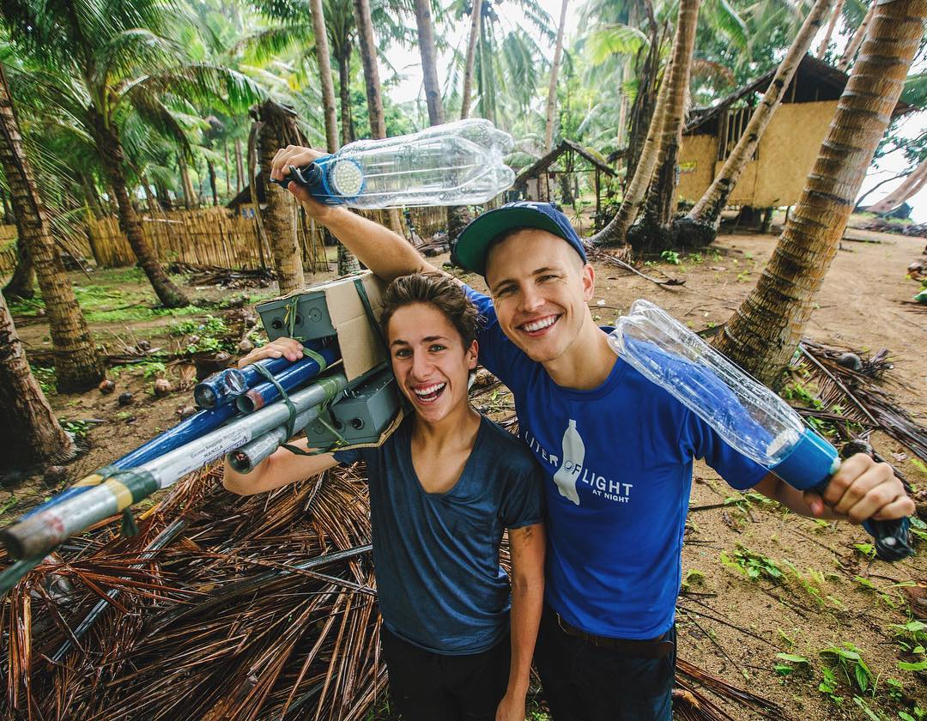

Slide 15
Liter of light cont.
“There are currently more than 21 branches of the project around the globe and one of the leaders of the movement is the social entrepreneur Illac Diaz. Other notable ambassadors include the French comedian Jérôme Jarre, athletes Serena Williams and Usain Bolt, the singer Usher and many more local celebrities. The project was also part of the COP21 in Paris, where it was presented to a world-wide audience as part of the event’s bid to end energy poverty. Current supplier partners include Sika, Coral, Pepsi and Tiger, and their support enables the project to keep product costs low. In 2015, the project was awarded the Zayed Energy Prize and a World Habitat Award.” – The St. Andrews Prize for the Environment

Slide 16

Liter of light cont.
Liter of light uses the “teach a man how to fish” method
  “Through a network of partnerships around the world, Liter of Light volunteers teach marginalized communities how to use recycled plastic bottles and locally sourced materials to illuminate their homes, businesses, and streets.” - liter of light
WHAT CAN YOU DO WITH 150K LIKES?

Slide 17


Slide 18
Jérôme’s newest endeavour: Love army
“WE MAKE LOVE VISIBLE”
What is love army?
  LOVE ARMY started in feb 2017
  Love army “fills social media and the news media with Hope stories, Love stories, and resolution to problems happening around the world.”

Slide 19
Love army for somalia
Jérôme along with actor Ben Stiller and Youtuber Casey Neistat set up a GoFundMe page for Somalia to help people affected by famine
  Jérôme convinced Turkish Airlines to provide an airplane to help deliver tons of food and water. They managed to send 60 tons
  Turkish airlines also helped by covering the cost for their flight to somalia
  They managed to reach their goal of $2.7 million dollars

Slide 20
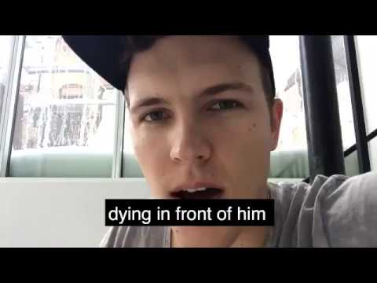

#turkishairlineshelpsomalia

Slide 21
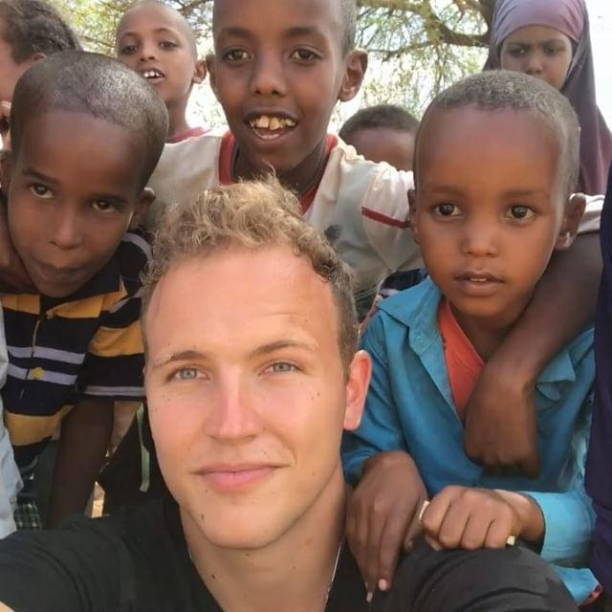
Pictures for love army somalia

Slide 22
Love army rohingya - https://www.gofundme.com/love-army-for-rohingya
Love army rohingya started in nov 2017
  They have yet to reach their goal of $2.5 Million
Why the rohingyas? Genocide
  “Rohingyas are often called the most persecuted minority in the world, unable to claim citizenship in a country that refuses to recognize them. The atrocities inflicted on the Rohingyas at the hands of the Myanmar government are staggering. Over the past week, Amnesty International and the international news media have reported stories of beatings, villages set on fire, rape, and murder.”

Slide 23
Love army Rohingya cont.
Around 900,000 Rohingyas are refugees in bangladesh currently
What is love army doing to help?
  Providing food, clean water and other supplies
  Love army employed rohingyas at the camp
    “We hired 3,000 people in this camp for cleaning, construction, teaching, doctors etc but this was a turning point because they had so many ideas it inspired us and they were so proud to work.“ - Jérôme Jarre

Slide 24
Pictures for love army rohingya

Slide 25
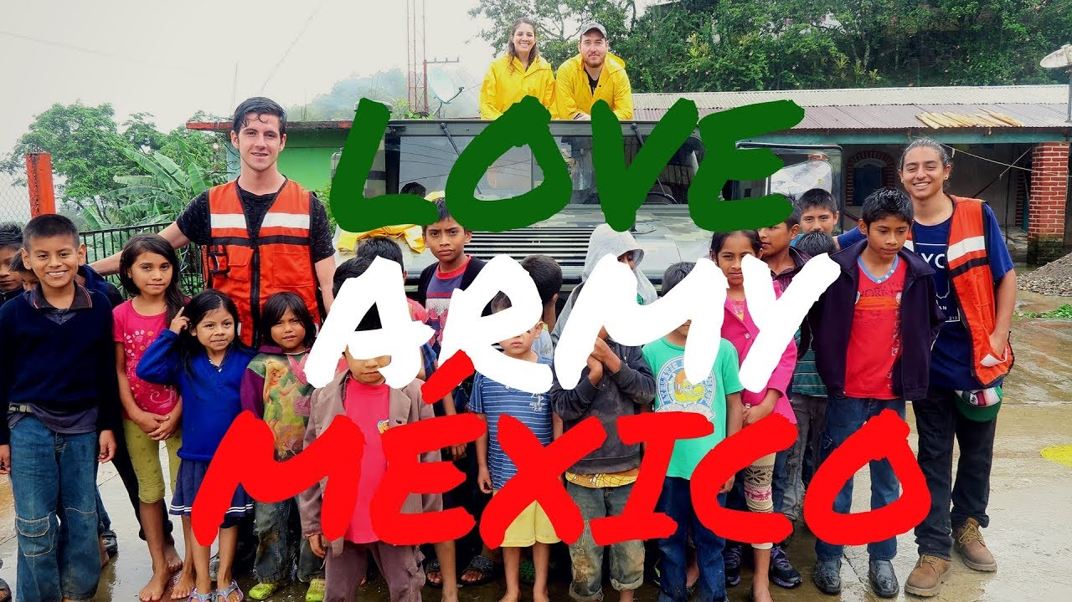
Love army Mexico
Juanpa zurita, on behalf of Love army also started a mexico earthquake relief.
They reached their goal of $1 million which they used to contribute to the efforts already being made

Slide 26
What comes next?
Of course food and clean water can go a long way but what comes next? What happens when it runs out again?
Jérôme jarre says “You can give money to the families in Somalia and they will start their own business, they will buy animals, they will buy goats and that is more empowering and the money is in this way injected in the Somali ecosystem vs. if you buy rice in another country or food in another country. It is not helping Somalia that much in the long run.”
Love army is not just providing temporary help they are equipping people with knowledge for the long run

Slide 27
Jérôme on why he started love army
Jérôme wanted to use his social media influence for a good cause
“I don’t believe that charities or big humanitarian actions are going to change the world, I believe the world is going to change when each one of us starts doing the small acts because means of small actions will always be bigger than one big action. So if we want the world in peace we need millions of small steps and we need it to all do it together.
“We decided we needed to create this pure, uncorrupted place on social media for the world and that’s what Love Army is and stays. We are building this very slowly we are not trying to build this super fast because if we did this we could corrupt it quickly so right now we have a pure seed and we are trying to keep it. It will grow at a natural speed.

Slide 28
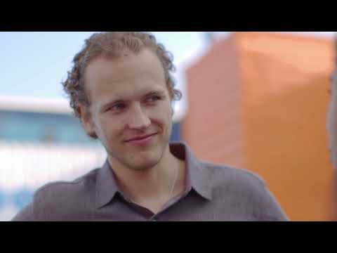
How you can contribute
“I know we are doing work on the other side of the world but there is so much that needs to happen locally. Any love action is worth as much as a big humanitarian action." – Jérôme Jarre

Slide 29
Sources
https://www.linkedin.com/in/Jérômejarre
https://www.crunchbase.com/organization/grapestory#section-overview
http://www.thestandrewsprize.com/finalist/liter-of-light-brazil-ecologically-sustainable-lighting
https://www.instagram.com/LITEROFLIGHT/
https://www.instagram.com/Jérômejarre/
http://arcrelief.org/love-army-somalia/

Slide 30
Sources cont.
https://literoflight.org/
https://www.youtube.com/playlist?list=PL-Ln1mMHHAx6N0LnECbGI_KV0pORvqcLv
https://www.oneyoungworld.com/counsellors/Jérôme-jarre
https://www.yenisafak.com/en/life/french-social-media-star-leads-humanitarian-causes-3462989
https://www.gofundme.com/love-army-for-rohingya
https://www.oneyoungworld.com/blog/lovearmy-raises-over-15million-rohingya-crisis

