Slide 1
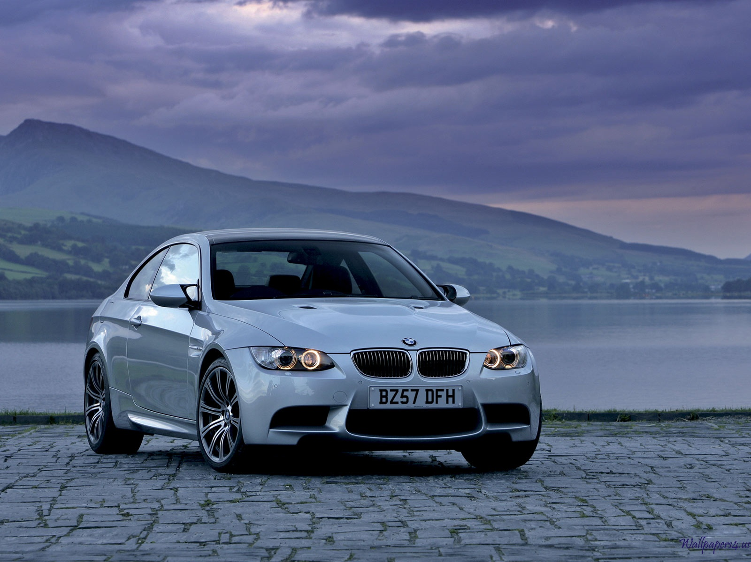
The 2008 BMW M3
Brandon Spirito / Felix

Slide 2

BMW - M3 Official Commercial

Slide 3
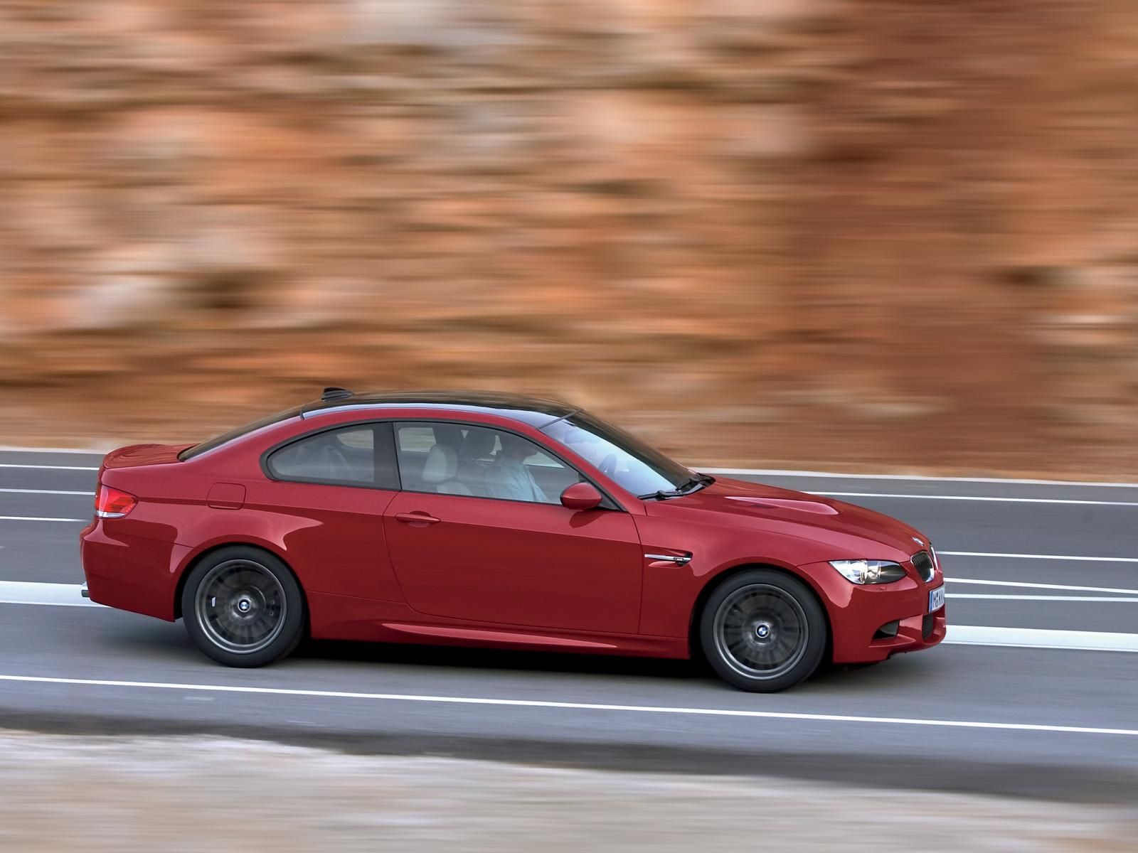
BMW M3 E92 Coupѐ
$56,500 MSRP
4.0-liter, V-8 engine
414 horsepower
Rear-wheel drive

Slide 4
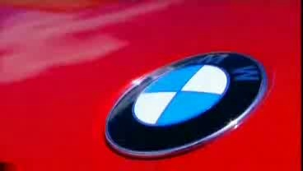
The 2008 BMW M3

Slide 5
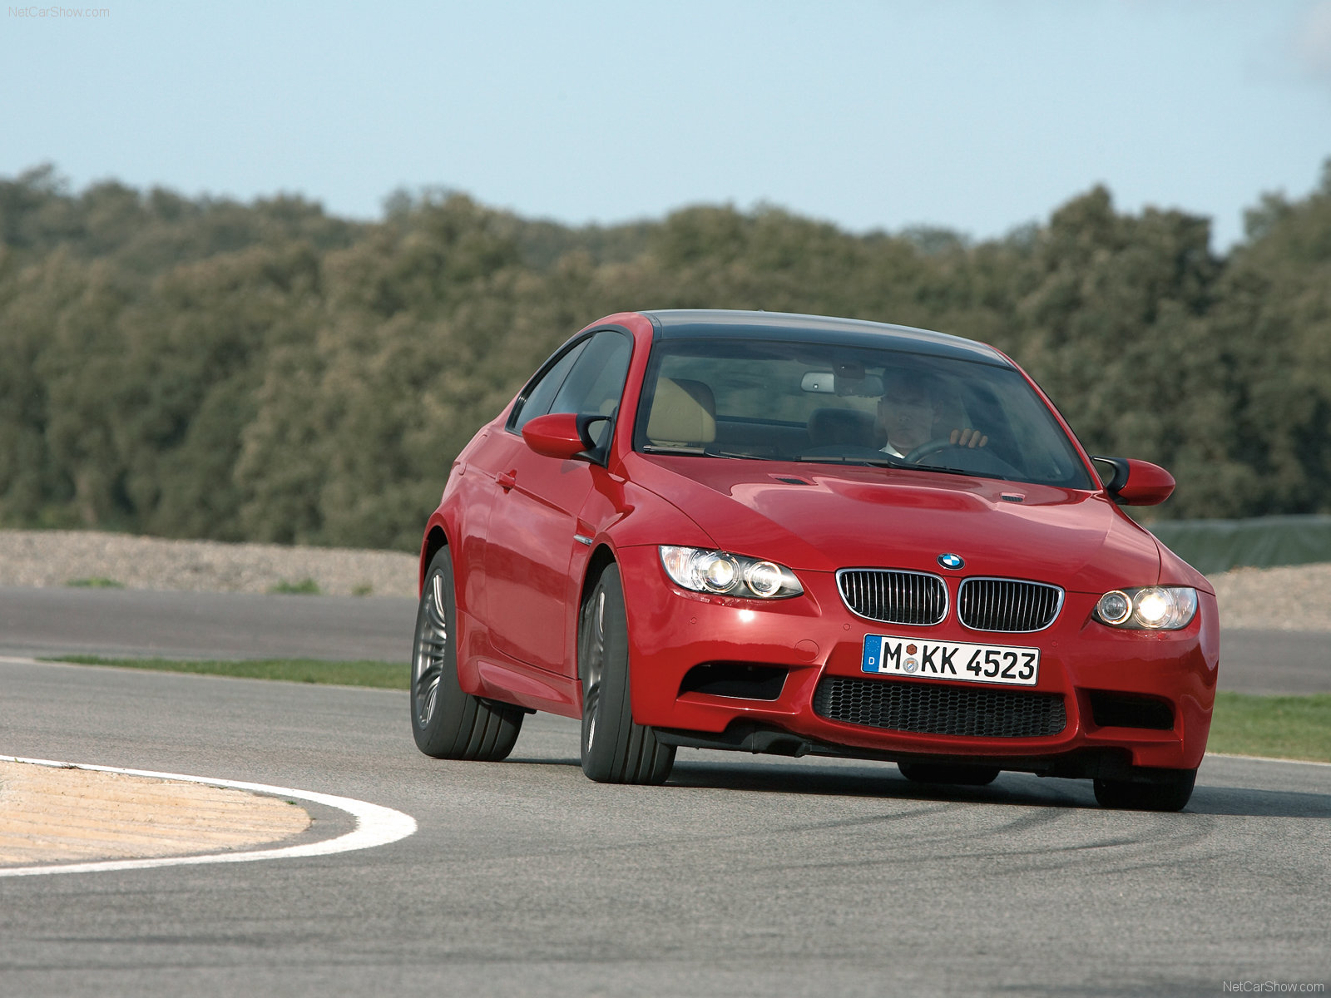
Performance & efficiency
4.0-liter 32-valve 414-hp v-8 engine
Digital motor electronics (DME) = on-board diagnostics
Engine Start/Stop button
6-speed manual transmission w/ additional oil cooler and heavy-duty dual-disc clutch
8 individual throttles, electronically controlled (drive-by-wire)
  Sensitivity
  Motor assisted instead of being mechanically attached to petal
Oil coolant heat exchanger
3-way catalytic converter with heated oxygen sensor
  Helps to conserve fuel by monitoring air/ fuel ratio’s

Slide 6
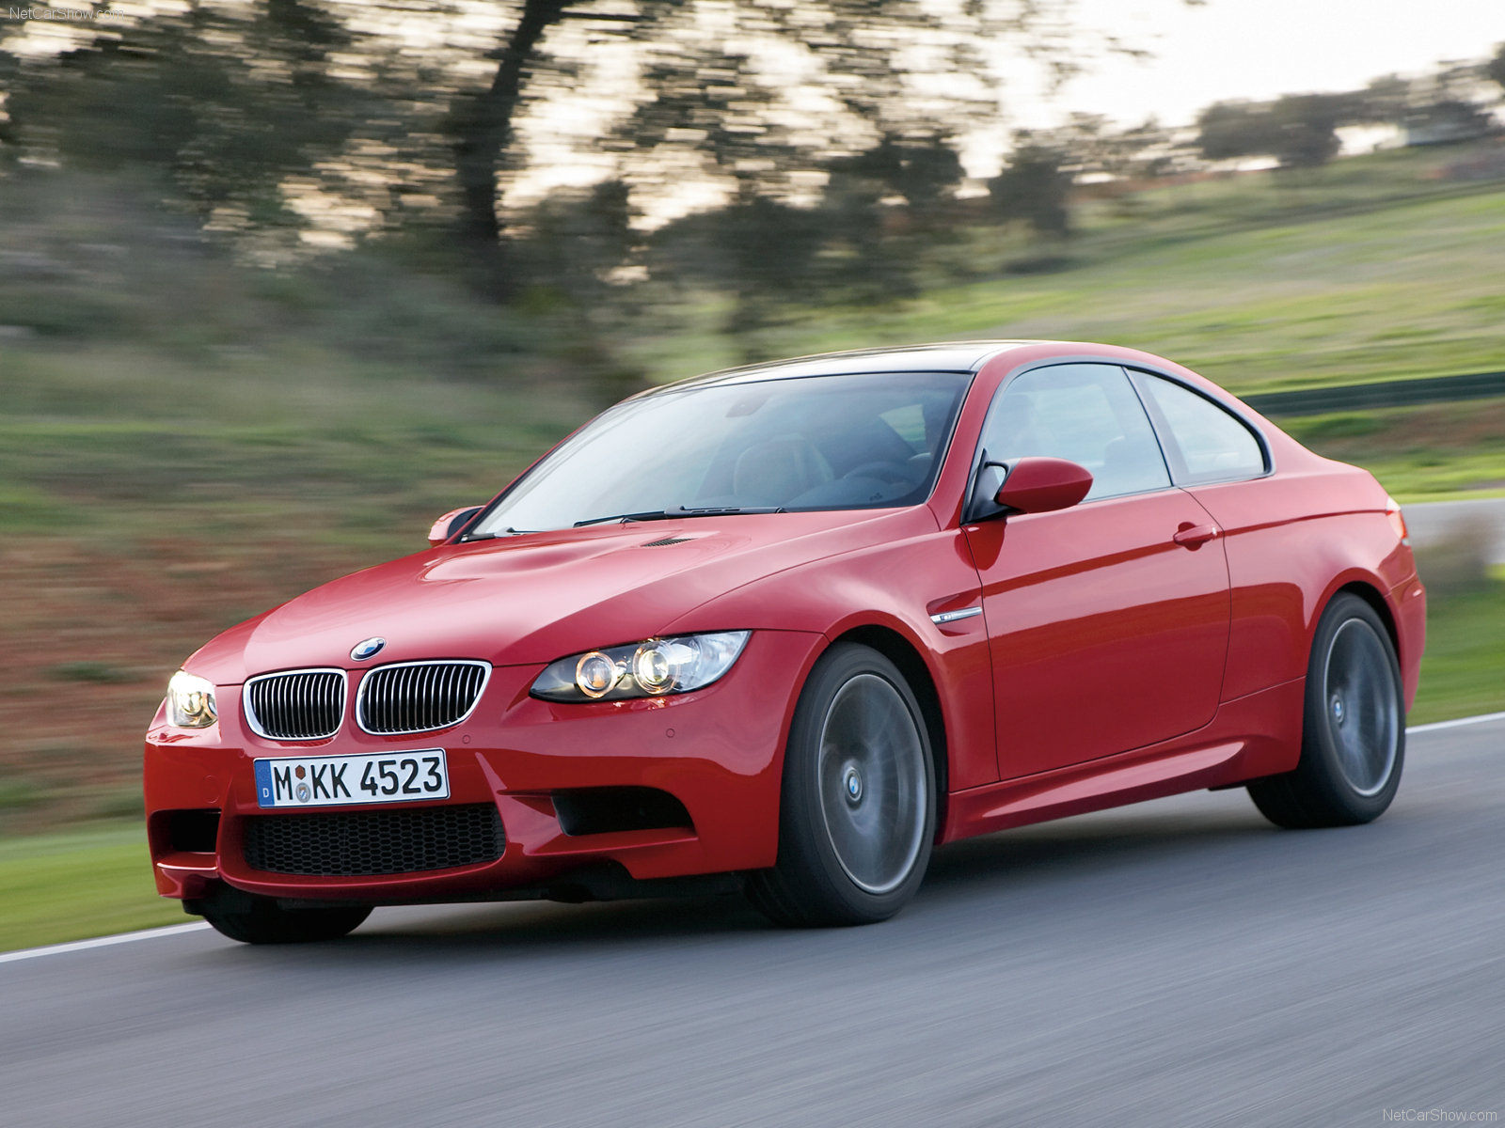
Handling/ ride
Dynamic Stability Control (DSC)
  Corrects over & under steer
Vehicle-speed-sensitive variable-assist power steering (M Servotronic)
Gas-pressurized front struts and rear shock absorbers
  Gas-pressurized shocks respond faster then regular air shocks
All Season Traction with Variable M Differential Lock
  Equally power to both tires when loss of traction is present

Slide 7
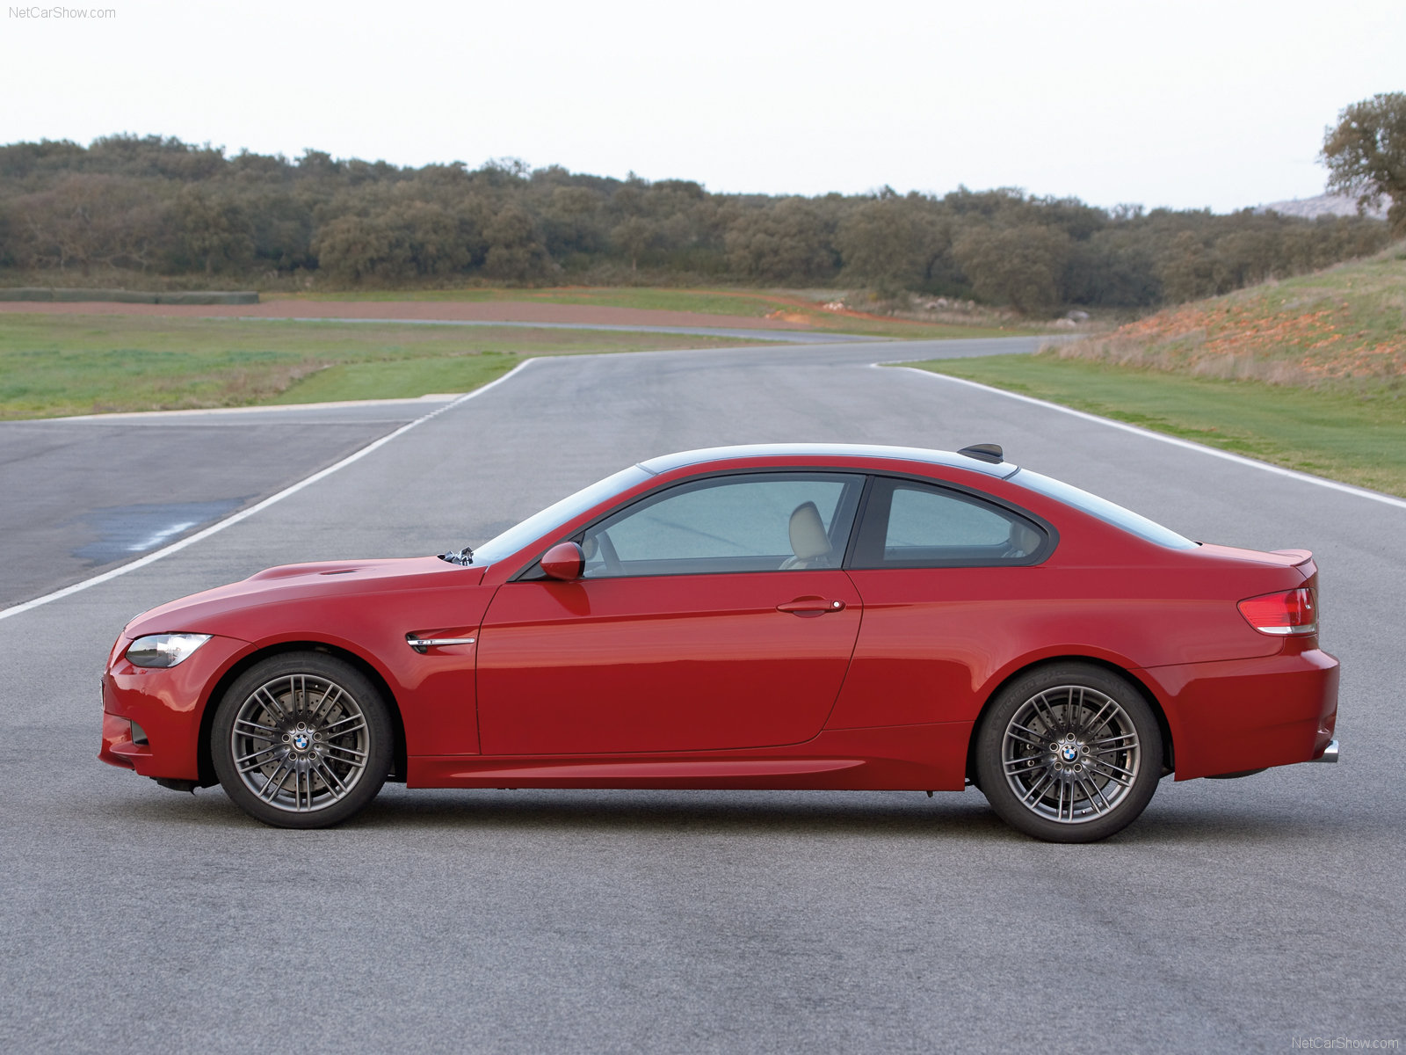
M suspension
  aluminum twin-joint spring-strut front axle
  aluminum rear axle sub frame in steel
  lightweight steel construction

Slide 8

BMW M3 - Extreme Testing

Slide 9
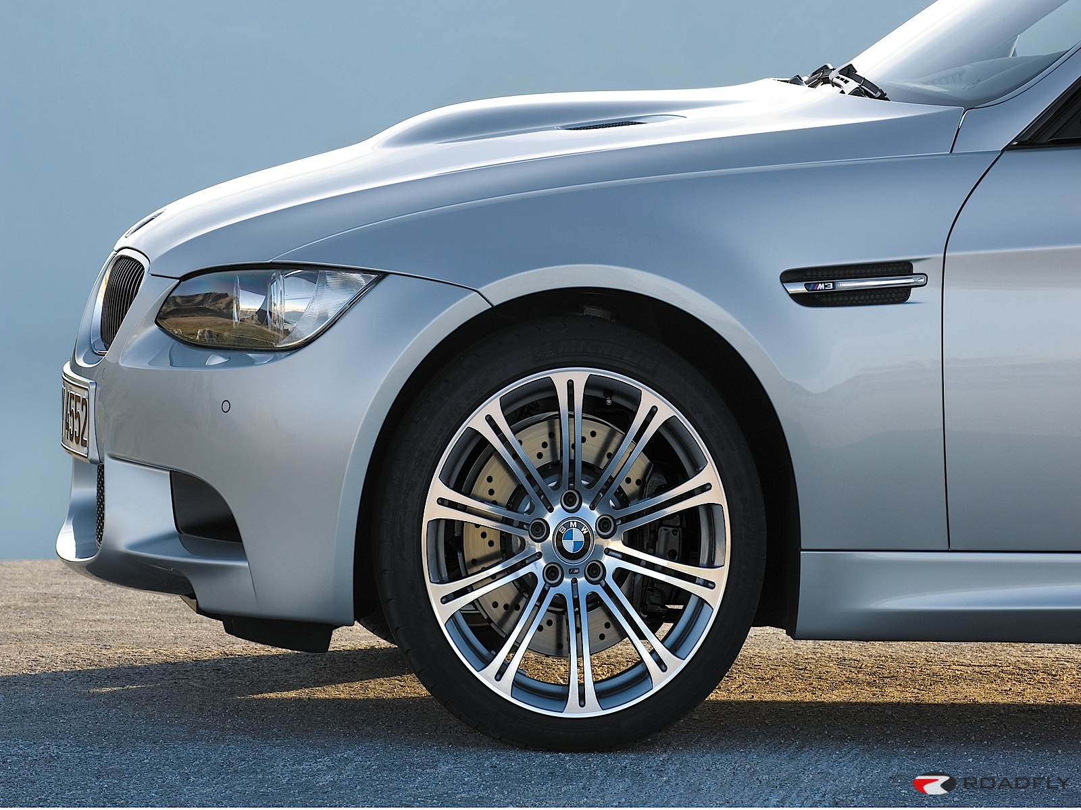
Brakes
BMW M vacuum-assisted ventilated, cross-drilled compound disc brakes with floating brake rotors
High-performance-tuned anti-lock braking system (ABS) with Dynamic Brake Control

Slide 10
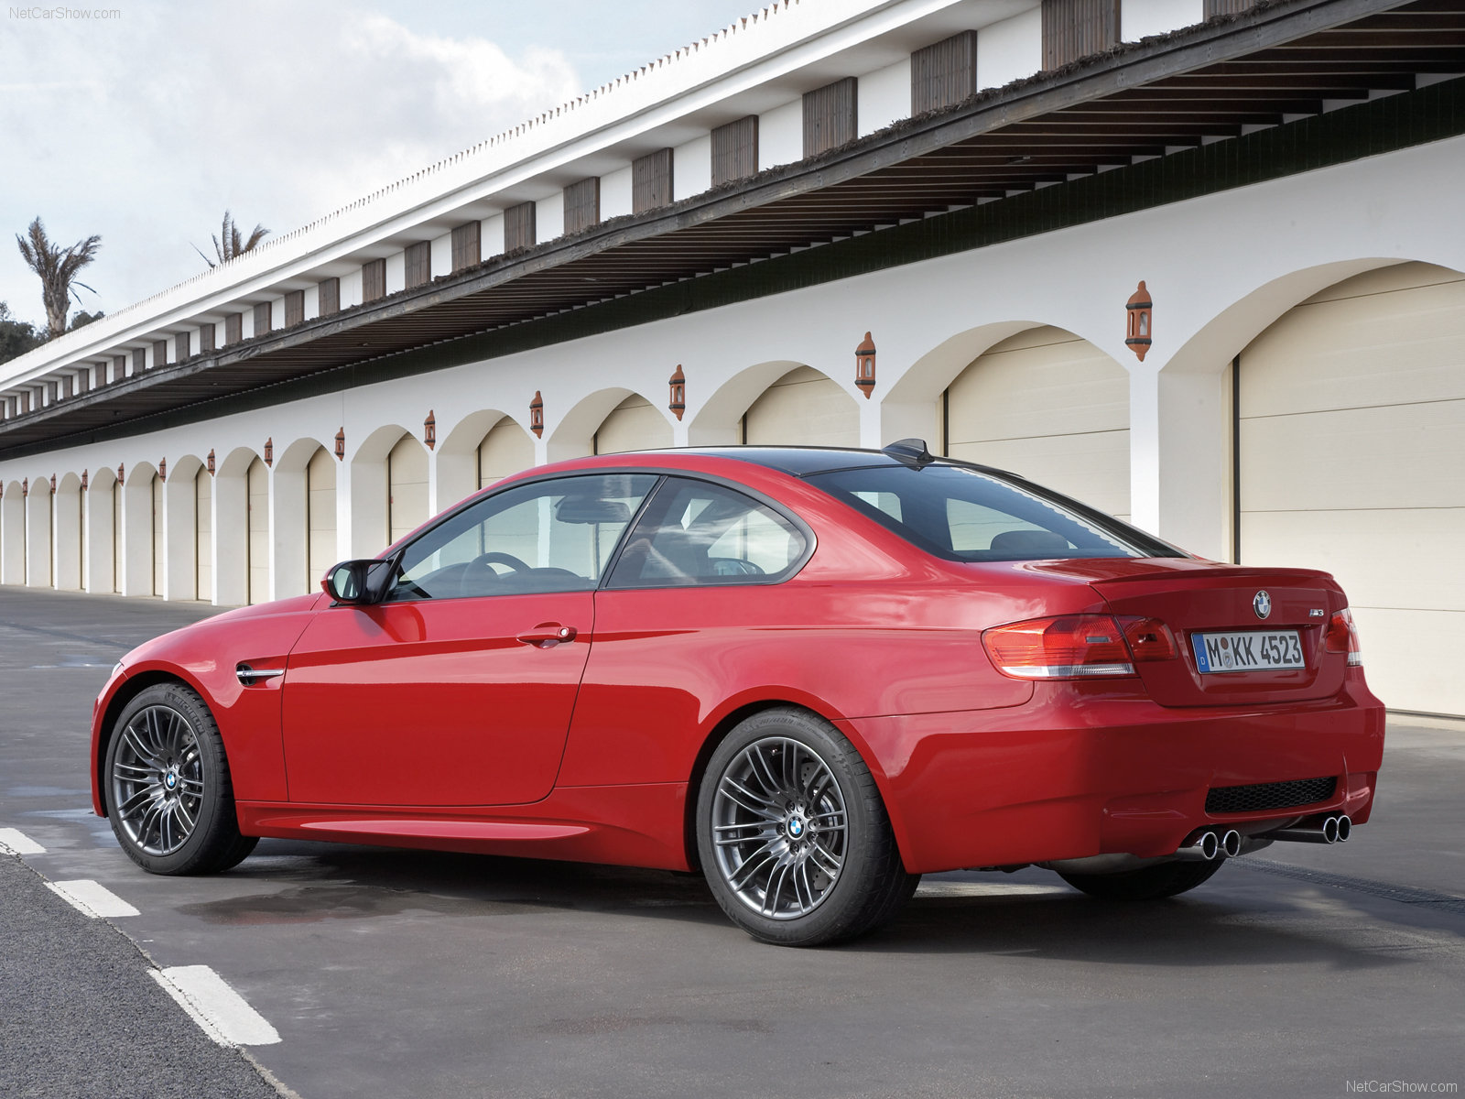
Wheels/ tires
M Double Spoke (Style 219M) Satin Chrome finish light alloy wheels
18 x 8.5 front
18 x 9.5 rear
245/40 front performance tires
265/40 rear performance tires

Slide 11
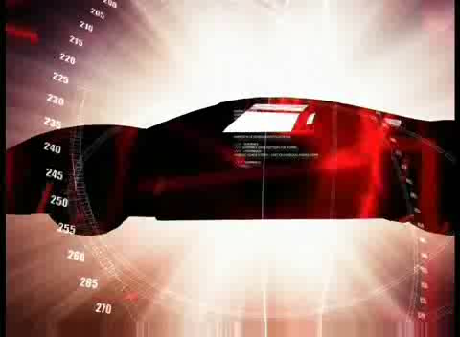
BMW M3- Auf Dem Nürburgring

Slide 12
Fenders
Flared front and rear fenders
Extended wheel arches

Slide 13
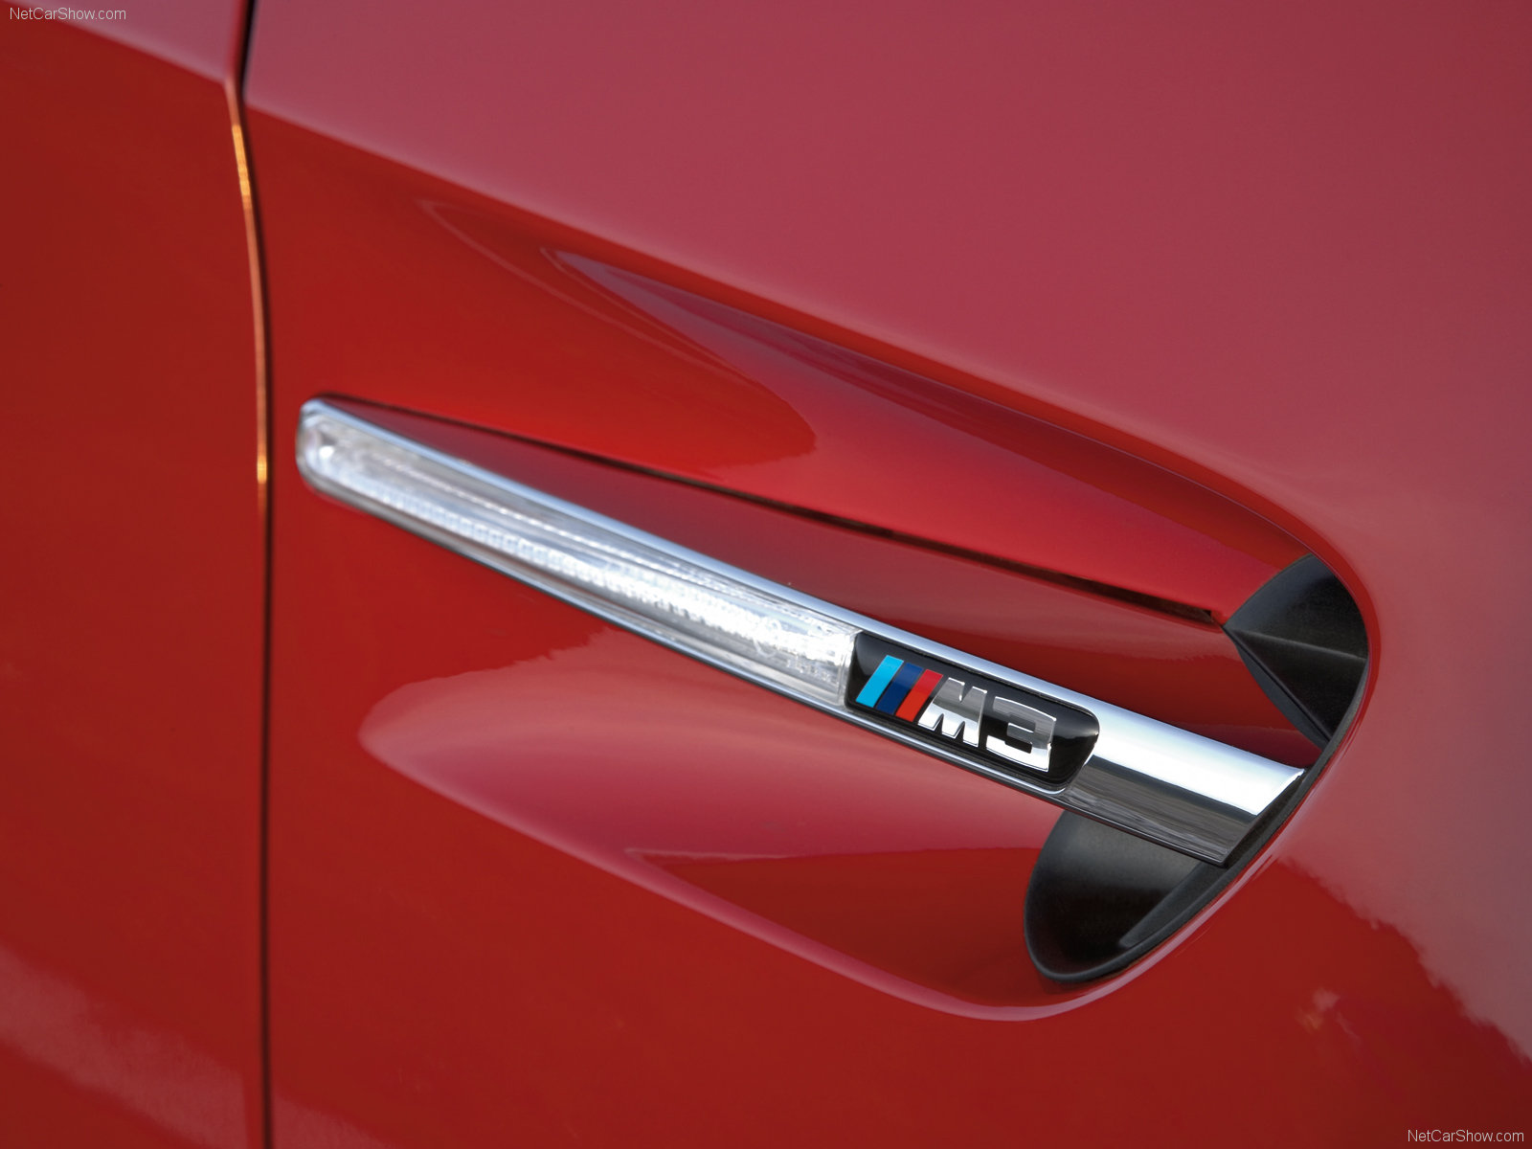
Vented gills
vent gills in front fenders
integrated light indicator
An awesome M3 logo of course!

Slide 14
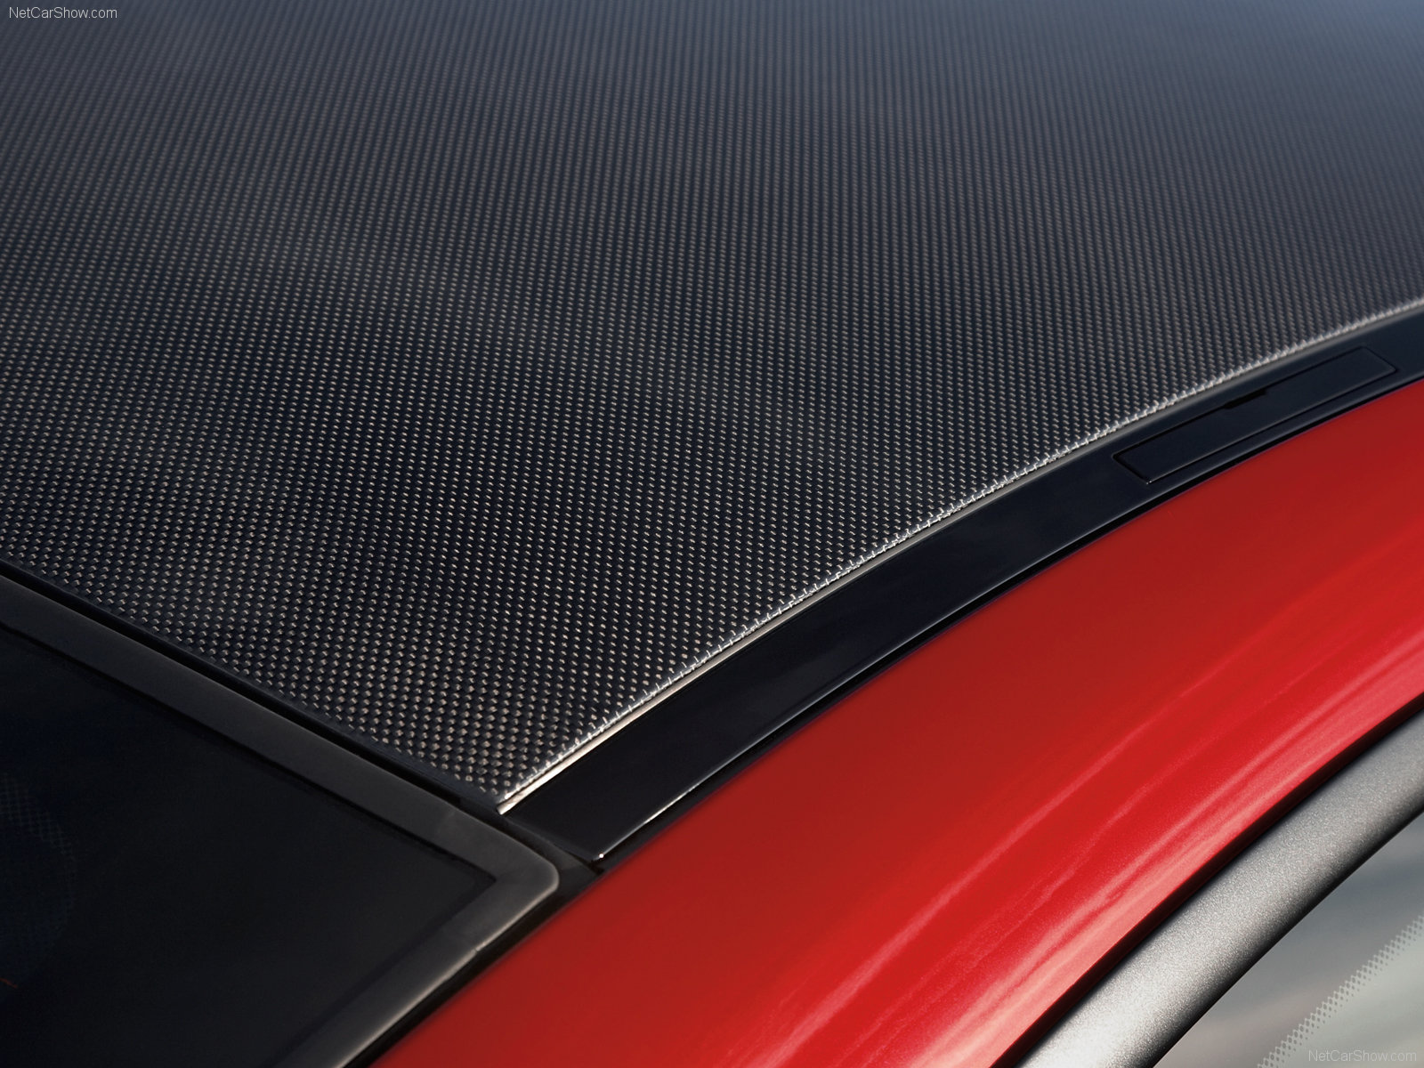
Carbon Fiber Roof
Helps to lighten the overall weight of the car.

Slide 15

BMW Culture

Slide 16
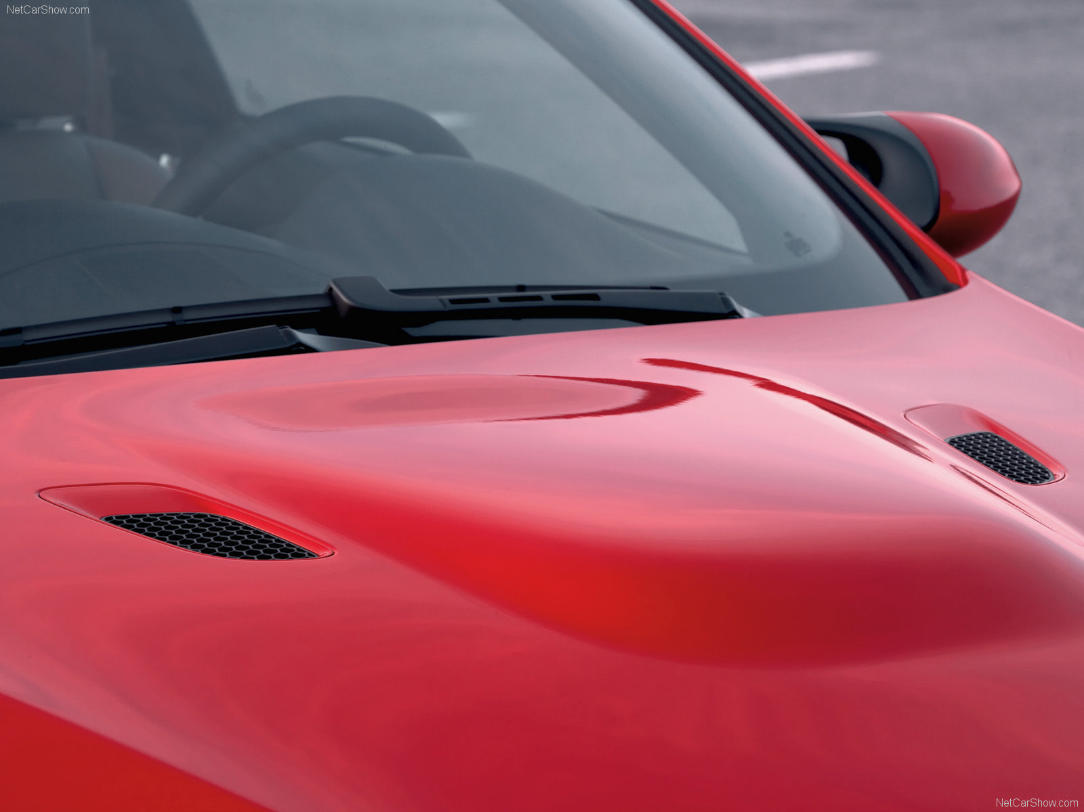
Hood
Aluminum hood with powerdome
windshield washer jets
Rain-sensing windshield wipers with Automatic headlight control

Slide 17
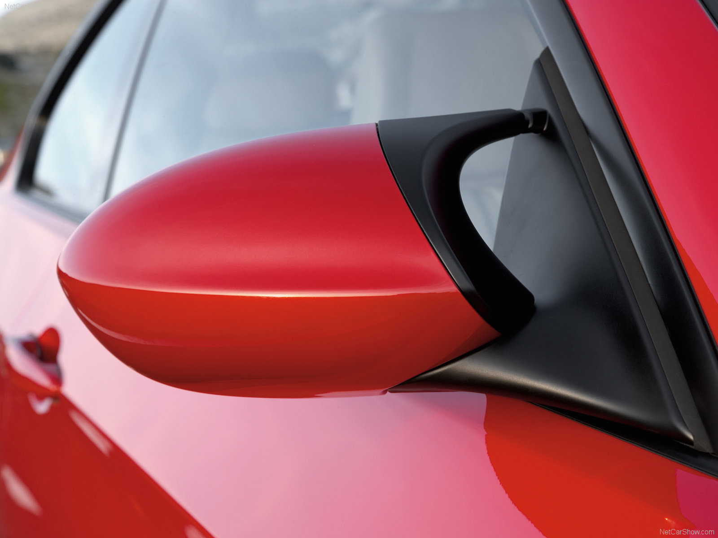
Side-view mirrors
M exterior side-view mirrors in body color with double bridge in black
White turn-signal indicators
Heated side-view mirrors
memory system for user’s adjusted preference
Automatic tilt-down of passenger's side-view mirror when vehicle is shifted into reverse gear

Slide 18

BMW M3 vs Bugatti Veyron

Slide 19
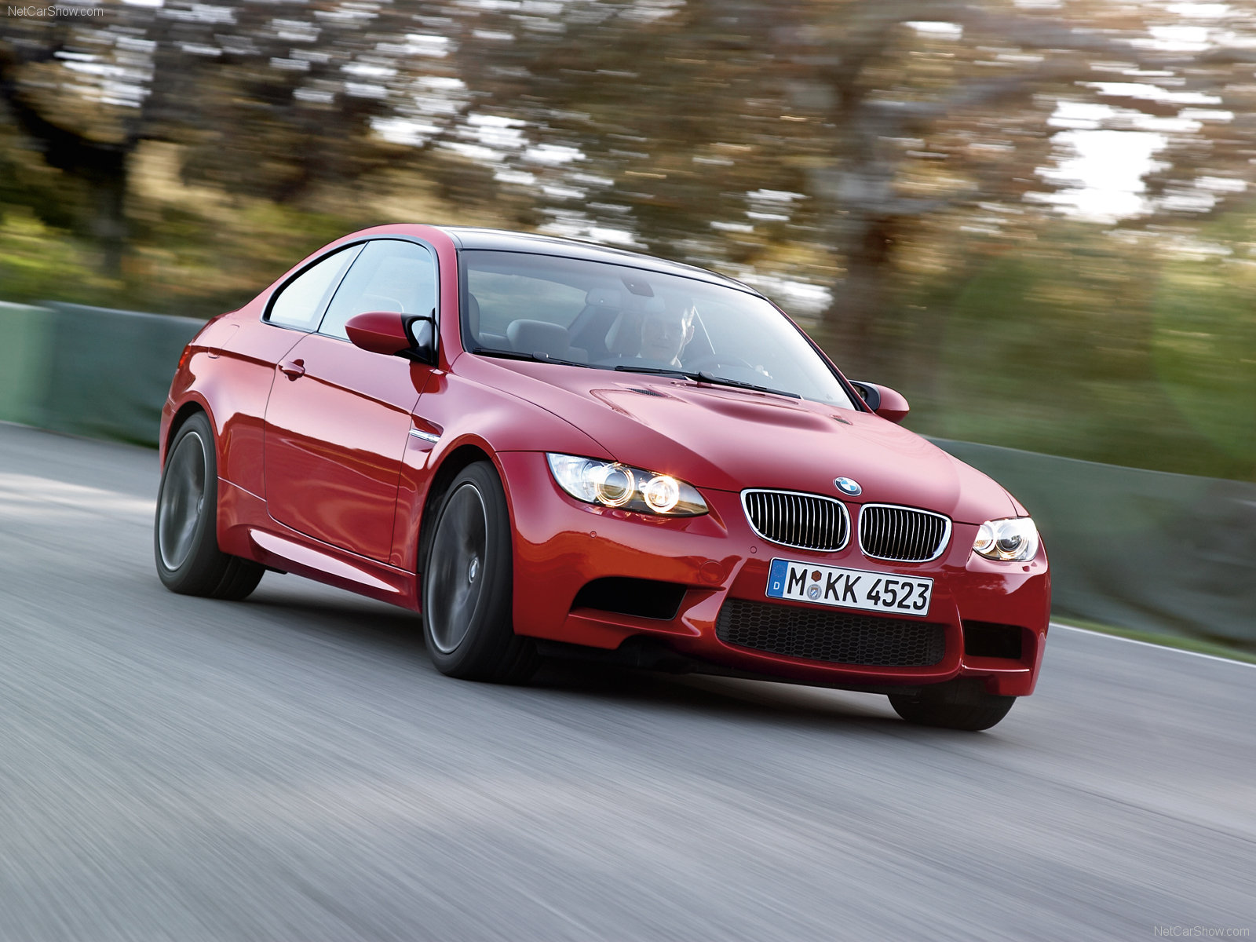
Fuel consumption
City -14 mpg
Highway - 20 mpg
Gasoline Tank Capacity - 20 gallons

Slide 20
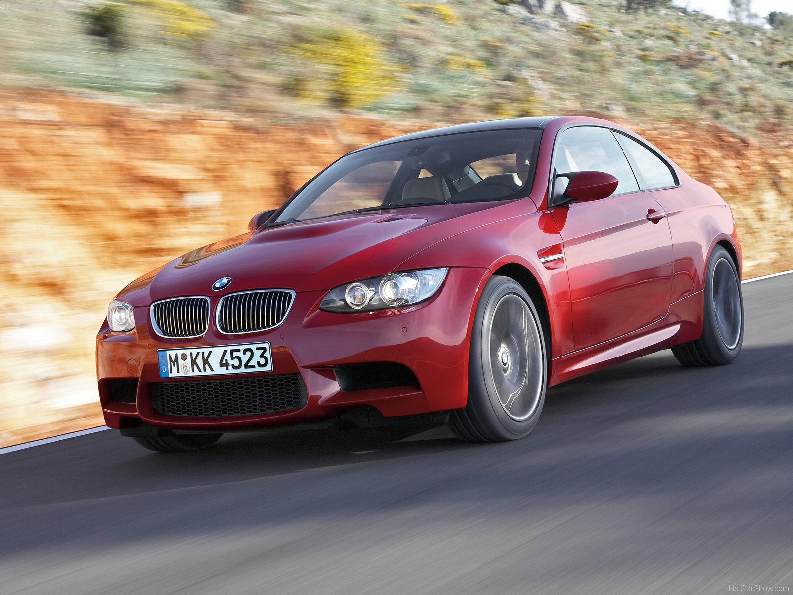
Front
Front spoiler
Xenon Adaptive low and high-beam headlights with auto-leveling and Cornering Lights function

Slide 21
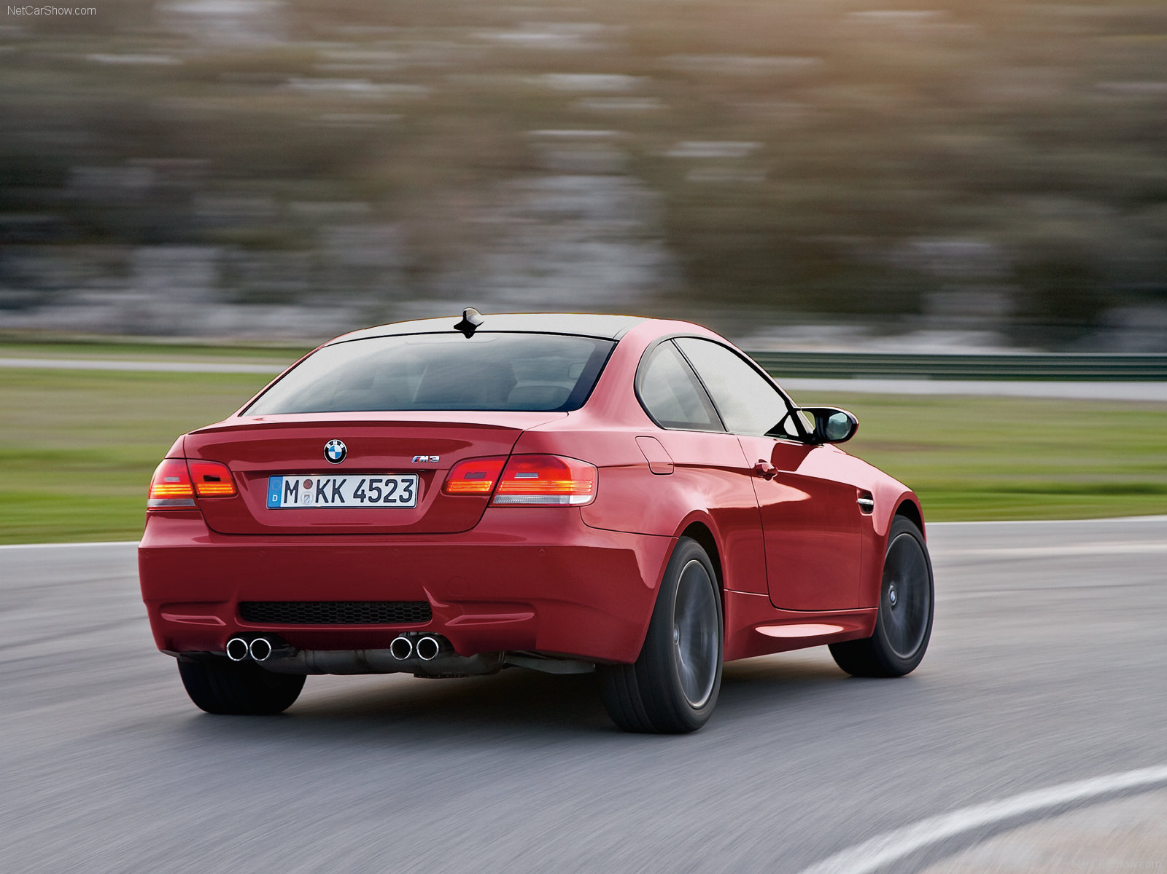
Rear
Rear spoiler
M rear bumper with Venturi Tunnel or diffuser
Flat-paneled underbody

Slide 22
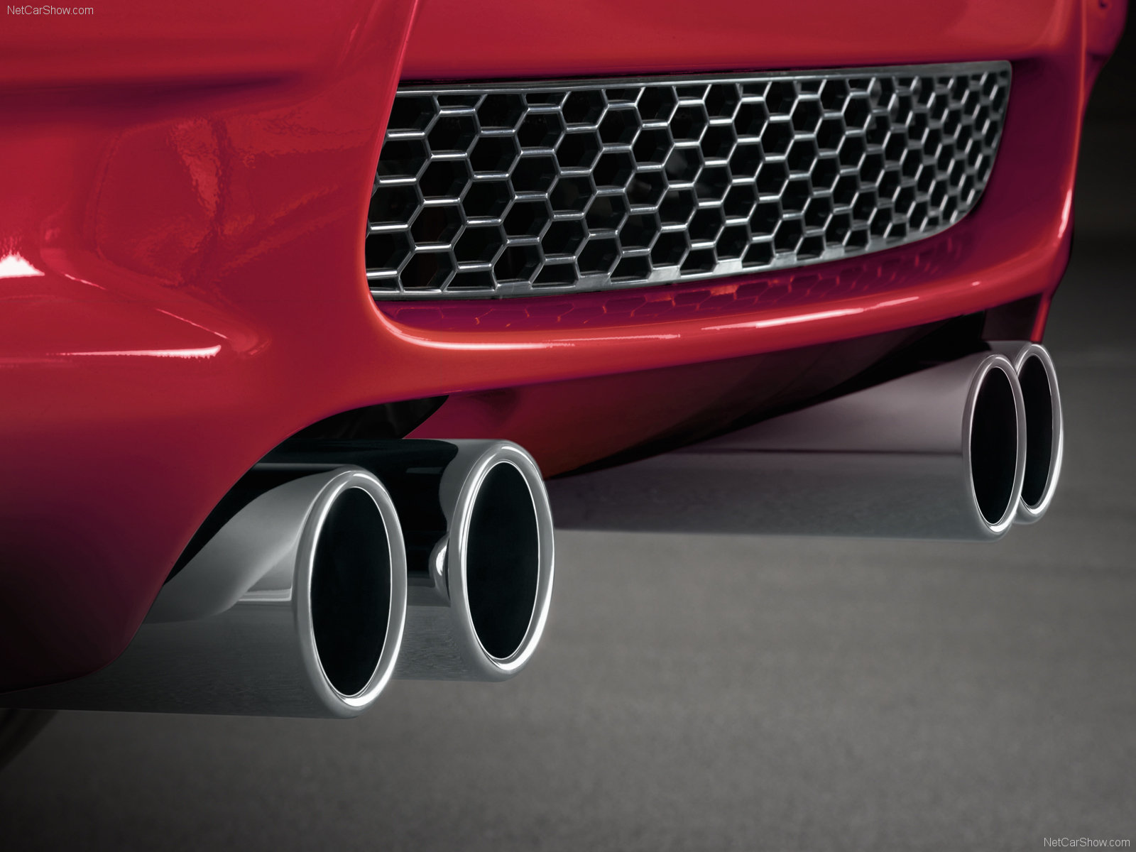
Quad exhaust tips up-close
M quad polished stainless-steel exhaust tips
Aerodynamics
Venturi Tunnel or diffuser
  Down force at high speeds at the rear

Slide 23
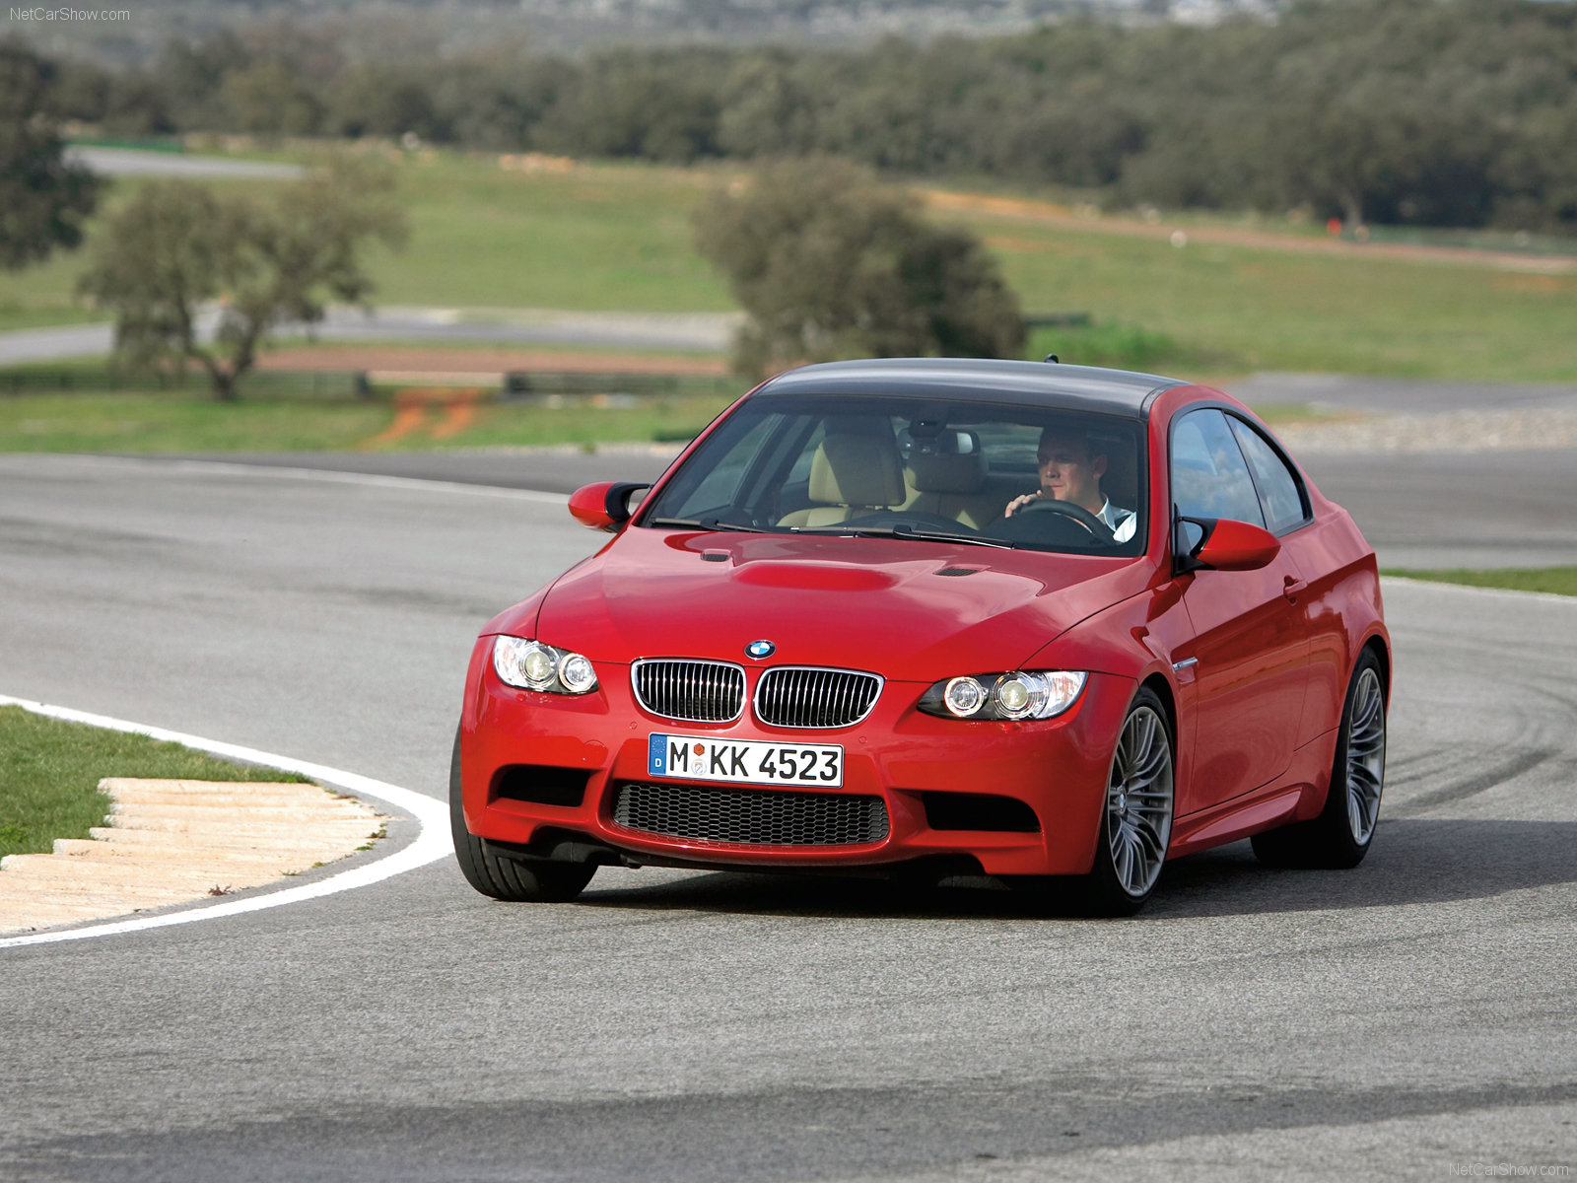
Exterior Dimensions & Weight
Length =181.7 in
Width =71.6 in
Height = 55.8 in
Weight in (lbs) = 3648 lbs
Weight in (kg) = 1655 kg

Slide 24
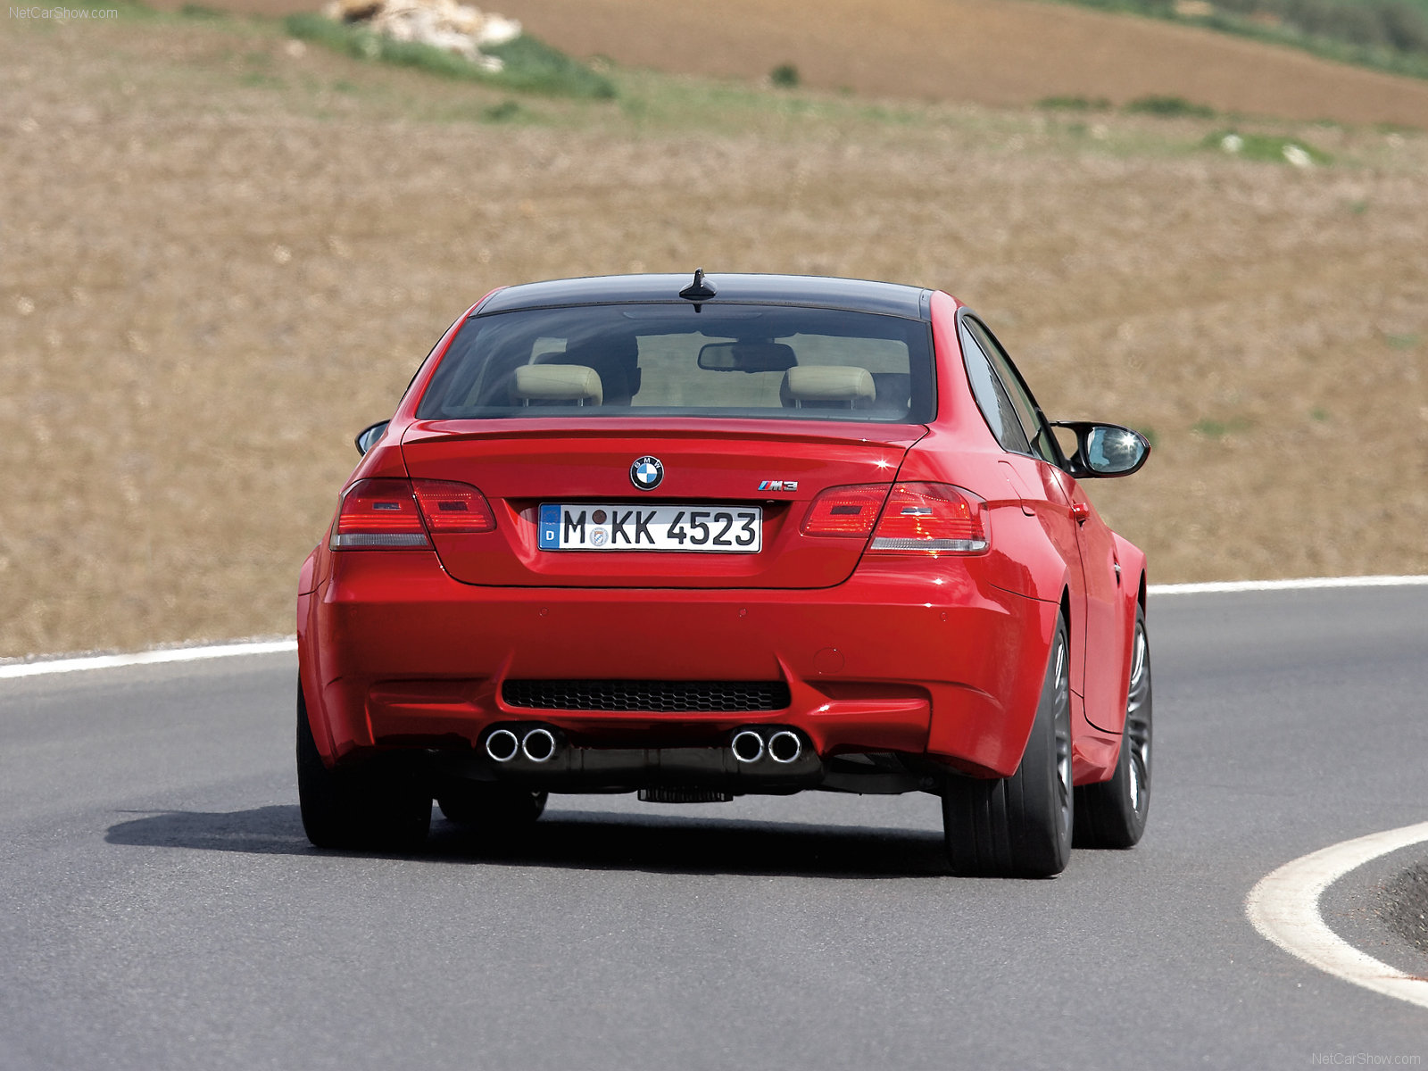

Slide 25

Making of "M3 Revolution"

Slide 26

"M3 Revolution"

Slide 27
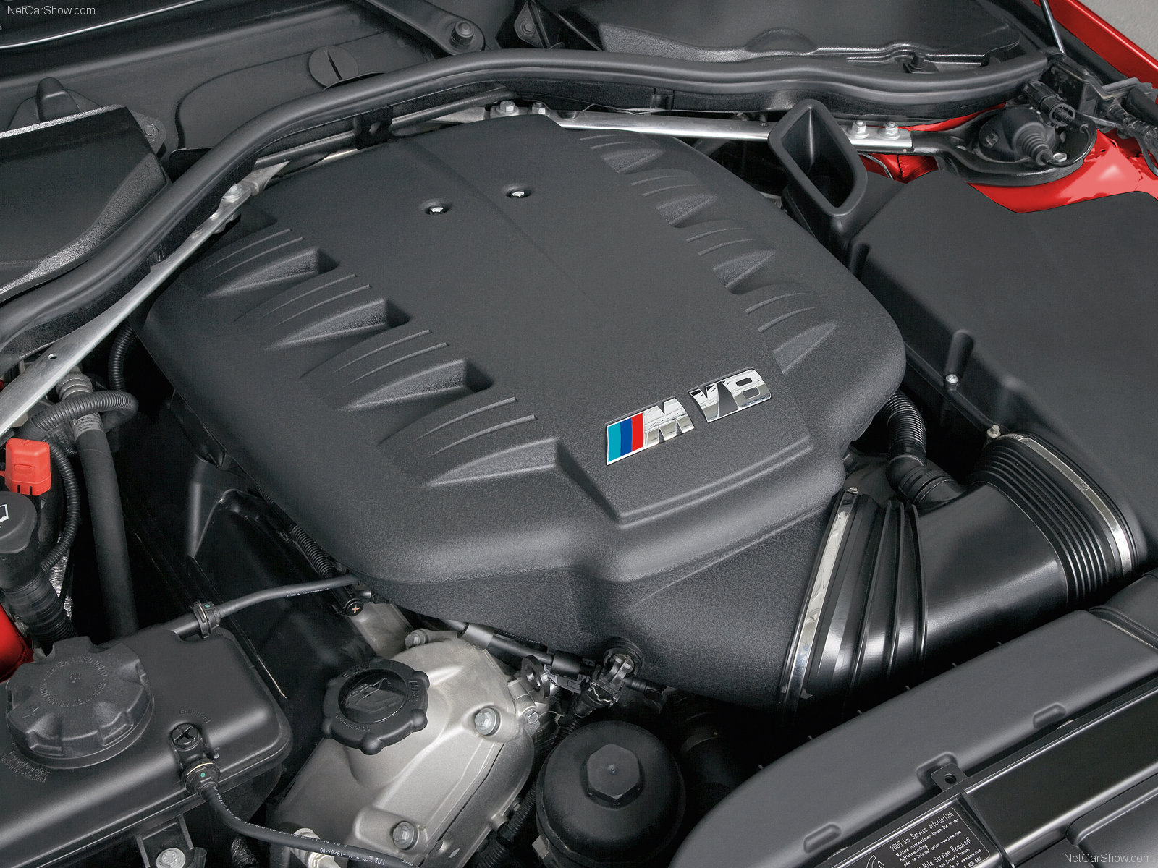
Engine
Liters * cylinders
4.0 * V-8
Maximum horse power @ rpm
414 @ 8300
Maximum torque @ rpm
295 @ 3900
0-60 mph @ 4.7 sec
Top Speed @ 155 mph (electronically limited)

Slide 28
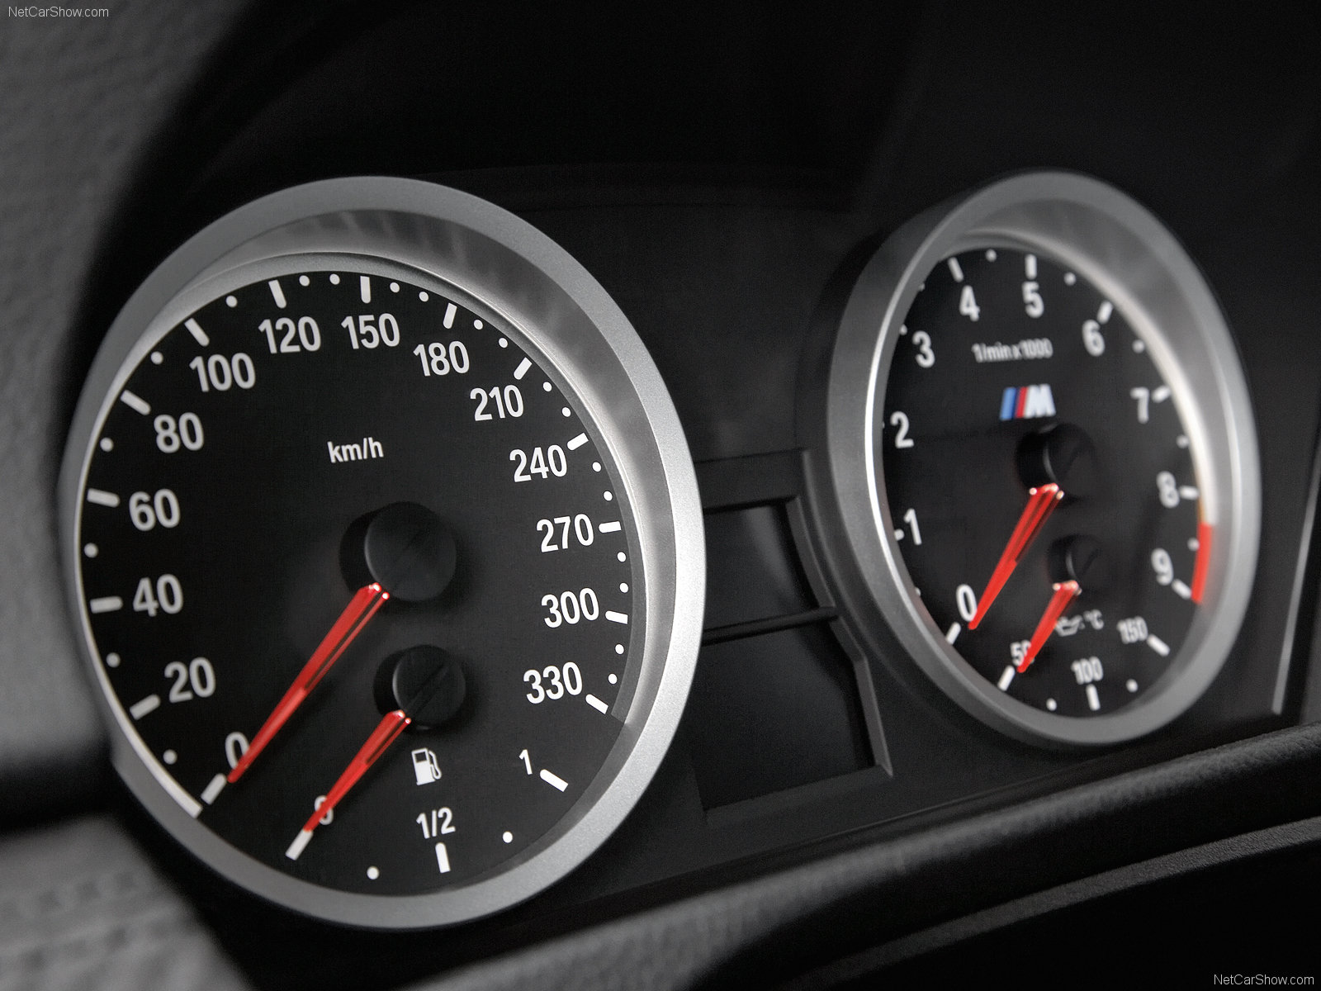

Slide 29
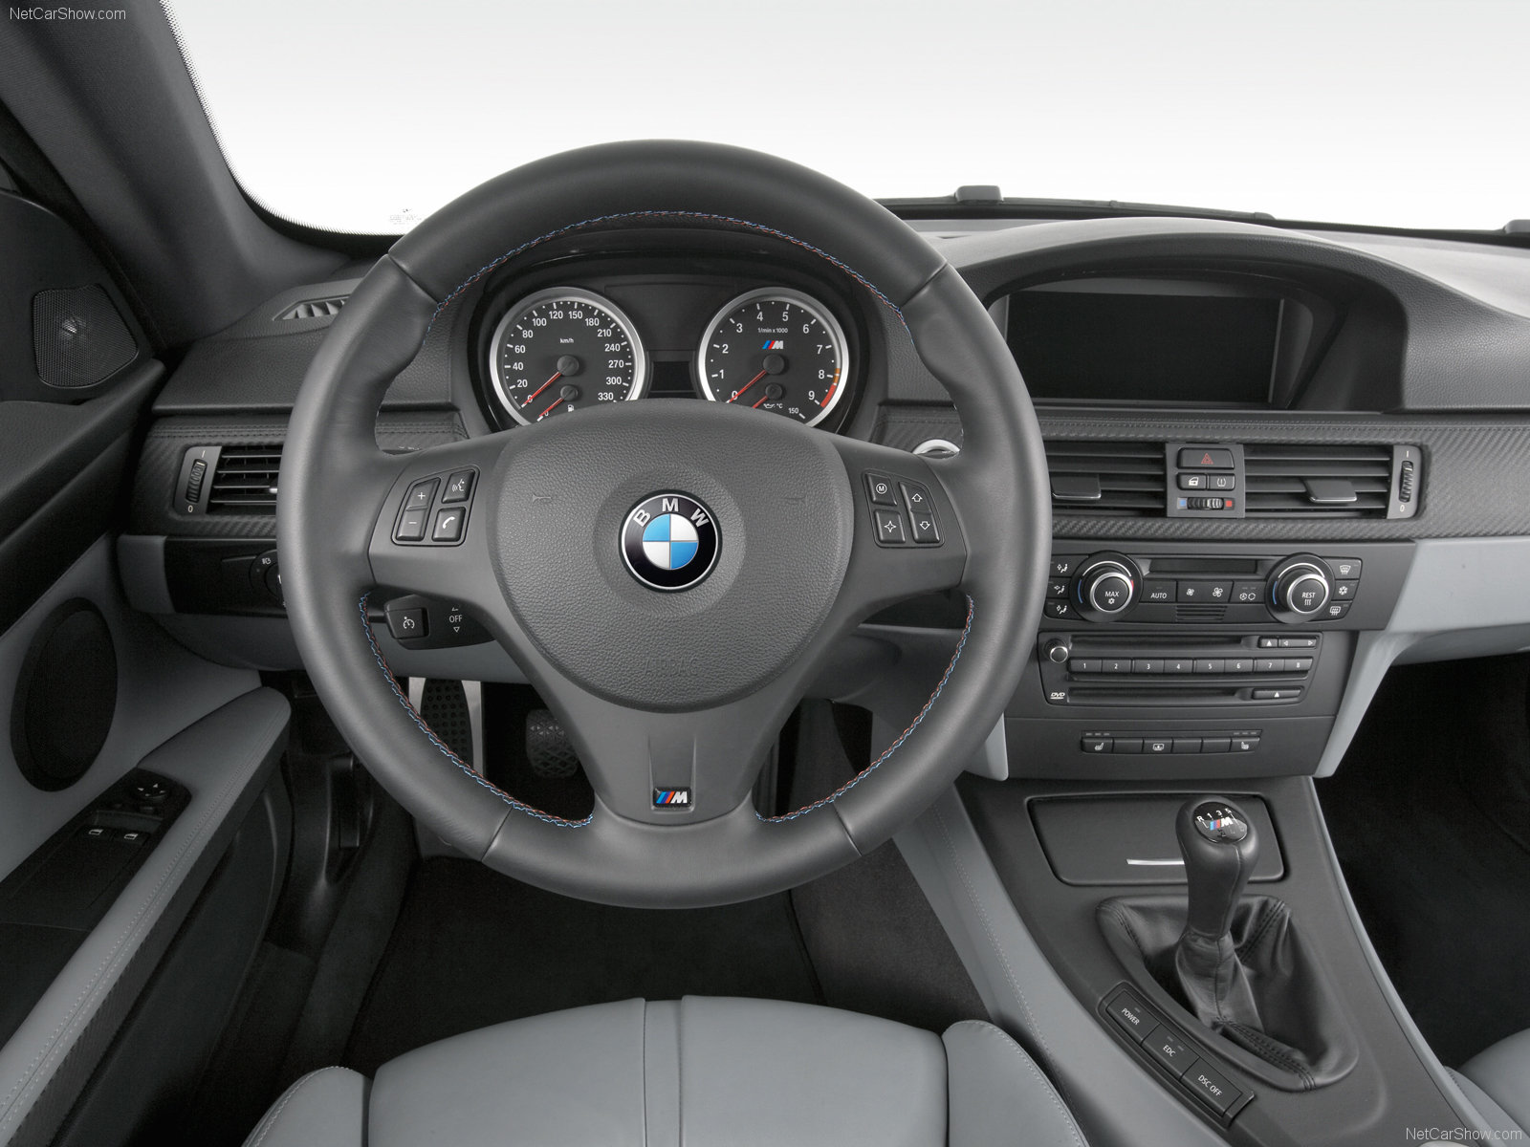
Front Seat View
Titanium Shadow interior trim
AM/FM stereo/CD audio system 10 speakers
Radio Data System (RDS), Auto-Store, MP3 capability and 3-channel FM diversity antenna system
On-board computer with detailed vehicle information
  including travel range on remaining fuel
  external temperature (including freezing temperature warning)
  Tire Pressure Monitor

Slide 30
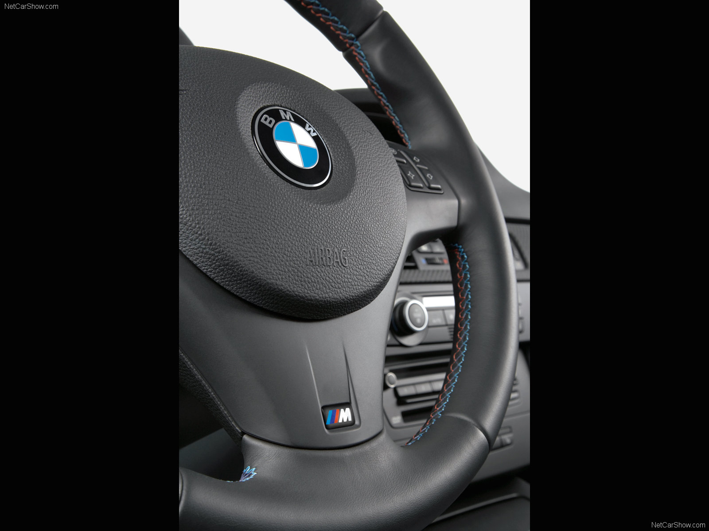
Steering wheel
3-spoke, leather-wrapped multi-function M sport steering wheel with audio and phone controls

Slide 31
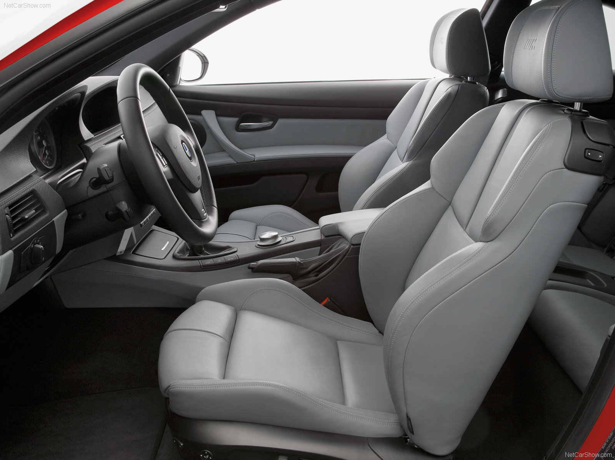
Front & Passenger Seats
Anthracite and Black Cloth/Leather upholstery
Power-adjustable front sport seats with 4-way lumbar support
manually adjustable thigh support and memory system for driver's seat

Slide 32
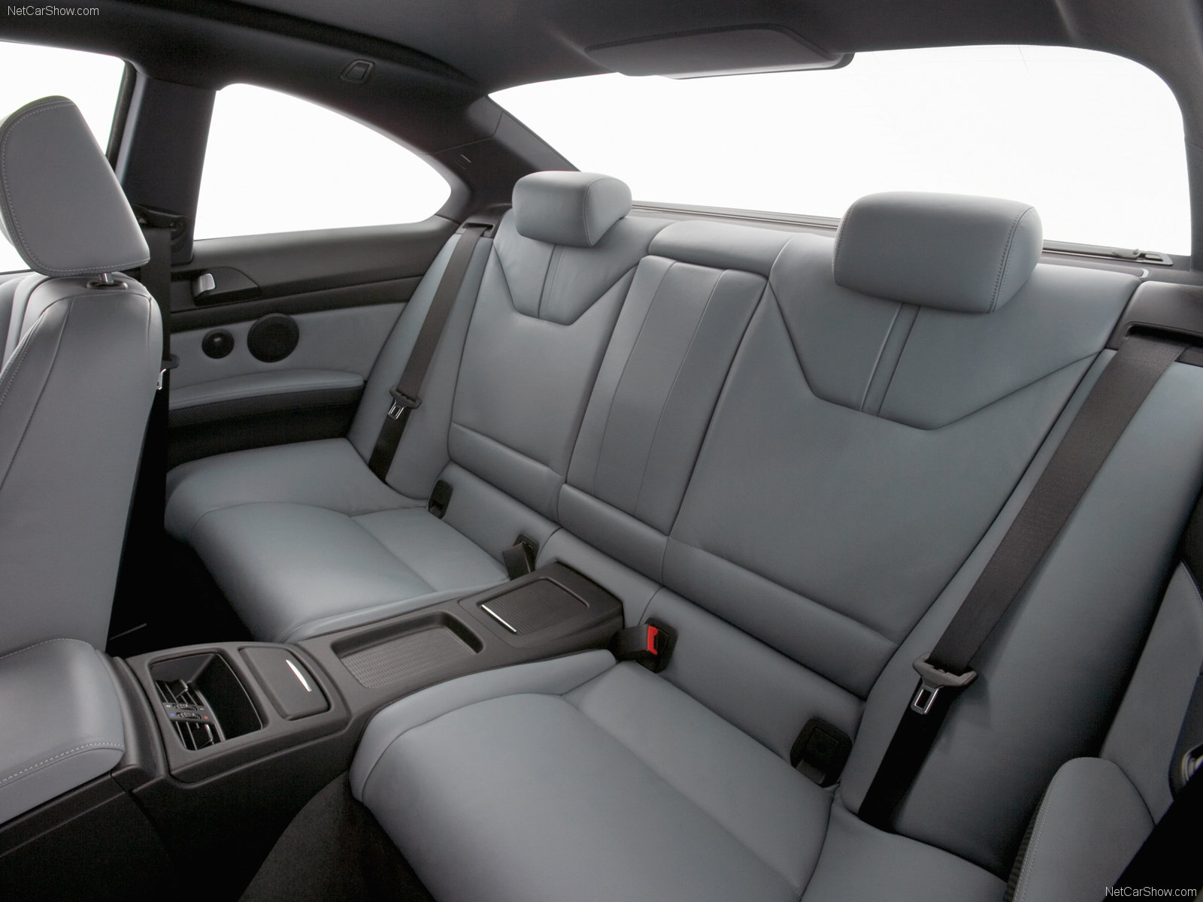
Back seats

Slide 33
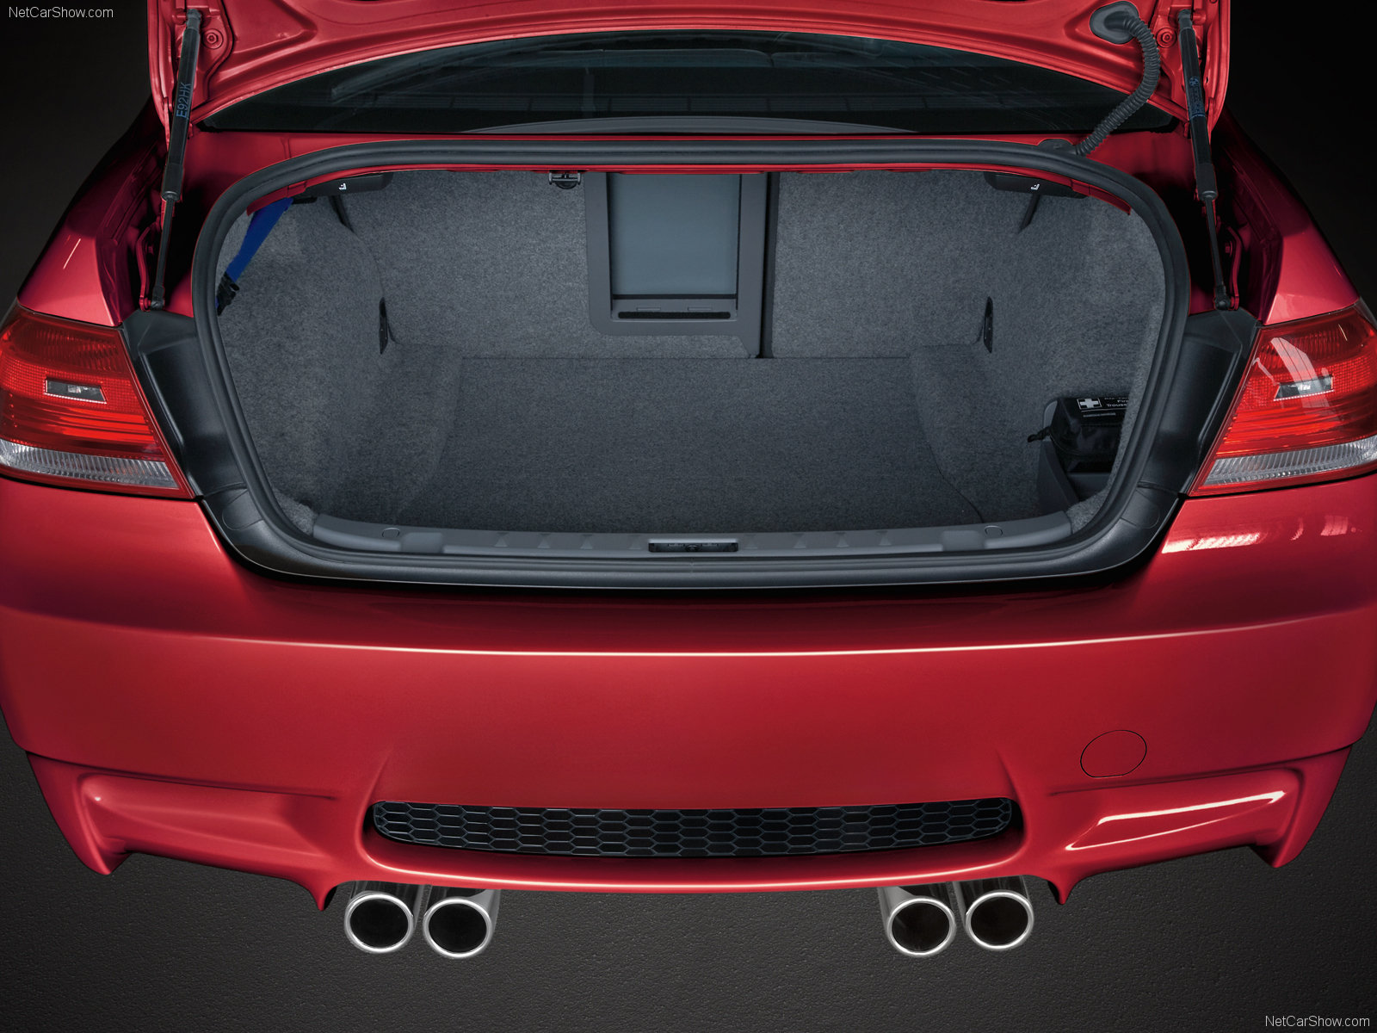
Trunk
Fully finished trunk w/ roadside assistance kit
Electric interior trunk release
You kill em! we chill em!

Slide 34

Mgear – BMW M3

Slide 35
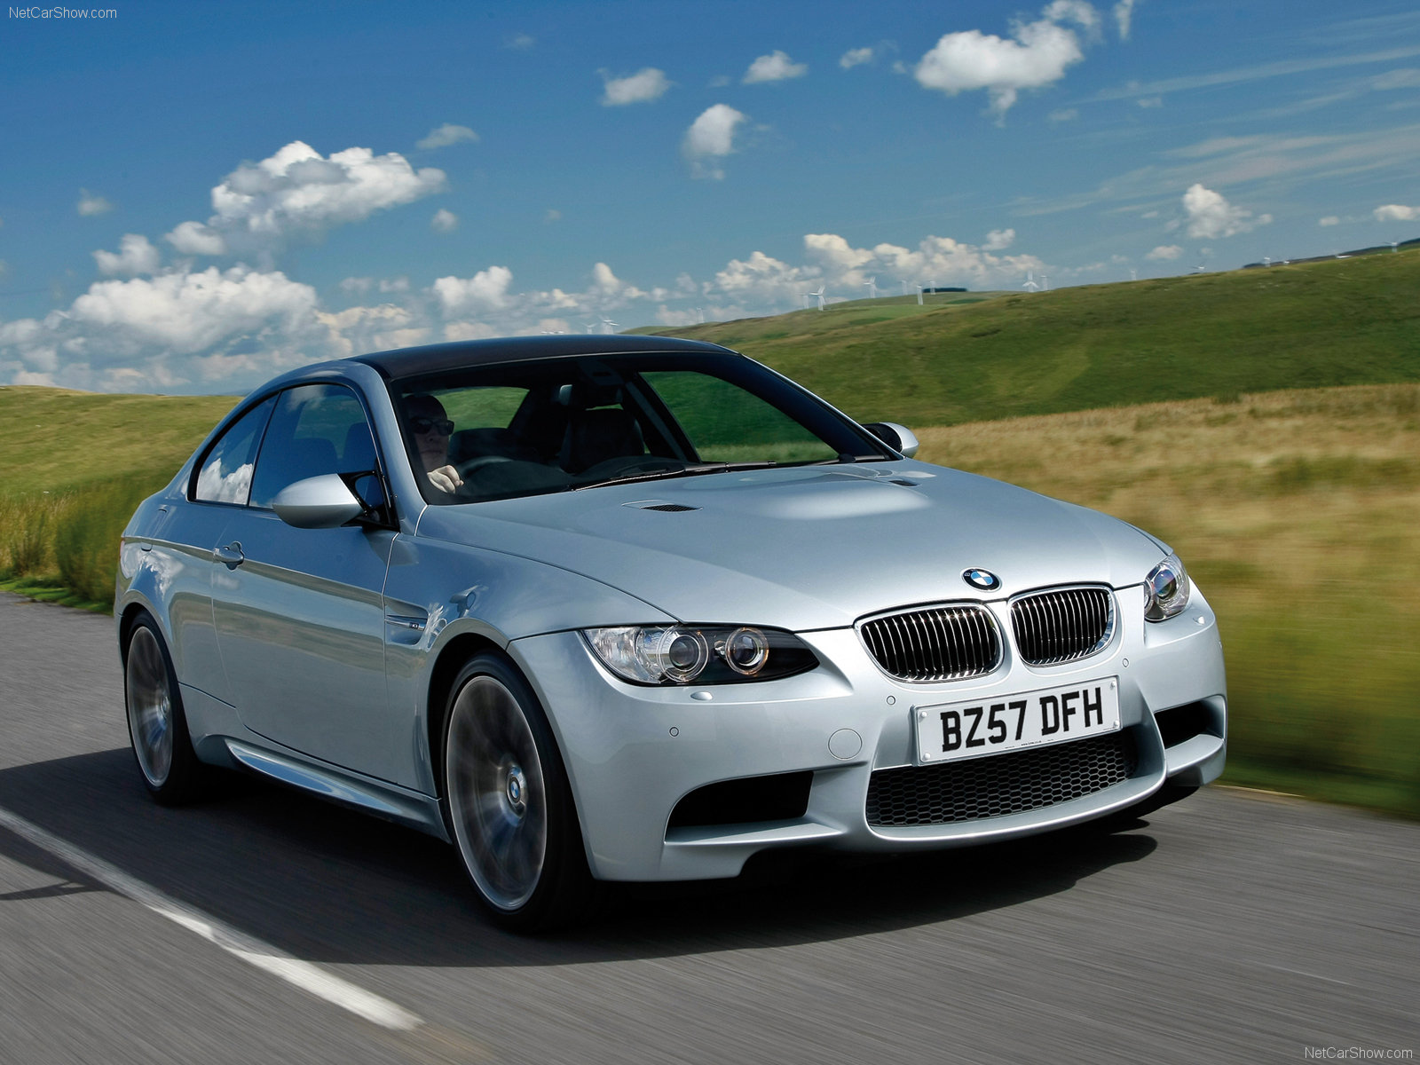
Safety
Driver's and passenger's front airbag supplemental restraint system (SRS) with dual-stage deployment
Front-passenger seat sensors designed to prevent unnecessary airbag deployment.
Crash sensor with Battery Safety Terminal and automatic fuel cut-off, triggered by airbag deployment
Front-seat-mounted side-impact airbags
BMW's Advanced Safety System for integrated deployment of passive and active safety features
Head Protection System (HPS), front and rear
Child-seat automatic safety-belt locking device in rear seats
Crash sensor with automatic door unlocking and hazard light activation
Bumper system with aluminum impact absorbers at the front, steel impact absorbers at the rear, and front-compressible elements

Slide 36
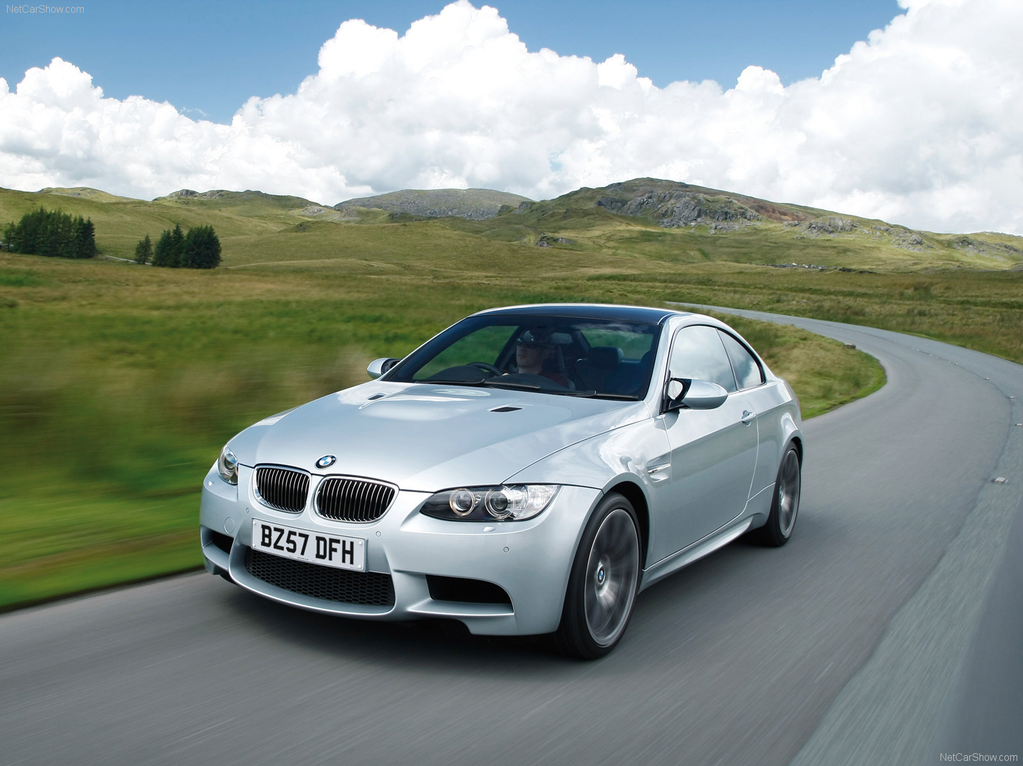
Security
Interlocking door anchoring system to help protect against door intrusion in side impacts
Gas Door
Central locking system w/ double-lock feature

Slide 37
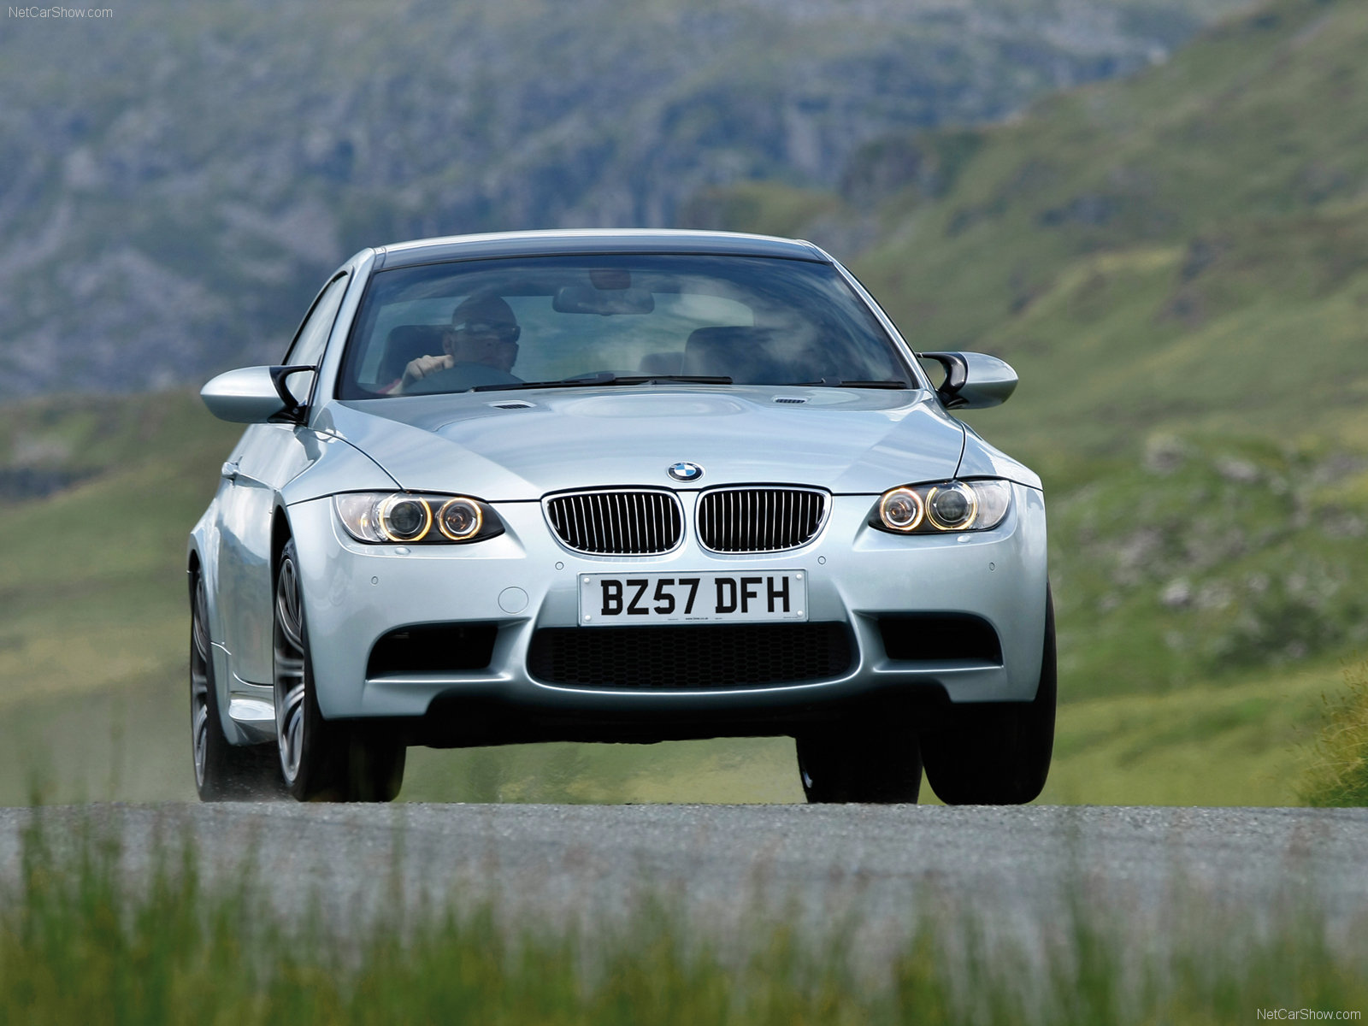
Comfort & Control
Automatic climate control
  micro-filter
  automatic air recirculation
  Left & right temperature control
  temperature- and volume-controlled rear outlets
  windshield misting sensor
  heat at rest
  recall of individual user settings

Slide 38

Fair Fight-
BMW M3 Coupe vs. Audi S5 Coupe

Slide 39
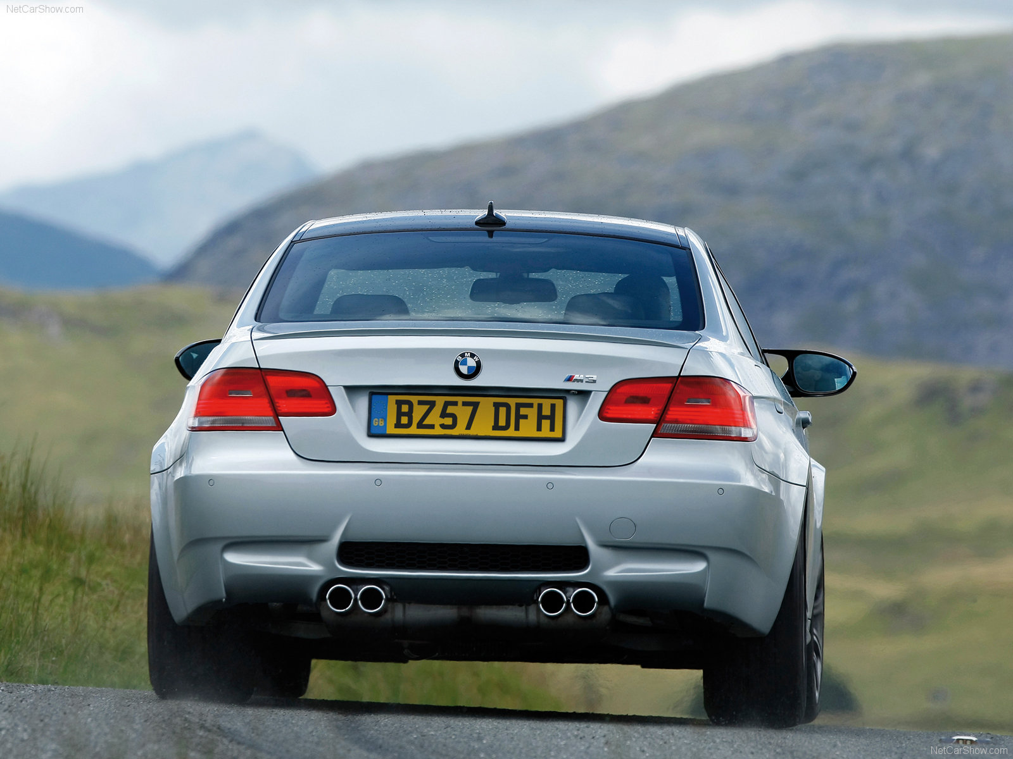
Work Cited
http://www.manualgear.com/en/driven-71-BMW+M3+E92.html
http://www.bmwusa.com/
http://www.metacafe.com/watch/846222/the_new_2008_bmw_m3/
http://www.motortrend.com/roadtests/coupes/112_0710_2008_bmw_m3
http://www.caranddriver.com/buying_guide/bmw/m3/2008_bmw_m3_coupe
http://www.rsportscars.com/bmw/2009-bmw-m3-coupe/

