Slide 1
Strauss vs. Strauss
Two of the German World's Greatest Composers

Slide 2
We should clarify a few things first...
Not all music played by an orchestra is "Classical Music"
The term "Classical" refers to one specific time period
"Orchestral music" would be more accurate

Slide 3
Musical Periods
Middle Ages/Medieval Period ~ 500 C.E. to 1400 C.E.
Renaissance Era ~ 1400 C.E. to 1600 C.E.
Baroque Period ~ 1600 C.E. to mid-1700s
Classical Period ~ mid-1700s to early-1800s
Romantic Era ~ early 1800s to 1900
Twentieth Century ~ 1900 onward

Slide 4
Important things to know about Musical Eras
No hard break from one to the next
Lots of overlap, gradual transition
Other minor periods exist within these major periods
Impressionist composers bridge the Romantic Era and Twentieth Century

Slide 5
The Romantic Era
Term comes from the style of literature produced during the time.
Many artforms influenced orchestral music throughout the period
Program symphonies and symphonic poems became popular
Bigger orchestras
Longer compositions
Wagner's opera, "The Ring", took four days to see

Slide 6
The Romantic Era
Classical music was methodical and calculated
Romantic music strayed from this
Composers took more artistic liberties
Music became passionate and emotional
Emphasis on nature
Led to the composers of the Twentieth Century taking more risks with their work

Slide 7
SO how are things in Austria?
Lots of civil unrest
French Revolution inspired attempts at revolution in Austria
Lower class sought voting rights, civil liberties, and equal representation
Lower class was ignored, so things got ugly
Revolutionaries were disorganized
Any progress they made was soon crushed by the military
The revolution failed

Slide 8
Later, in Germany...
Began the Romantic Era as Prussia, finished it as Germany
Prussia/Germany just could not stay out of trouble.
Schleswig Wars, Austro-Prussian War, Franco-Prussian War...
Late-Romantic Germany saw a rise in anti-semitism.
Adolf Hitler took power.
First World War began

Slide 9
Johann Strauss I
This is not our contender in the upcoming Strauss vs. Strauss battle royale.
We'll mostly be talking about his son, Johann Strauss II
Two Johanns. Get ready to be confused.
From here on out, We're calling this one "Dad"

Slide 10
"Dad"
Wanted to me a musician at a young age
Parents refused to allow him to pursue this
Ran away from home, then parents changed their minds
Studied the violin first
Switched to viola when a job opportunity came along

Slide 11
"Dad"
As an adult, directed his own orchestra
Orchestra became quite popular in Vienna
Popularity eventually increased beyond Vienna
Toured in Germany, France, Belgium, and England
Respected composer
Known for writing Waltzes

Slide 12
Johann Strauss II
Born in 1825
Developed an interest in music at an early age
Dad wanted him to be a banker, refused to allow Johann to study
Mom hired a music tutor
Johann was trained in secret
This changed when he was 17 and Dad left
Finally, Johann was allowed to practice his music openly

Slide 13
Johann Strauss II
Achieved fame without riding Dad's coattails
Did not take his popularity seriously
Very humble
Sensitive, known to go out of his way to avoid hurting someone
Always tried to please everyone around him

Slide 14
Johann Strauss II
Plagued by insecurities
Had many phobias, such as a fear of heights, tunnels, and hospitals
Could not attend his first wife's funeral, due to his fear of cemeteries

Slide 15
Johann Strauss II Love Life Roller Coaster
First wife, Henrietta, was a singer
Supportive of Johann's career
Died after 16 years of marriage

Slide 16
Johann Strauss II Love Life Roller Coaster
Second wife, Angelika, was an actress
Married only six weeks after the death of his first wife
Upper-class, snooty, everything one would expect from a celebrity
Discouraged Johann's work
Eventually divorced

Slide 17
Johann Strauss II Love Life Roller Coaster
Third wife, Adele, supported Johann's musical career
Johann composed his greatest works during this time
Adele is the reason so much of his work survives
Johann made no efforts to preserve his work
Adele took it upon herself to do so
Many earlier works were lost, but compositions during their marriage were saved

Slide 18
"You can't make it as a musician, you'll never work!"
Johann was consistently employed
Admired by Brahms, Wagner, and Verdi
Composing came easily to Johann
Did not struggle to find new ideas

Slide 19
High demand takes its toll
Johann faced and met unreasonable deadlines
"I need a new waltz for my party this evening"
Found himself under immense physical and emotional strain
Had a nervous breakdown, and took some time off
Johann's brother Josef directed the orchestra during Johann's recovery

Slide 20
Never forget where you came from
Johann was a member of the Austrian revolutionaries
Now he was kept employed by the Austrian nobility
Known for "writing for the gallery"
The cheap seats got as good a concert as the rich people
Wrote for the rich, but wrote to the poor
Due to his revolutionary past, he made efforts to stay on the Emperor's good side
Often wrote songs dedicated to Emperor Franz Joseph

Slide 21
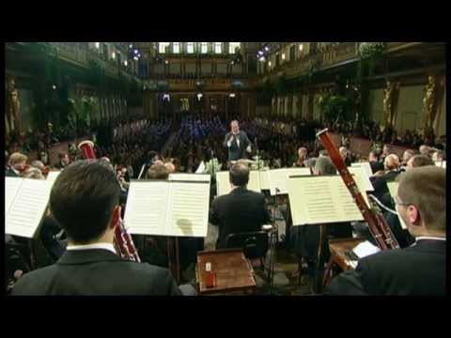
Kaizer Walzer

Slide 22
"The Waltz King"
Johann Strauss was and is best known for his waltzes
Also wrote several operettas
"Die Fledermaus" - comedy operetta
Wrote one full-length opera - "Ritter Pazman"
Ritter Pazman failed during its first run

Slide 23
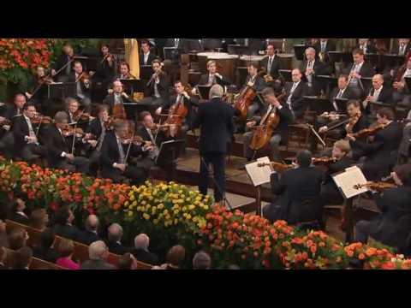
Die Fledermaus

Slide 24
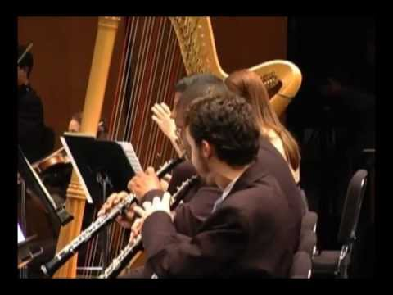
Tales from the Vienna Woods

Slide 25
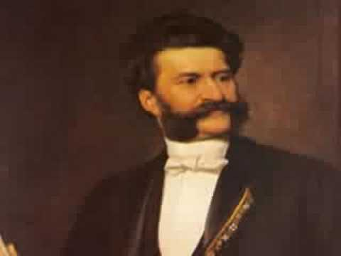
The Blue Danube Waltz

Slide 26
Richard Strauss
Born in 1864
His father, Franz Strauss was a horn player in Wagner's orchestra
Richard's musical talent developed at a young age
Began violin lessons at age four
Composed a short Christmas song at age six

Slide 27
Richard Strauss
Family was not especially wealthy, but Richard definitely had a privileged upbringing
Never experienced poverty
Enjoyed luxuries such as travel
Family was able to afford the best teachers available
These were usually found through his father's connections

Slide 28
Richard Strauss
Music dominated the household
Piano lessons continued throughout his childhood
Eventually picked up the violin as well
His extended family also encouraged his growth as a musician
Wrote songs for his aunt Johanna to sing when he was only 15
Had a vast library of early compositions

Slide 29
Richard Strauss
Mostly influenced by Mozart, his father's favourite composer
Also enjoyed the works of Haydn and Beethoven
Frequently crossed paths with Brahms
Heard many of Brahms's compositions before they were published
This connection led to the first professional performance of Richard's first symphony
Later made his debut as a conductor with the Brahms Violin Concerto

Slide 30
Richard Strauss
Loved to perform
Continued performing after he established himself as a composer and a conductor
This was unusual for conductors to do

Slide 31
Richard Strauss and Nazi Germany
Franz Strauss was an anti-Semite
Richard shared these views early in his life, but changed his mind in later years
His daughter-in-law and grandson were Jewish

Slide 32
Richard Strauss and Nazi Germany
Appointed to the State Music Bureau when Hitler came to power
Cooperated with the Nazis, but remained politically neutral
Did this to protect his family

Slide 33
Notable works
"Burleske" - a piano concerto meant to be a spoof on the traditional concerto
Incredibly difficult. The first rehearsals were a mess
Was criticized for being too long
Richard hated the piece, but grew to love it later in life

Slide 34
Notable works
"Der Rosenkavalier"
Three-act comedic opera
Featured a female vocal trio as its protagonists
"Also Sprach Zarathustra"
Tone poem
Popularity skyrocketed in the twentieth century

Slide 35
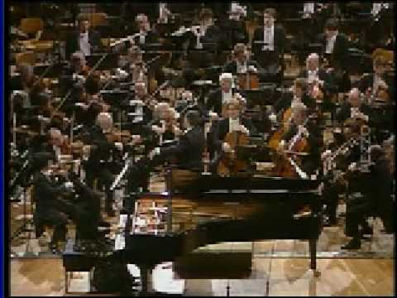
Burleske

Slide 36
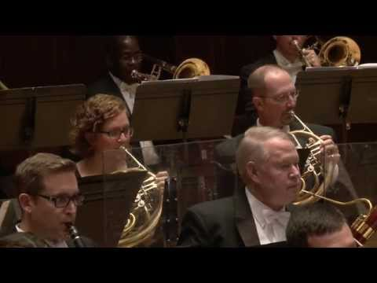
Der Rosenkavalier

Slide 37
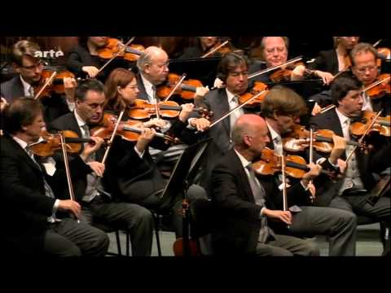
Also Sprach Zarathustra

Slide 38
And the winner is...

Slide 39
Richard Strauss

Slide 40
Why cellists and violists hate waltzes
Waltzes have a reputation for lacking excitement in the cello/bass and viola parts
Cellos/basses play mostly "down beats"
Violas (and often second violins) play "up beats"
First violins get to have all the fun

Slide 41
Stop listening to waltzes!
Why are Shakespearean plays a snooze to read?
They were meant to be seen
Waltzes were not written for a seated audience
Waltzes were meant to be danced
Try it! It's a great time

Slide 42
Other reasons I prefer Richard Strauss
His works tend to be more interesting to play
He took risks that Johann would not have been able to take
Richard composer in the latter portion of the Romantic period, crossing into the Twentieth Century
Music had evolved a bit more during Richard's time.

Slide 43
Now...

Slide 44
Who wants music lessons?

