Slide 1
Medical Advances Throughout German History
Brianna Jacobs/Johanna

Slide 2
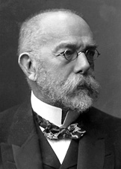
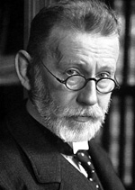
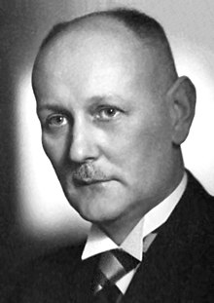
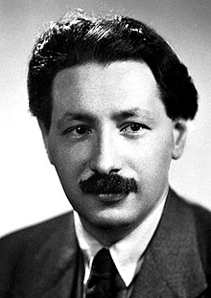
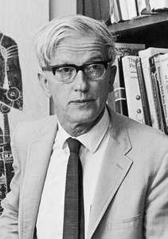
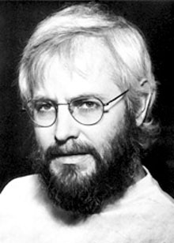
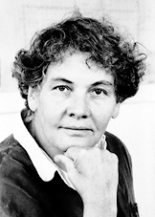
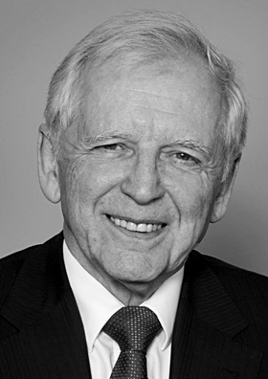
German Nobel Peace Prize Winners in Medicine/Physiology
Robert Heinrich Herman Koch
Paul Ehrlich
Gerhard Domagk
Sir Ernst Boris Chain
Max Delbruck
Georges Jean Franz Kohler
Christiane Nusslein-Volhard
Harald Zur Hausen

Slide 3
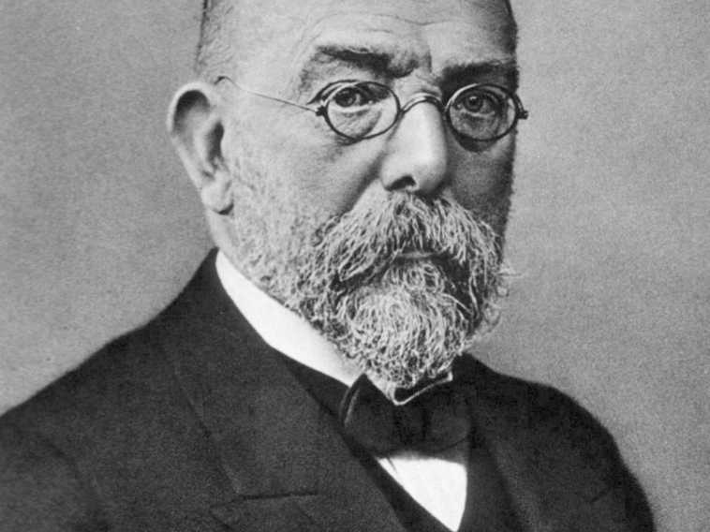
Robert Heinrich Herman Koch
(1843-1910)
Koch won a Nobel Peace Prize in 1905 for his work of discovering the bacteria responsible for tuberculosis.
Koch had also discovered the anthrax disease cycle, as well as the bacteria responsible for cholera.
He is commonly known as the father of Bacteriology.

Slide 4
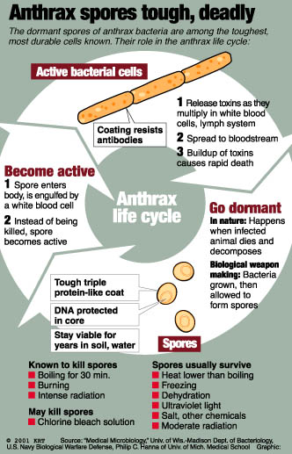
Robert Heinrich Herman Koch (1843-1910)
Koch attended the University of Gottingen, where he studied medicine and graduated in 1866.
He served in the Franco-Prussian War (1870-71) before he became district surgeon in Wollenstein.
He began his research of the anthrax disease by cultivating the anthrax organisms and watch them grow into long filaments.
Then Koch noticed that the formation within the oval was translucent bodies-dormant spores.
The dormant spores, under the right conditions, develop into the rod-shaped bacteria (bacilli), causing anthrax.
Explains why the disease can show up out of ‘nowhere’

Slide 5
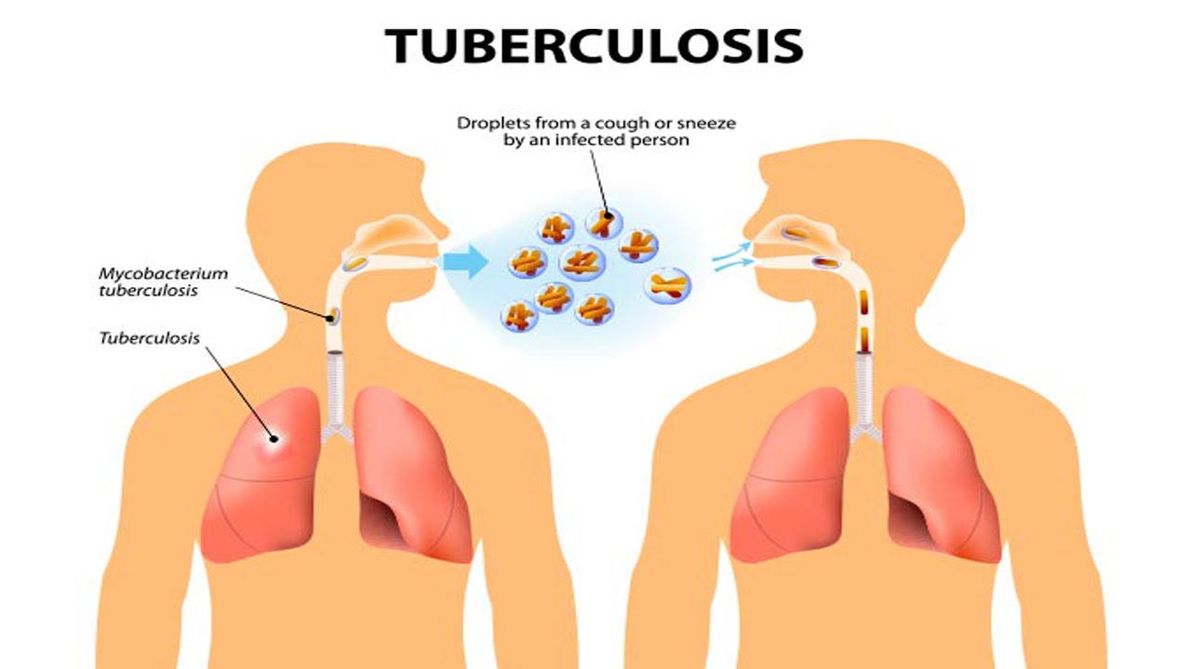
Robert Heinrich Herman Koch (1843-1910)
Koch’s contributions to pathology and bacteriology:
  Invented the apparatus and the procedure for the hanging-drop technique.
  ‘Koch’s Postulates’: 4 basic criteria
    A specific microorganism is always associated with a given disease.
    The microorganism can be isolated from the diseased animal and grown in pure culture in a lab.
    The cultured microbe will cause disease when transmitted to a healthy animal.
    The same type of microorganism can be isolated from the newly infected animal.

Slide 6
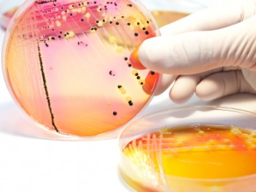
Robert Heinrich Herman Koch (1843-1910)
Koch’s studies of Cholera
  His research of TB was interrupted by an outbreak of Cholera in Egypt.
  He theorized that the bacteria Vibrio was the cause, but, the epidemic was over before he could complete his research.
  However, he traveled to India where he eventually identified the organism that causes Cholera and was able to even identify how it is transported from person to person. (Drinking water, food, etc..).
Koch’s studies of Tuberculosis
  His goal was to isolate and identify.
  With a modification of staining, he was able to isolated tubercle bacillus.
  March 24, 1882, Koch announced his discovery of TB.

Slide 7
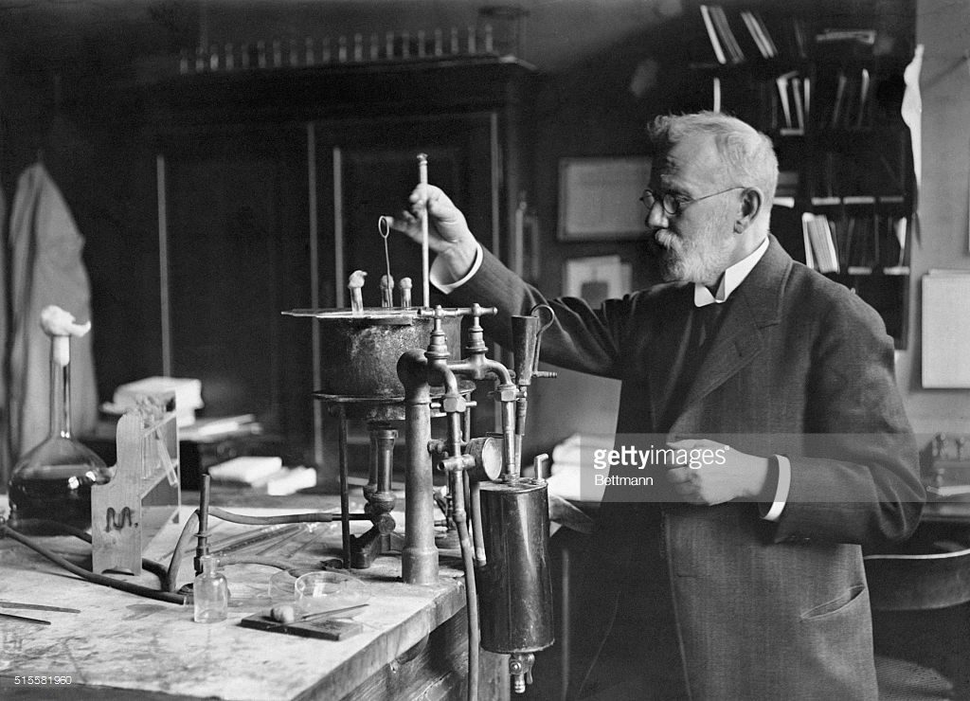
Paul Ehrlich (1854-1915)
Ehrlich won a Nobel Peace Prize for his work on immunity (1908).
He graduated with a medical degree from the University of Leipzig in 1878.
Ehrlich was then offered the position as head physician at Charite Hospital in Berlin.
He theorized that chemical agents could be used to heal diseased cells or to destroy infectious agents.
Ehrlich’s work on immunity and syphilis has changed the usual medical diagnostics.

Slide 8
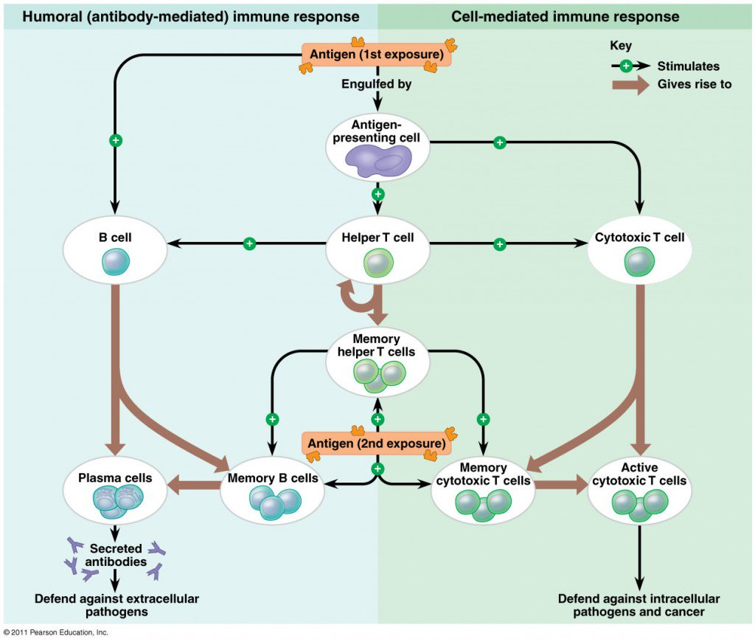

Paul Ehrlich (1854-1915)
Immunity Research
  A TB outbreak in Egypt lead Ehrlich to Koch’s institute for infectious diseases.
  There, he created the Side Chain Theory:
    The theory described how antibodies are formed and how they react with other substances.
    During this time of the theory the knowledge of how bacteria causes disease and even less of our body’s immune system and its defenses.
Ehrlich theorized that each cell has a series of receptors that attach to certain food molecules and disease causing toxins (antigens). Once the toxin binds to the receptors it blocks the uptake of nutrients. So the body produces new receptors, so many that they are secreted into the blood. The circulating receptors are the antibodies that neutralizes the toxins and in the end immunizing the infected individual.
However!....He was incorrect...

Slide 9
Paul Ehrlich (1854-1915)
However, his incorrect hypothesis didn’t stop Ehrlich’s research.
  He subjected rabbits to a slow and measured increase of toxic matter.
  The result was the rabbits survived 5,000 times the fatal dose.
  He was able to establish precise quantitative patterns of immunity.
Teamed up with Emil Von Behring.
  Developed effective ways of measuring serums.
1892 discovered that pathogens can be transferred from mother to baby by breast milk.
Developed the idea of Chemotherapy.
  Infectious disorders caused by protozoa didn’t respond to previous serum treatment.
  For trypanosomes he used coal tar to try as a treatment...didn’t work.
  Tried arsenic and benzene...wayyyy too toxic.

Slide 10
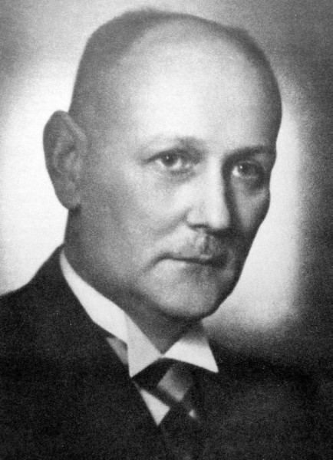
Gerhard Domagk
(1895-1964)
Medicine degree from the University of Kiel in 1921.
Taught at the University of Greifswald (1924-25)
(1927) Became director of the I.G. Farbenindustrie Laboratory for Experimental Pathology and Bacteriology in Elberfeld (Wuppertal).
Award Nobel Prize for his work in the antibacterial effects of Prontosil. (1939).
Domagk was unable to accept the award at the time but was later given the prize in 1947.

Slide 11
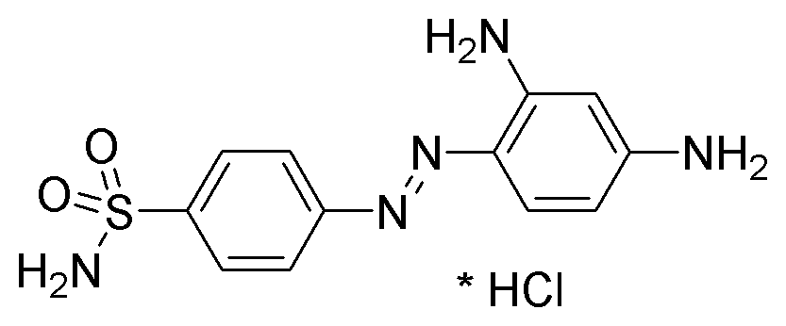
Gerhard Domagk
(1895-1964)
Domagk was inspired by Paul Ehrlich.
He began to study newly developed dyes and how they react against various bacteria.
He noticed the antibacterial action of the dye, Prontosil red, against streptococcus in mice.
  Able to be work with humans.
  Considered the 1st antibiotics.
He discovered that the active component of Prontosil was sulfanilamide.
  Bacteriostatic-inhibits growth and multiplication of bacteria but doesn’t kill the bacteria.
  It interferes with the folic acid of the bacteria causing the microorganisms to stop growing and multiplying without harming the host.

Slide 12
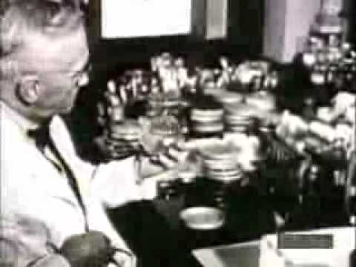
Sir Ernst Boris Chain (1906-1979)
1945 Nobel Peace Prize for his work with penicillin.
He worked with Howard Walter Florey and used ideas by Alexander Fleming.
They isolated purified penicillin, (a concept created by Fleming in 1928), and began the first clinical trials of the antibiotic.
2 Classes of Penicillin
  Naturally occuring
    Penicillin G(benzylpenicillin) - intramuscular injection.
    Penicillin V (phenoxymethylpenicillin)-orally

Slide 13
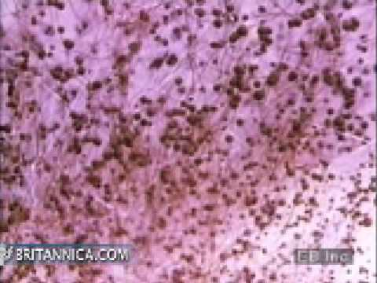
Sir Ernst Boris Chain (1906-1979)
Graduated from the Friedrich Wilhelm University of Berlin in chemistry and physiology.
Did research at the Institute of Pathology, Charite Hospital in Berlin (1930-33).
Fled Germany to the University of Cambridge.
Then to the University of Oxford where he worked with Florey on penicillin.
Chain also studied snake venom and the spreading factors.

Slide 14
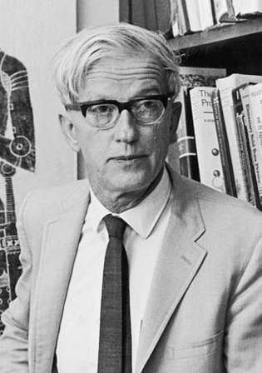
Max Delbruck
(1906-1981)
Awarded the Nobel Peace Prize for his work in the replication mechanism and genetic structure of viruses (1969).
Earned a Ph.D in physics from the University of Gottingen (1930).
Delbruck fled to the United States during WW2 (1937).
In 1945 he became an American citizen.
His interest in bacteriophages when he assisted with research at Kaiser Wilhelm Institute for chemistry in Berlin (1932-37).

Slide 15
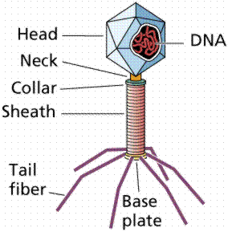
Max Delbruck
(1906-1981)
1 step process to grow bacteriophages, 1 hour latent period, result is thousands of progeny.
In 1943 Delbruck made his discovery known.
  His discovery showed that bacteriophages are viruses that attach to bacteria and inject their genetic material into the bacteria.
  This results in the rapid production of new phage inside the bacteria.
They were able to understand that like complex organisms, bacteria develop via mutations.

Slide 16
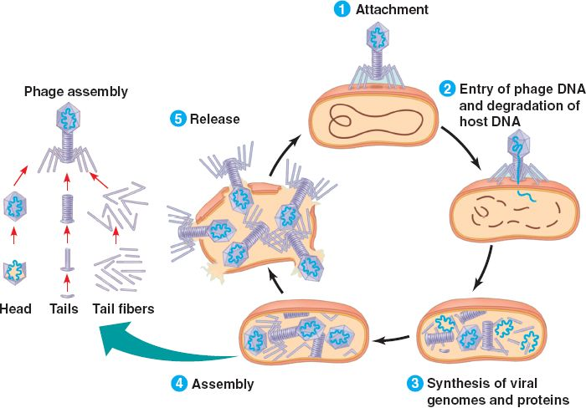

Slide 17
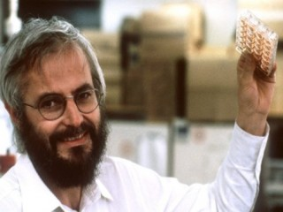
Georges Jean Franz Kohler (1946-1995)
Received a doctoral degree in biology (1974) from the University of Freiburg in West Germany.
1974-1976 Kohler worked with Cesar Milstein at the Medical Research Council Laboratory of Molecular Biology in Cambridge, England.
In 1984, Kohler, Milstein and Niels K Jerne, were awarded the Nobel Peace Prize for their work of developing a technique for producing monoclonal antibodies.
  Sensitive protein molecules that are used in diagnosing and combating diseases.

Slide 18
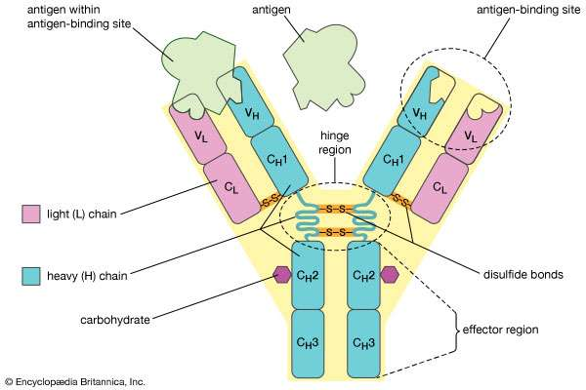
Georges Jean Franz Kohler (1946-1995)
Monoclonal Antibody
  An antibody that is produced by genetic engineering technique.
  When the cell is activated by a foreign identity, a B cell multiples to form a clone of plasma cells. These plasma cells secrete immunoglobulin molecules, and the descendents of those molecules are what is referred to as the monoclonal antibodies.

Slide 19
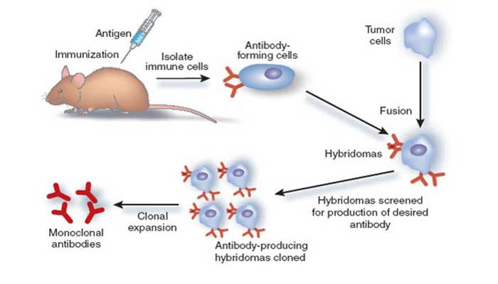
Can be designed to target specific cells or antigens.

Slide 20
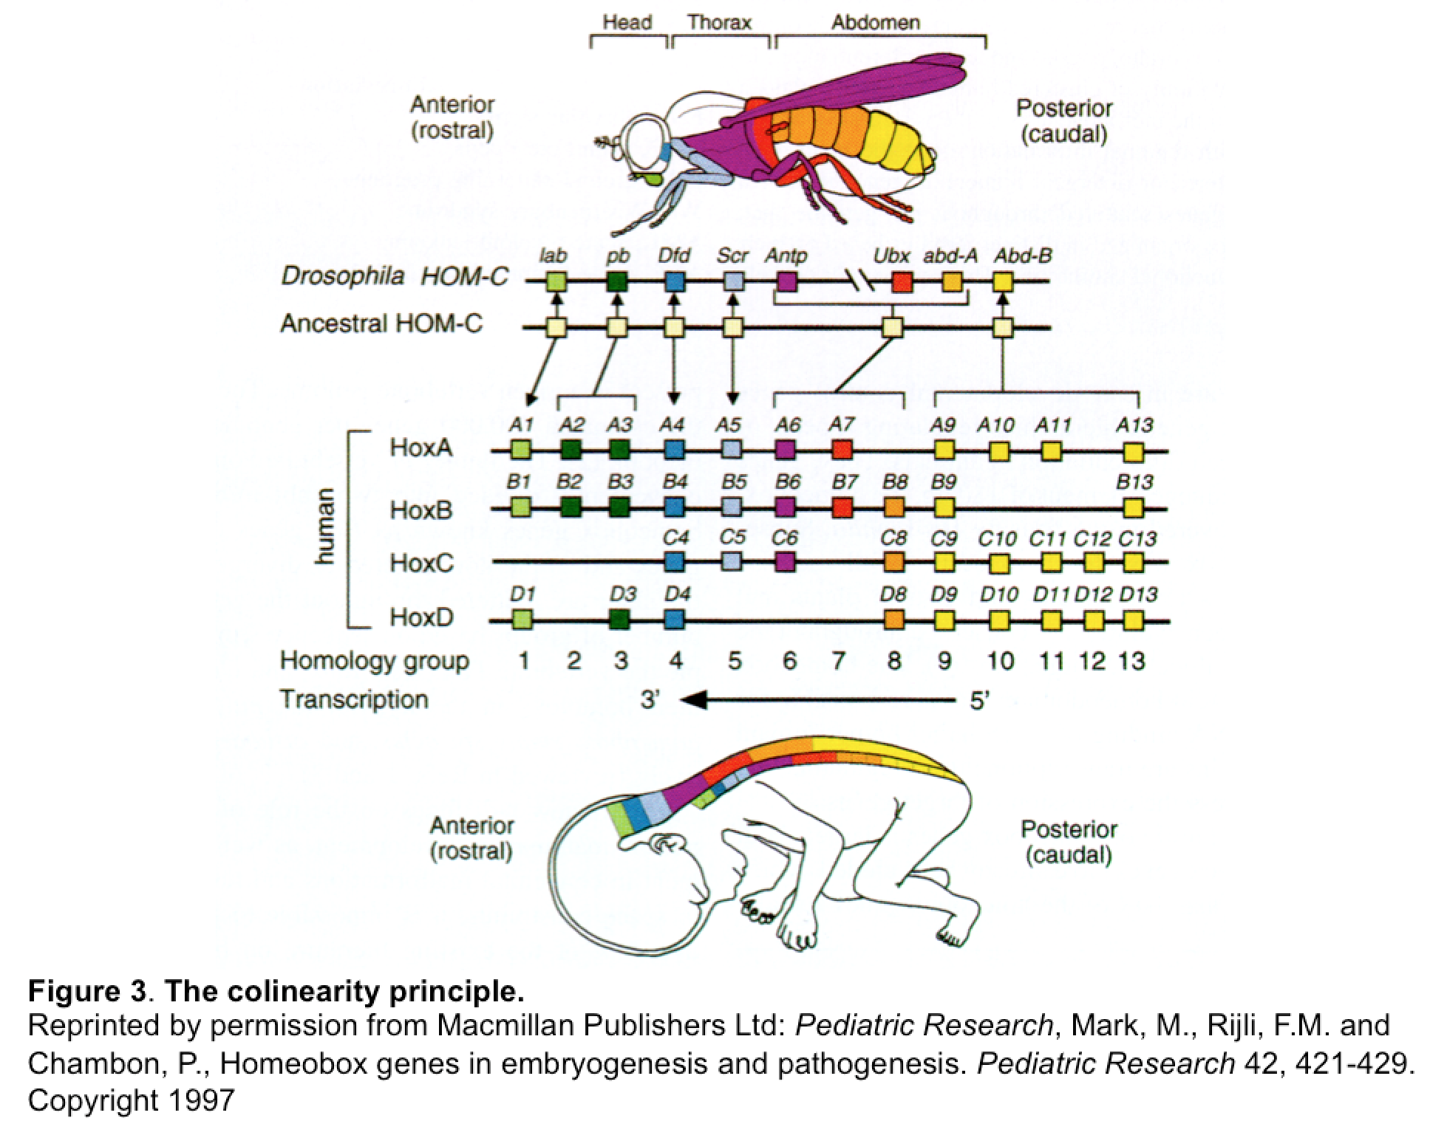
Christiane Nusslein-Volhard
(1942-Present)
Received diploma in biochemistry at Eberhard-Karl University of Tubingen (1968).
  Received a doctorate in genetics (1973).
Worked with Eric F. Wieschaus and Edward B. Lewis.
Nusslein-Volhard and Wieschaus crossbred 40,000 fruit flies.
  The result was the discovery of 5,000 out of the 20,000 genes, were important in the early development, while 140 were consider essential.
Out of this research resulted in 3 genetic categories
  (1) Gap Genes: head to tail body plan
  (2) Pair rule genes: body segmentation
  (3) Segment-polarity genes: repeating structures within each segment.

Slide 21
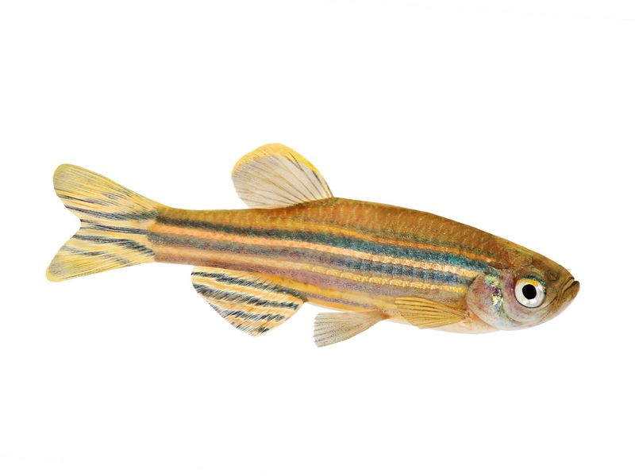
Christiane Nusslein-Volhard
(1942-Present)
In the 1990’s, Nusslein-Volhard studied zebrafish, similarly to how she studied the fruit flies.
She looked at what genes control the early development of the zebra fish because they are similar to other vertebrae.
This helped explain genes and other cellular substances that go into human development and the regulation of normal physical makeup
  Ex: two arms, two eyes on the face...

Slide 22
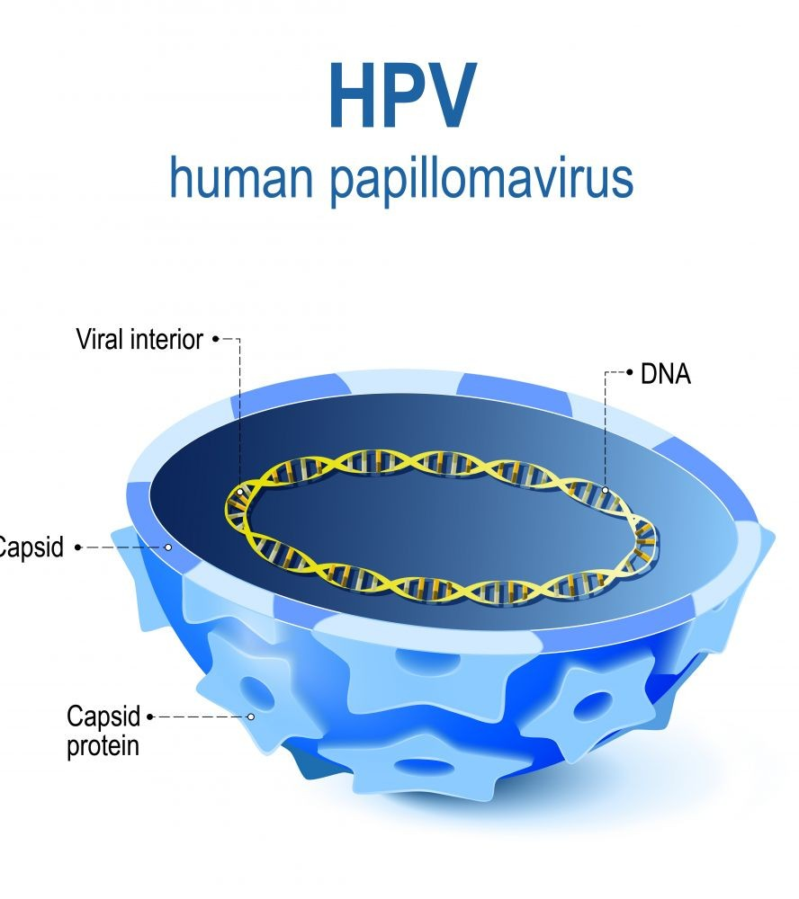
Harald Zur Hausen (1936-Present)
Studied medicine at the University of Bonn in Hamburg and Dusseldorf.
  Received MD in 1960
Awarded Nobel Prize in 2008 for his discovery of HPV, which can lead to cervical cancer.
When cells start dividing too quickly they can form cancerous tumors.
Hausen was able to show that cervical cancer is caused by certain wart viruses/papilloma viruses.
His discovery lead to the development of a vaccine for the 2nd most common tumor disease among women.

Slide 23
Why did I chose this topic?
I chose to research German advances in medicine because I am very intrigued by science and medicine and bacteria and wanted to explore how we were able to create vaccines for certain diseases. To be able to have the type of scientific knowledge we have now is really important. We have so much more insight into how our immune system works, how common illness occur and how we can treat them. Without these very very important advances then you would not have penicillin for your strep throat, no vaccine against HPV, no clue of how our immune system works and so much more.

Slide 24

THE END

Slide 25
Works cited
Britannica, The Editors of Encyclopaedia. “Christiane Nüsslein-Volhard.” Encyclopædia Britannica, Encyclopædia Britannica, Inc., 24 Mar. 2017, www.britannica.com/biography/Christiane-Nusslein-Volhard.
Britannica, The Editors of Encyclopaedia. “Georges J.F. Köhler.” Encyclopædia Britannica, Encyclopædia Britannica, Inc., 10 Apr. 2018, www.britannica.com/biography/Georges-J-F-Kohler.
“Gerhard Domagk - Facts.” Nobelprize.org, www.nobelprize.org/nobel_prizes/medicine/laureates/1939/domagk-facts.html.
“Harald Zur Hausen - Facts.” Nobelprize.org, www.nobelprize.org/nobel_prizes/medicine/laureates/2008/hausen-facts.html.
“Max Delbrück - Facts.” Nobelprize.org, www.nobelprize.org/nobel_prizes/medicine/laureates/1969/delbruck-facts.html.
www.nobelprize.org/nobel_prizes/medicine/laureates/1908/ehrlich-facts.htm.

Slide 26
Works Cited
Stevenson, Lloyd Grenfell. “Robert Koch.” Encyclopædia Britannica, Encyclopædia Britannica, Inc., 16 Nov. 2017, www.britannica.com/biography/Robert-Koch
“Ernst B. Chain - Facts.” Nobelprize.org, www.nobelprize.org/nobel_prizes/medicine/laureates/1945/chain-facts.html.

