Slide 1



DIFFERENTLY-ABLED and Proud
My Journey Discovering that Dreams DO Come True!

Slide 2
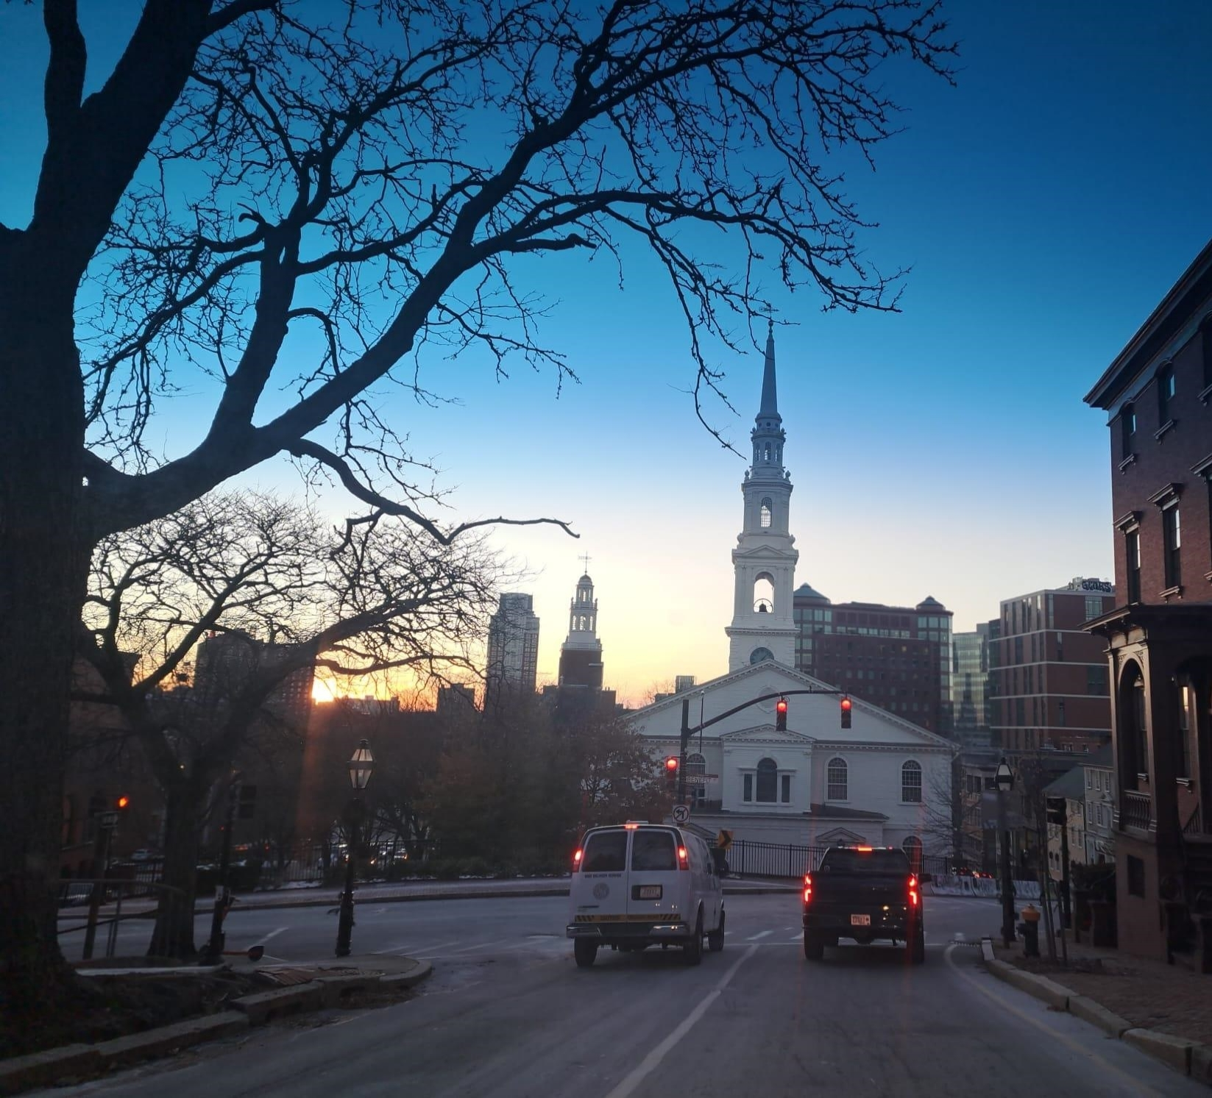
“College Hill”
The beautiful buildings of College Hill in Providence, RI have Incredible views with many slopes and hills
From another perspective this can be a challenge for some to navigate

Slide 3


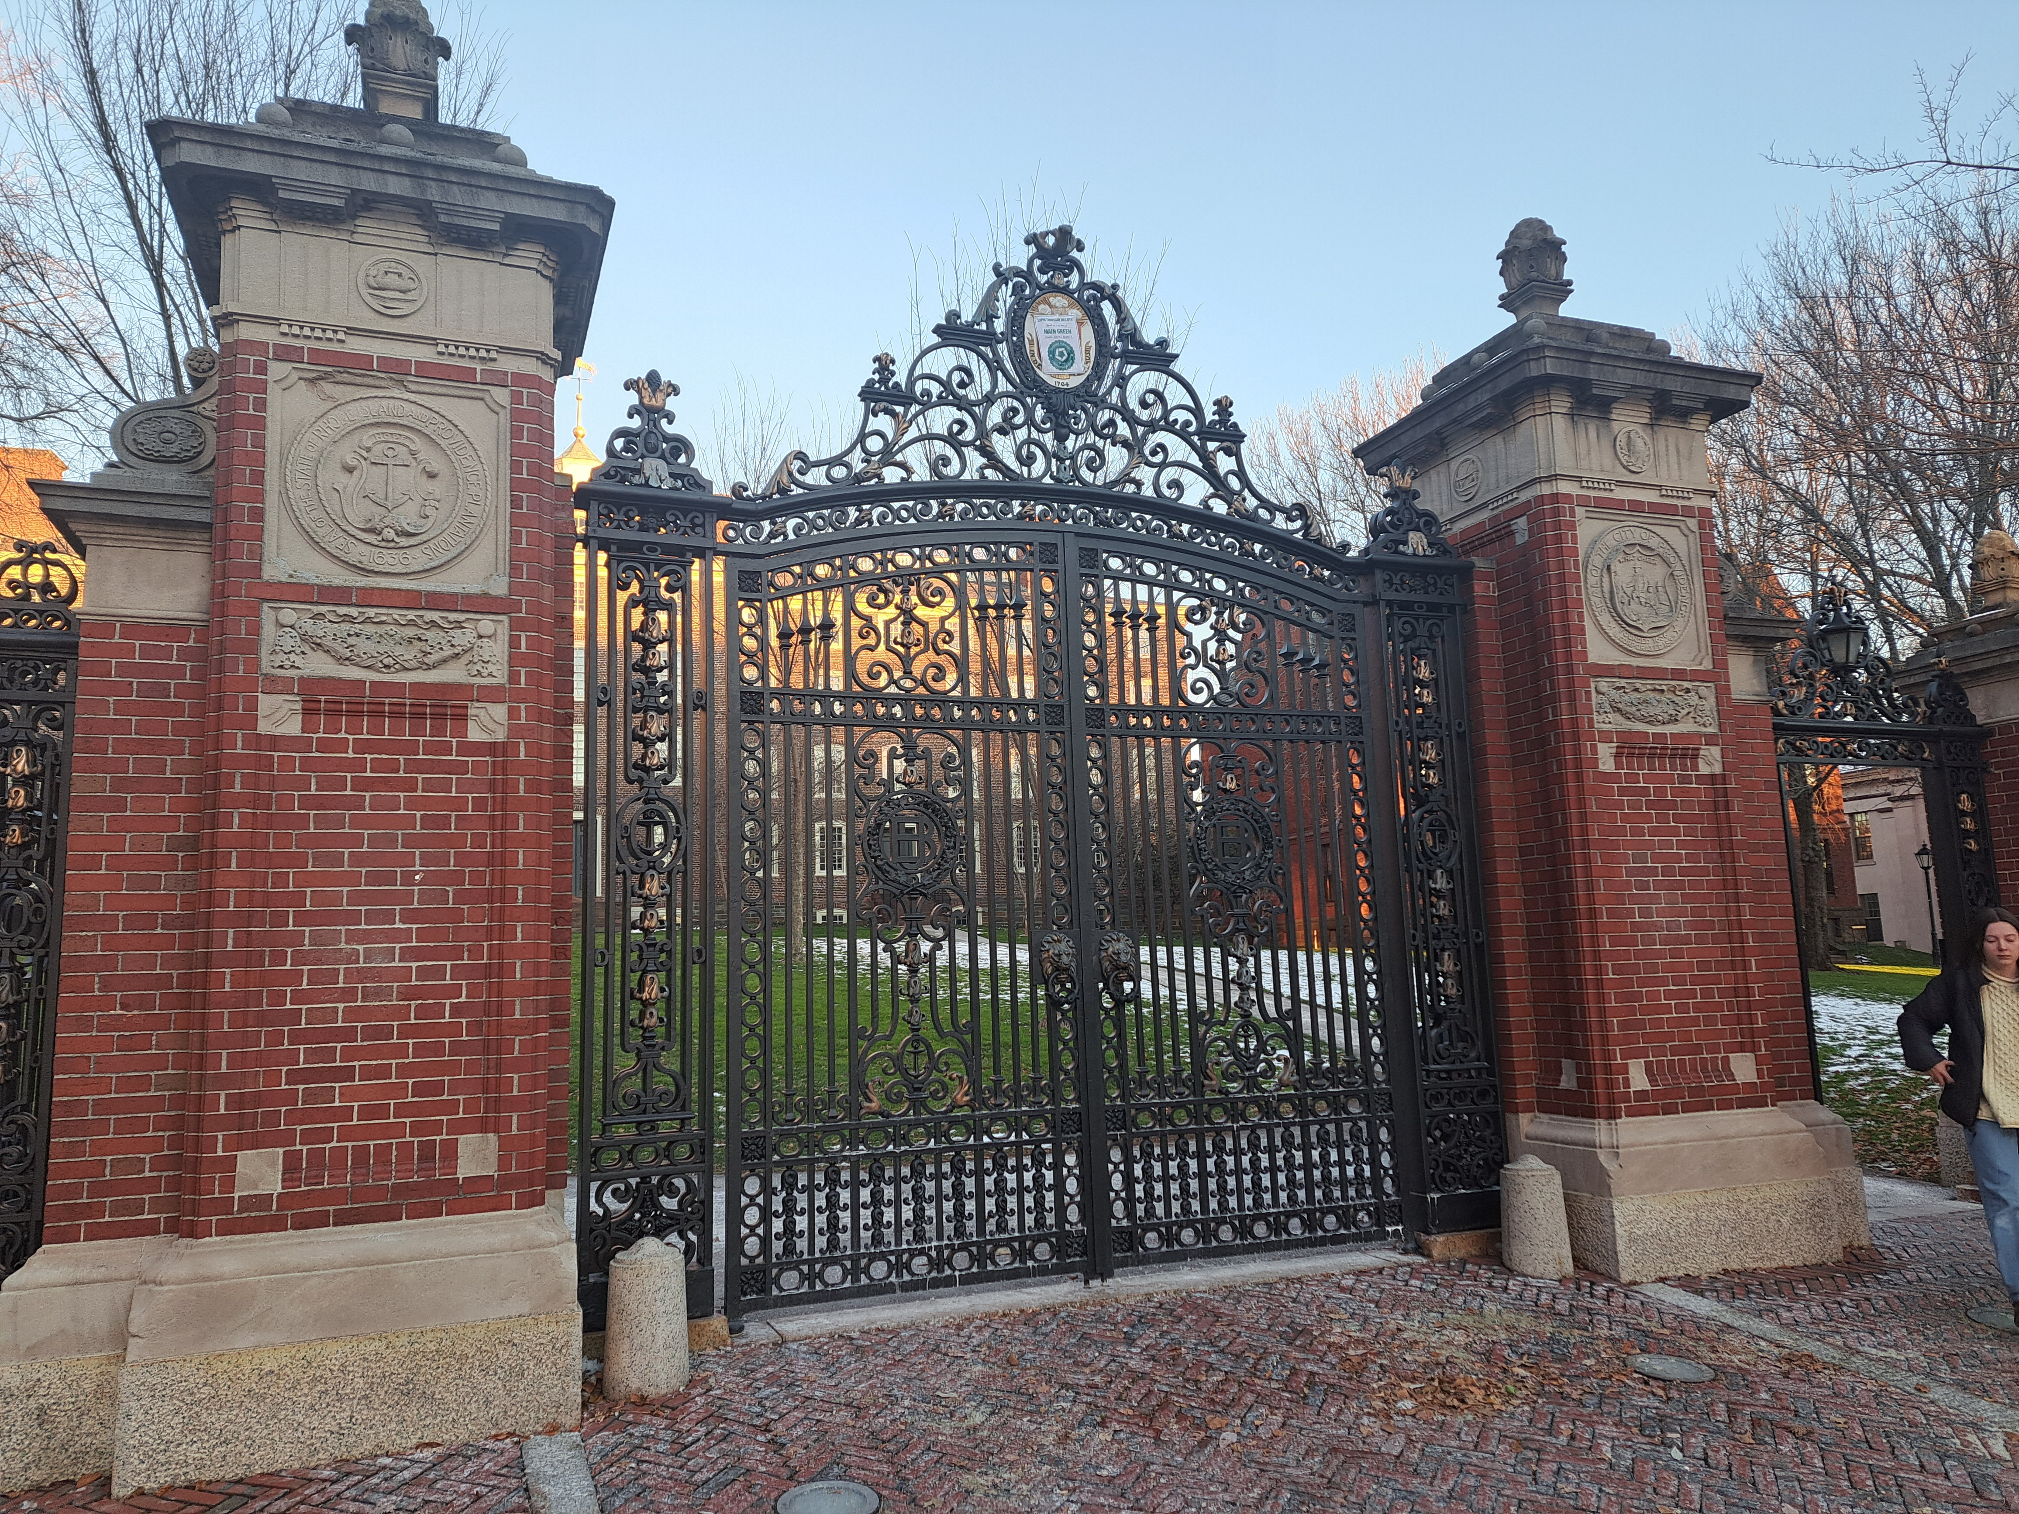
The Gateway to Brown University
The Iconic van Wickle Gates
The legend states that one should only pass through these gates twice
Passing More than twice is bad luck
Here is where my journey begins

Slide 4
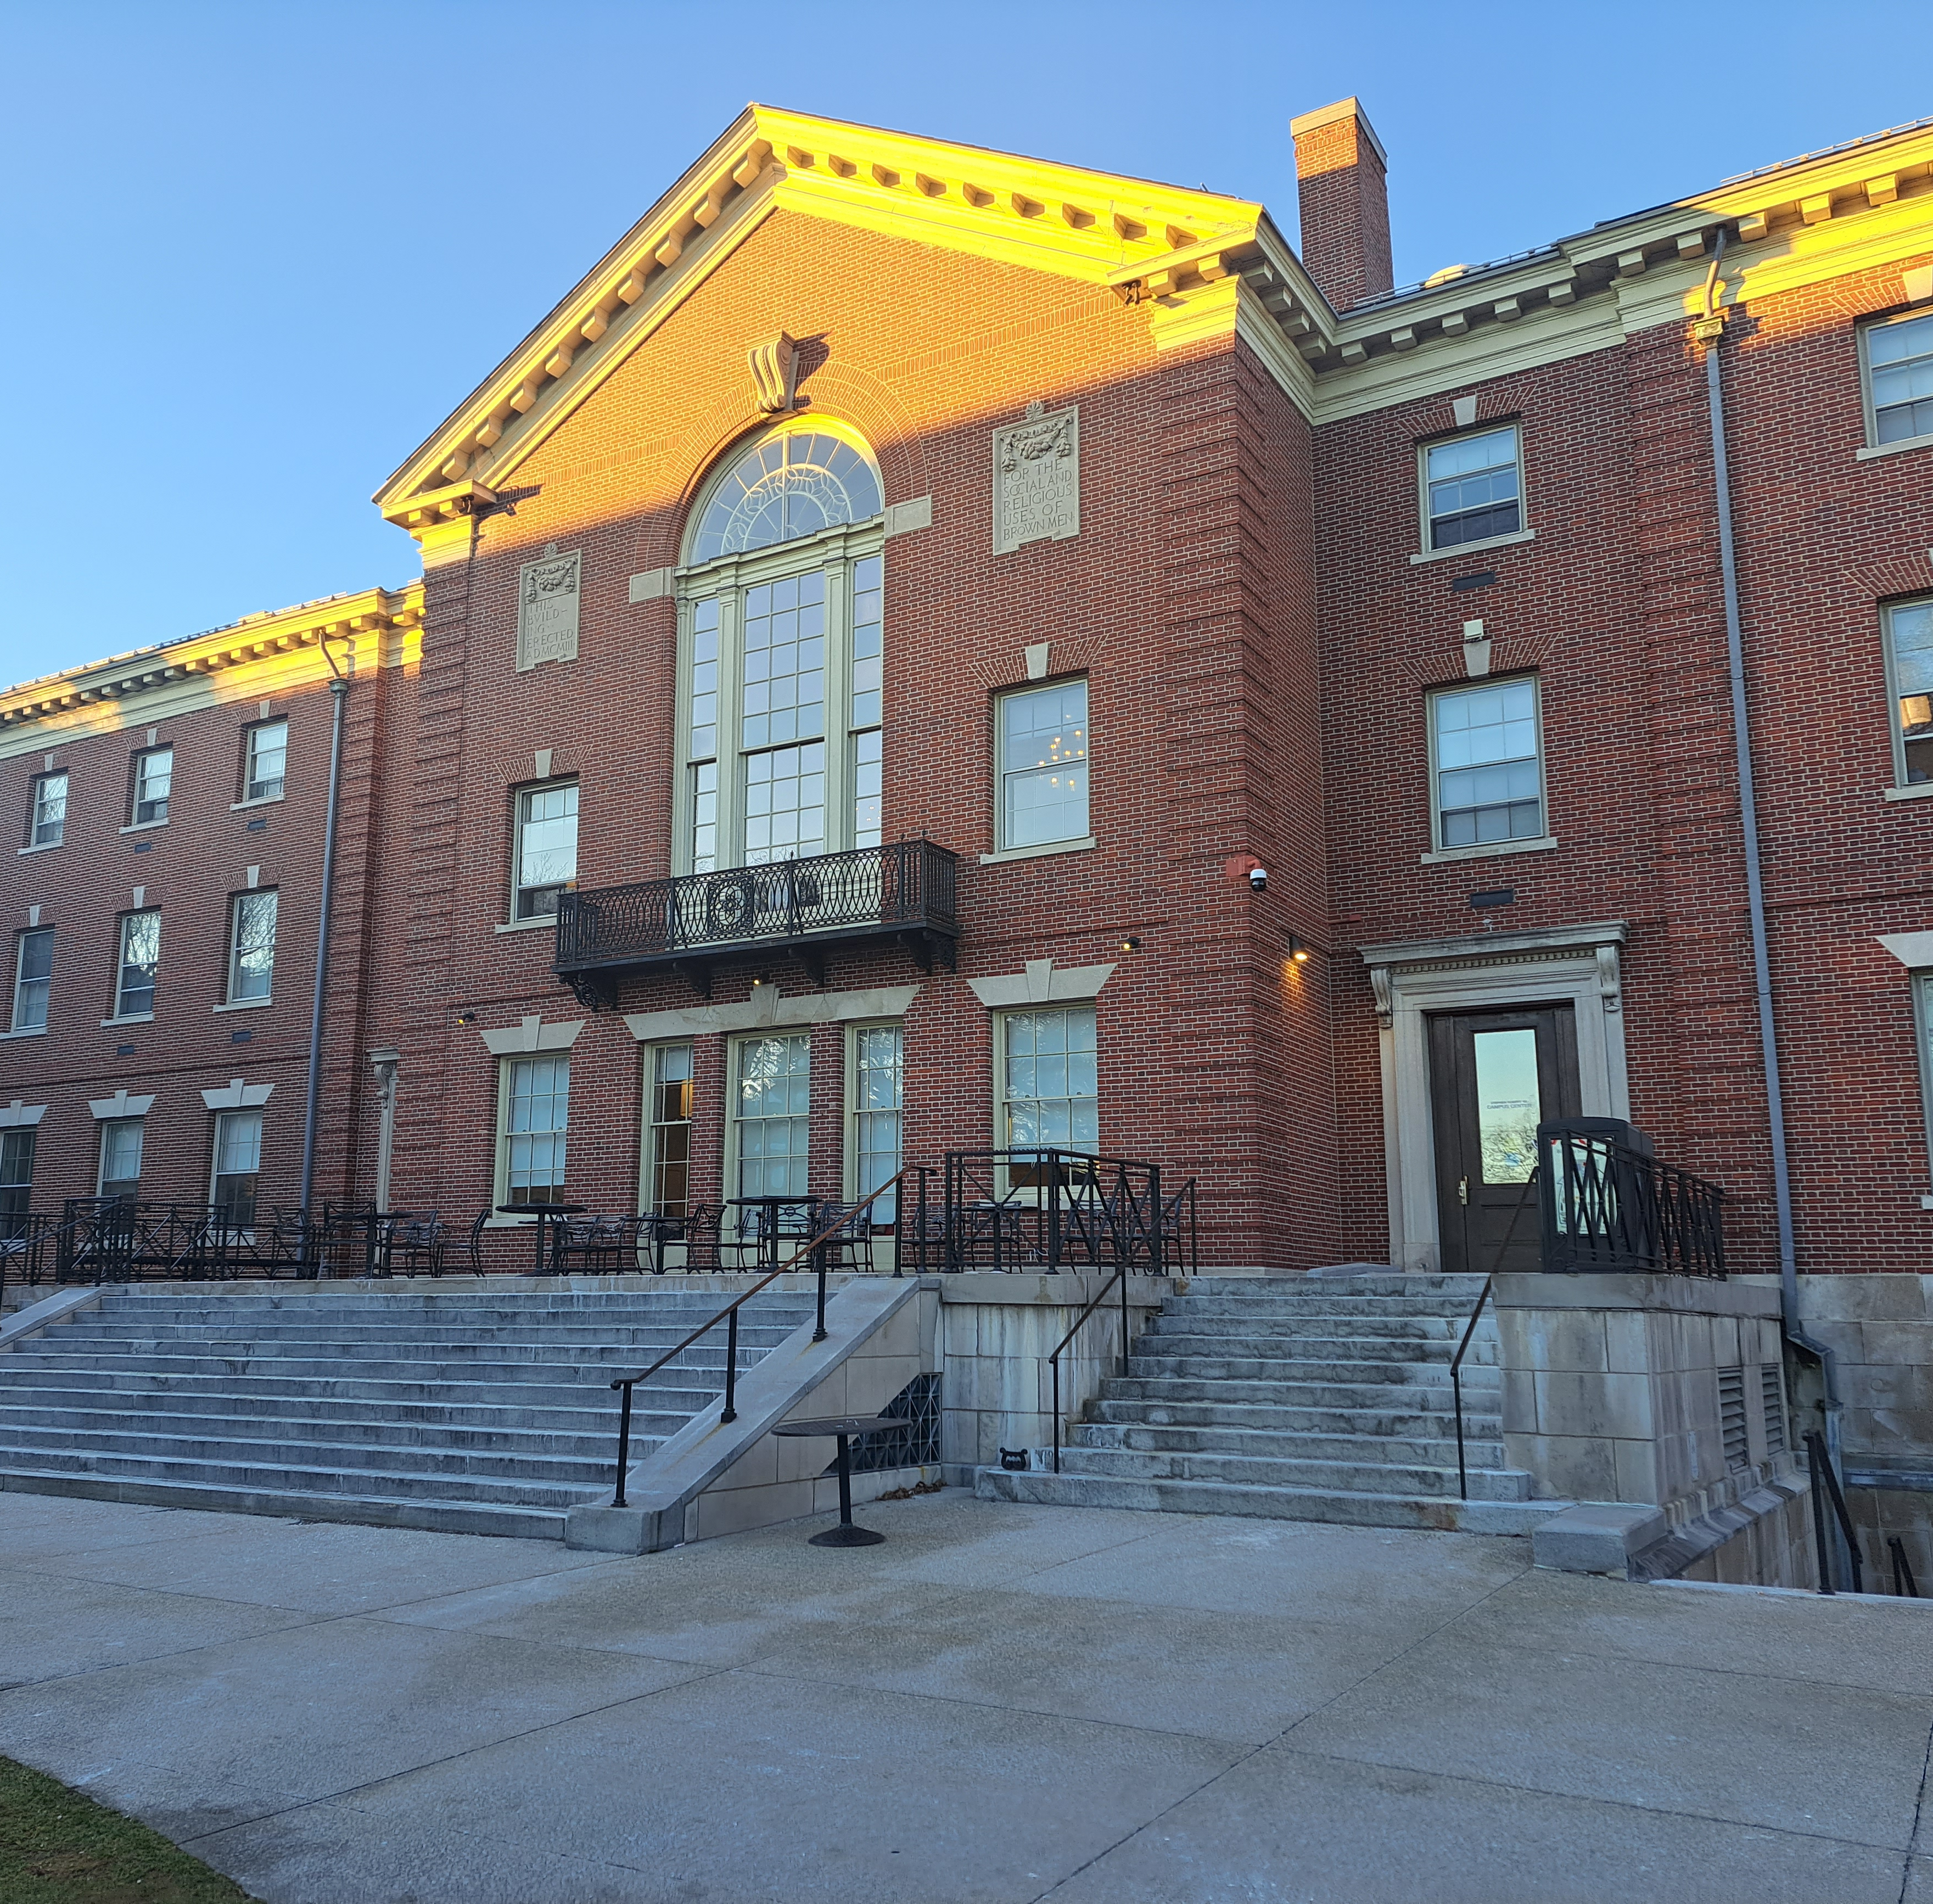
Stairs Can Be a Nightmare
The Brown University campus is an architectural delight however there are many stairs

Slide 5

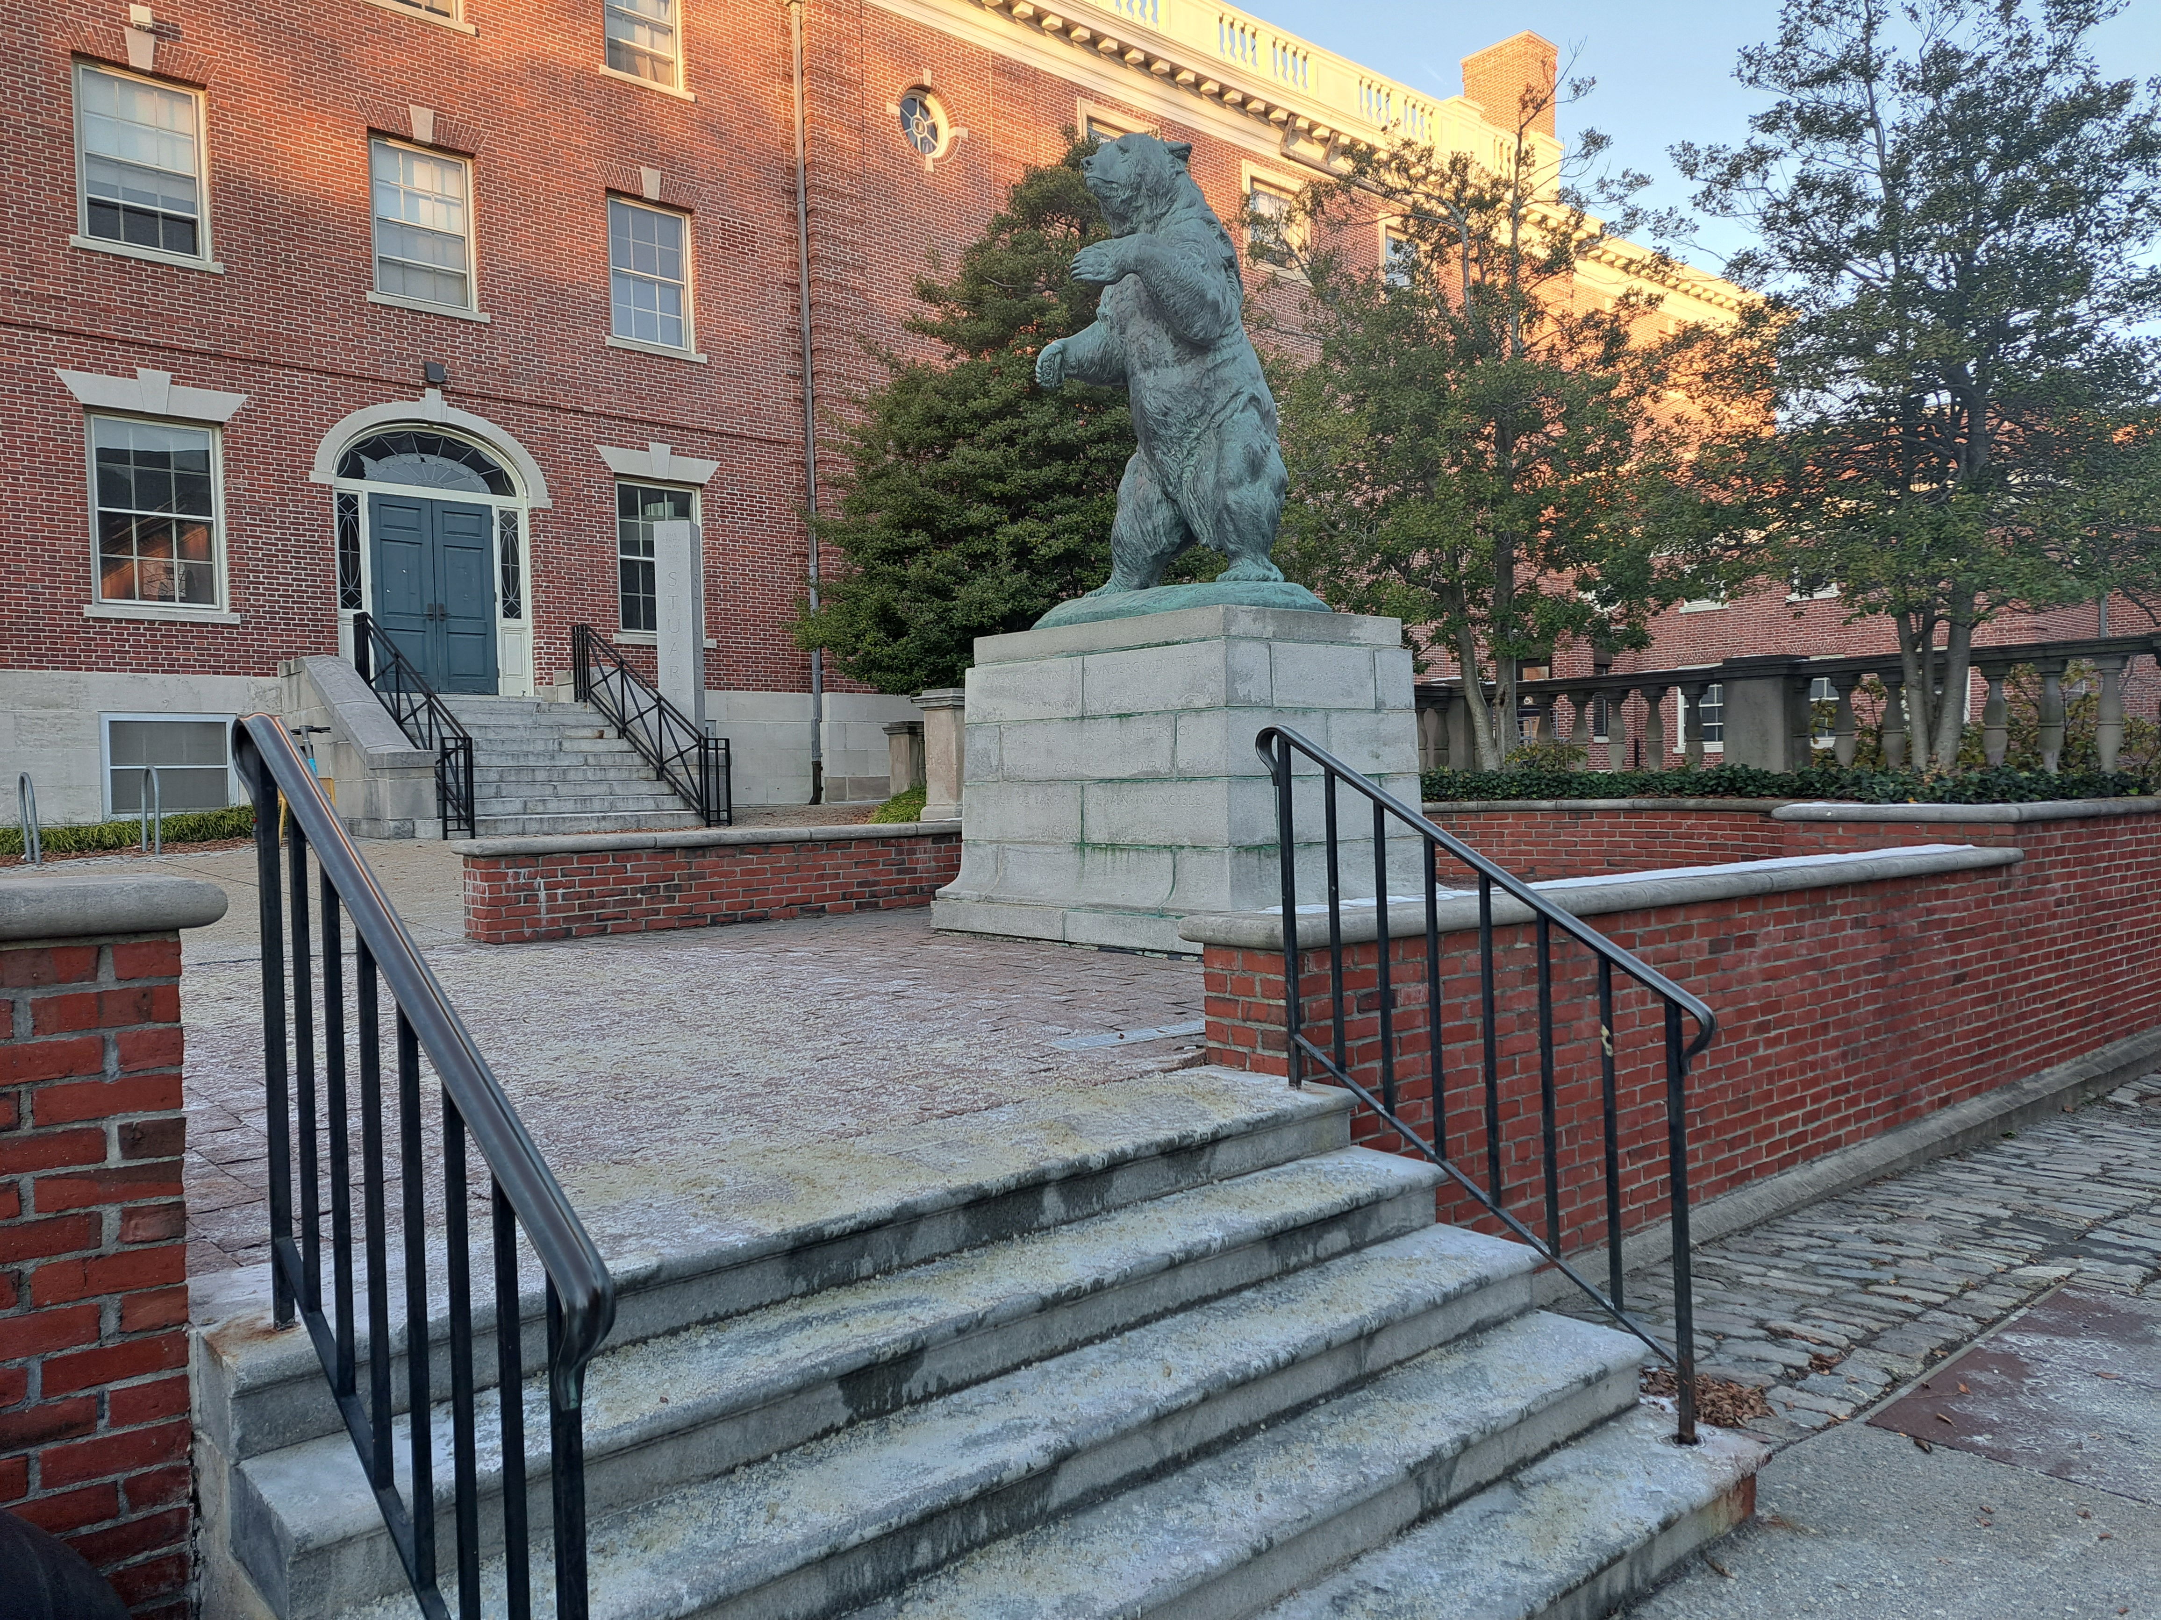
Bruno Bear
There are even stairs to view the famous Bronze Bruno Bear

Slide 6
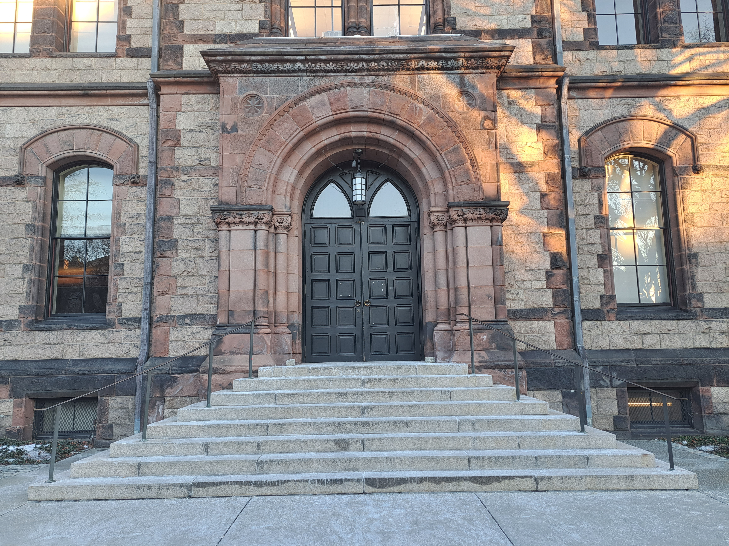
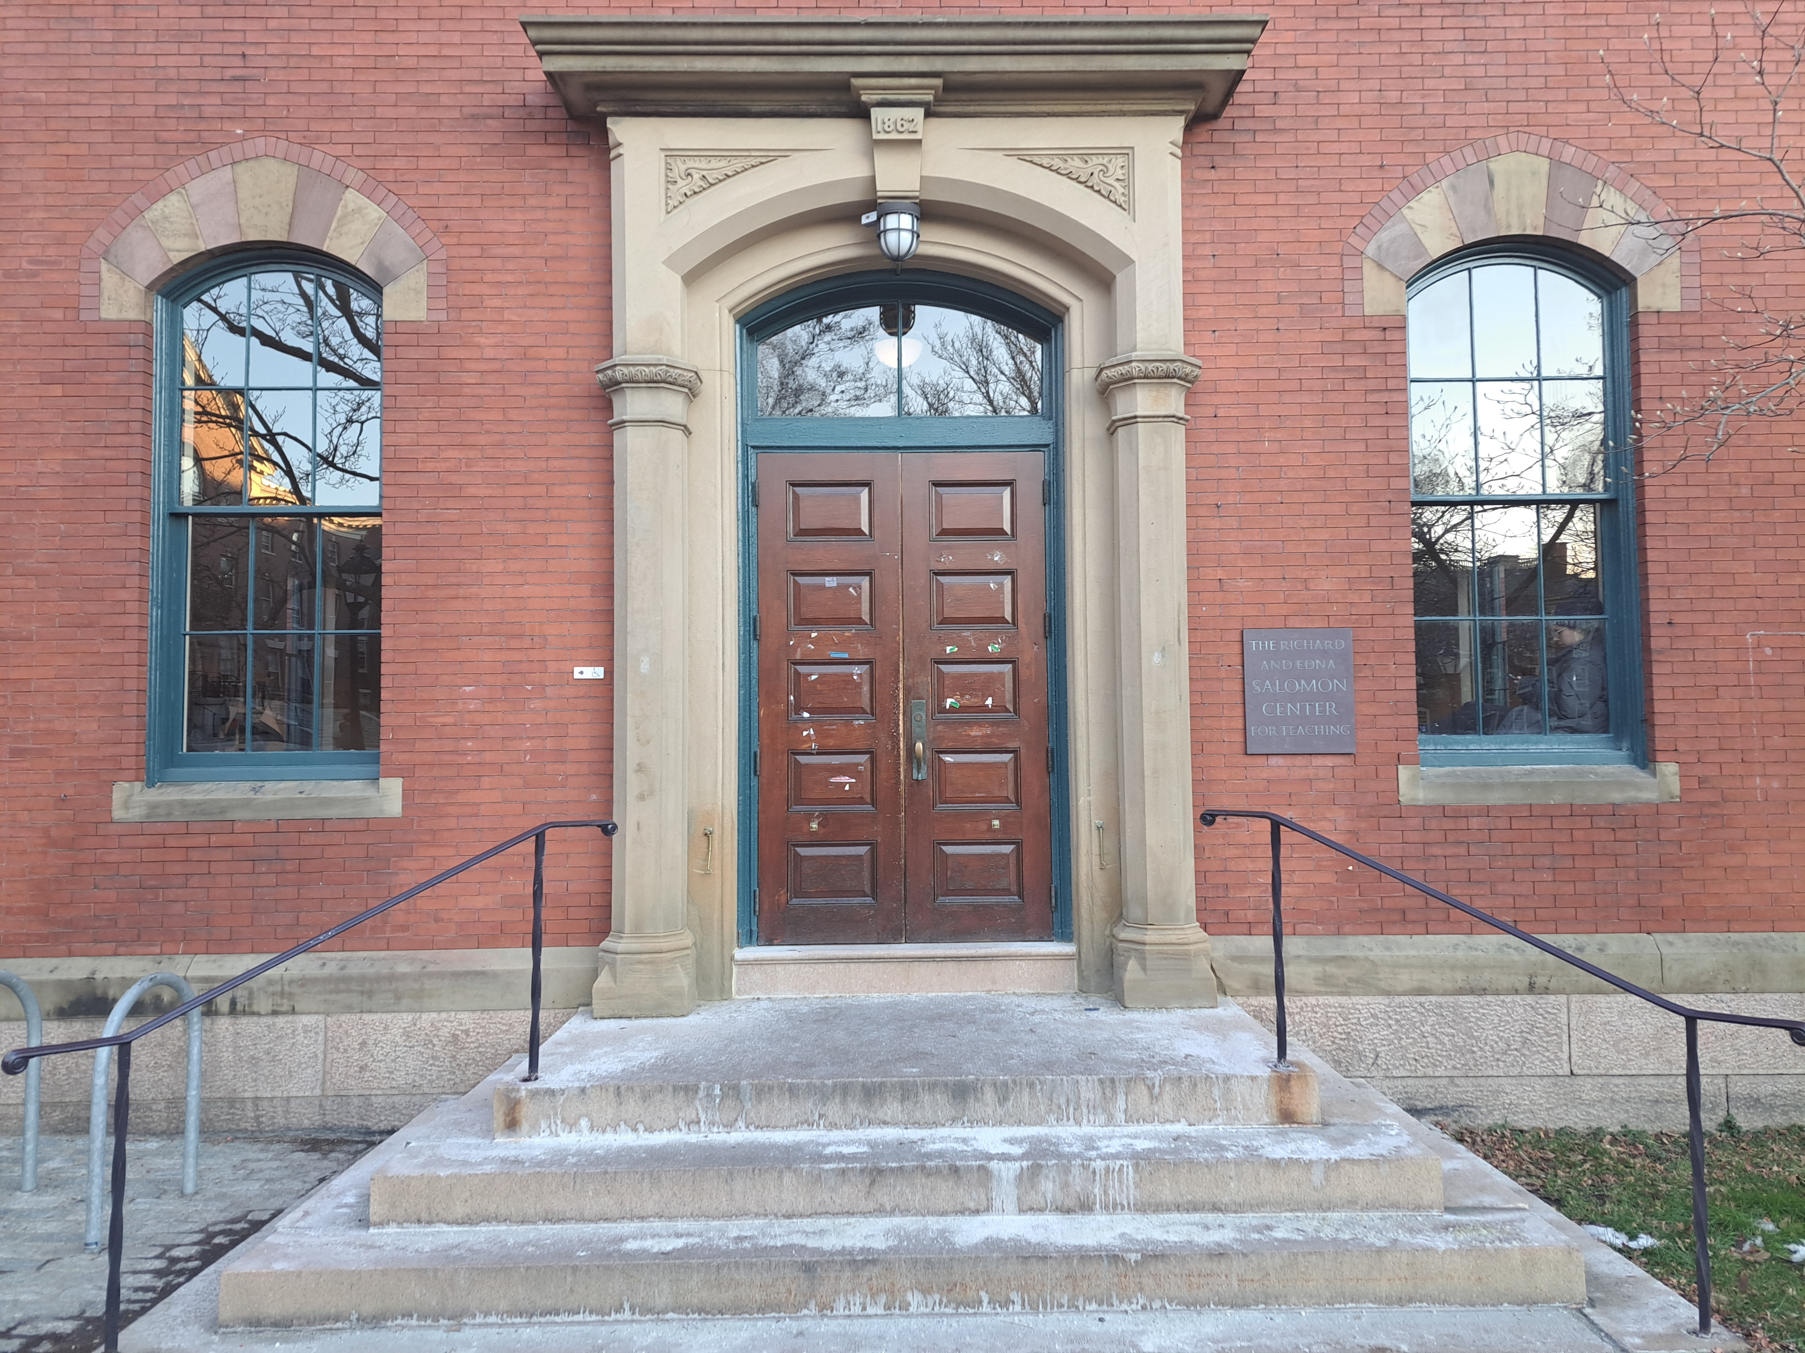
Fabulous entrances with more stairs
Sayles Hall
Salomon Center for Teaching

Slide 7
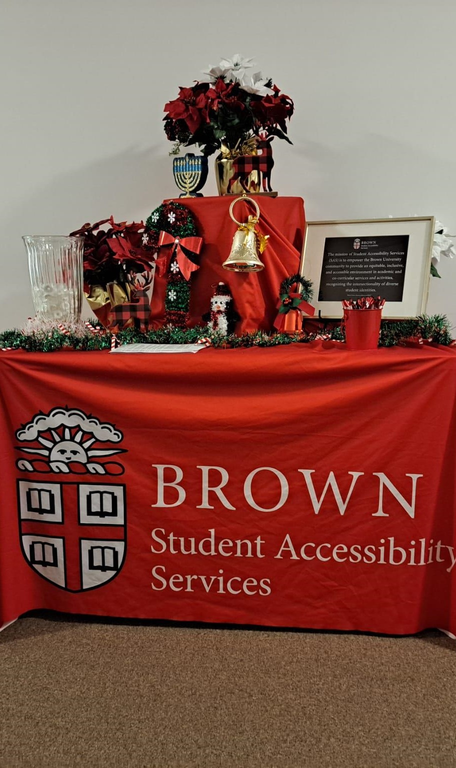
Brown’s Student Accessibility Services
My first step was to contact the Accessibility department
The Staff was exceptionally warm and helpful
Accommodations are readily available to facilitate the learning experience
There are many ramps, elevators and lifts for accommodations
Classes can be rearranged so that disabled students could be in a specific area of the campus with less traveling
After parking in one of the available lots, a convenient shuttle will Wisk you away to your destination on campus

Slide 8
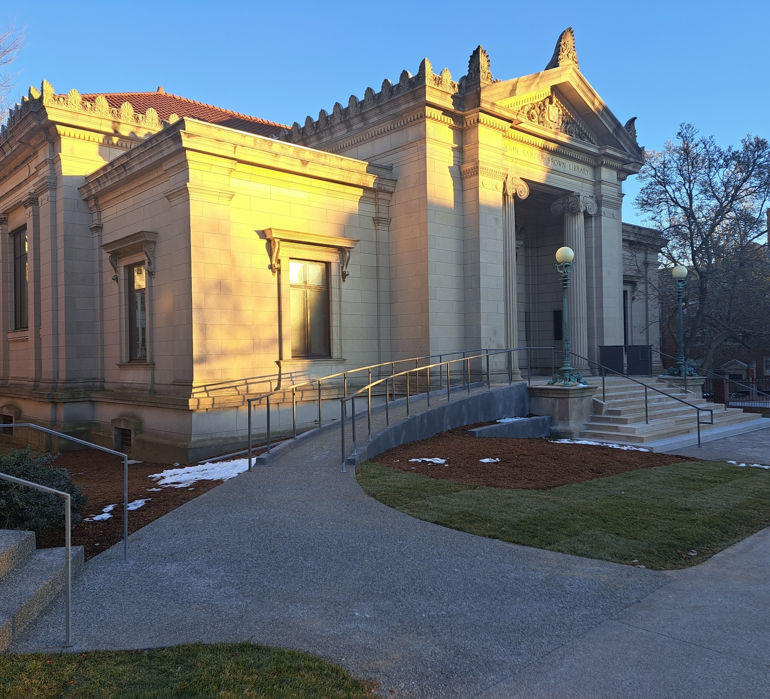
Ramps to the Rescue!
Ramps and improvements for accessibility are an ongoing project at Brown University
Pictured is the recently finished ramp at the John Carter Brown Library

Slide 9
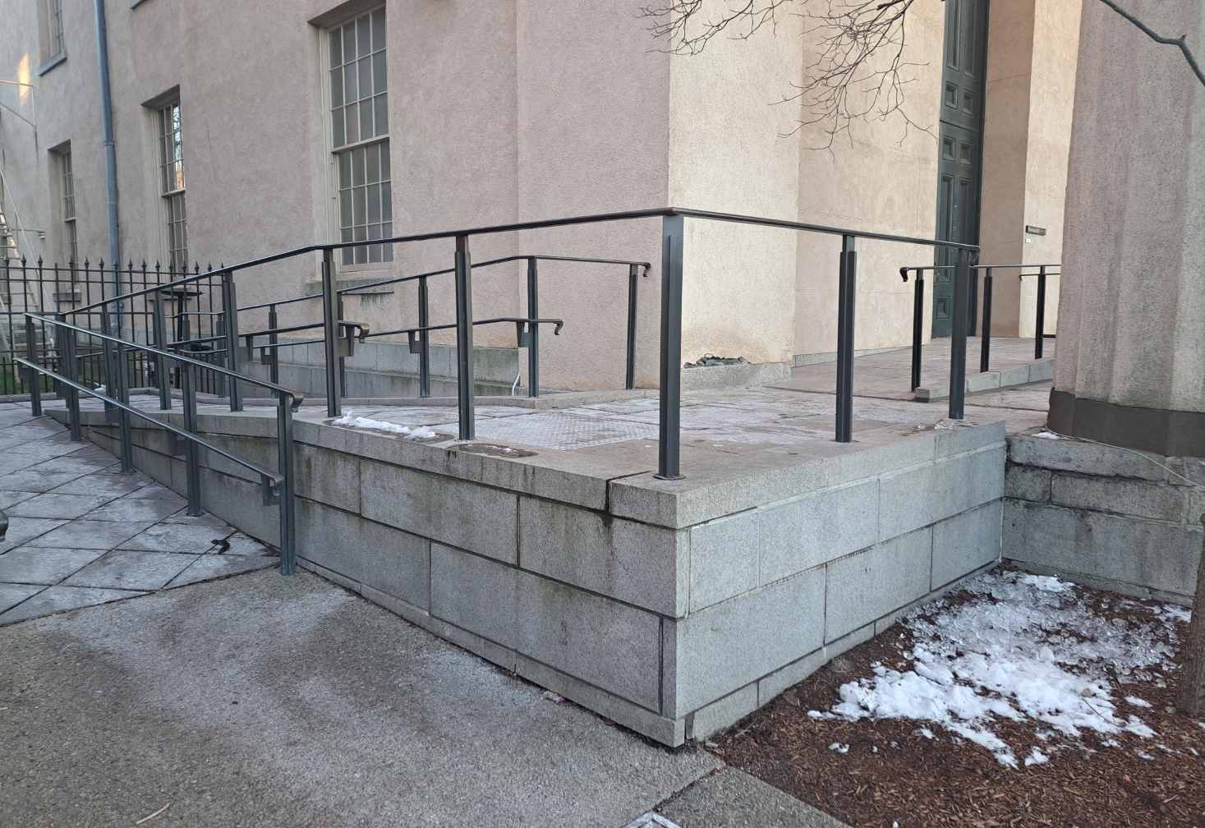
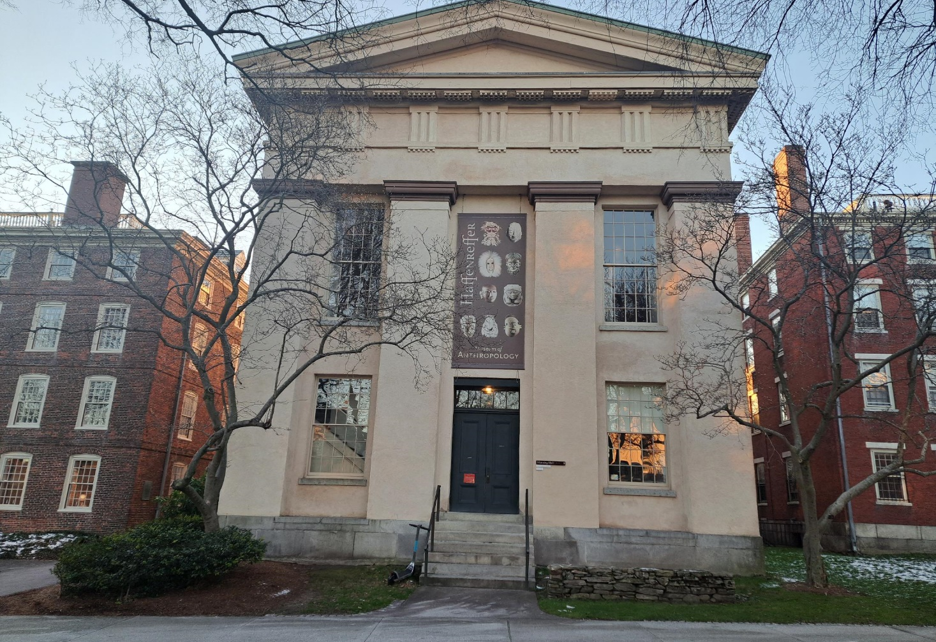
Haffenreffer Museum
The rear of the building hosts a functional and easy to maneuver ramp

Slide 10
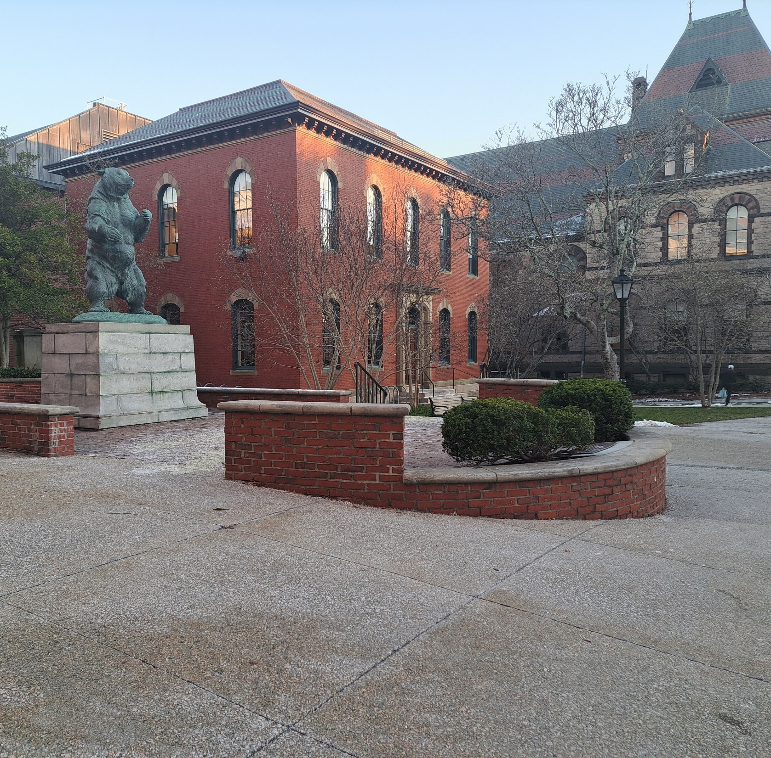
Bruno
Upon further investigation, Bruno Bear is indeed accessible
Even bears need a ramp to be inclusive of All their fans

Slide 11
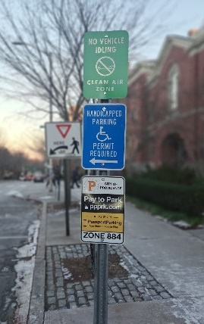
Parking
Brown has a mobile compatible campus map that reveals locations of accessible parking
The map also shows locations of the blue lights for immediate emergency help
Blue light areas have a phone with a direct speed calling button
There are over 150 phones and forty-five elevator phones

Slide 12
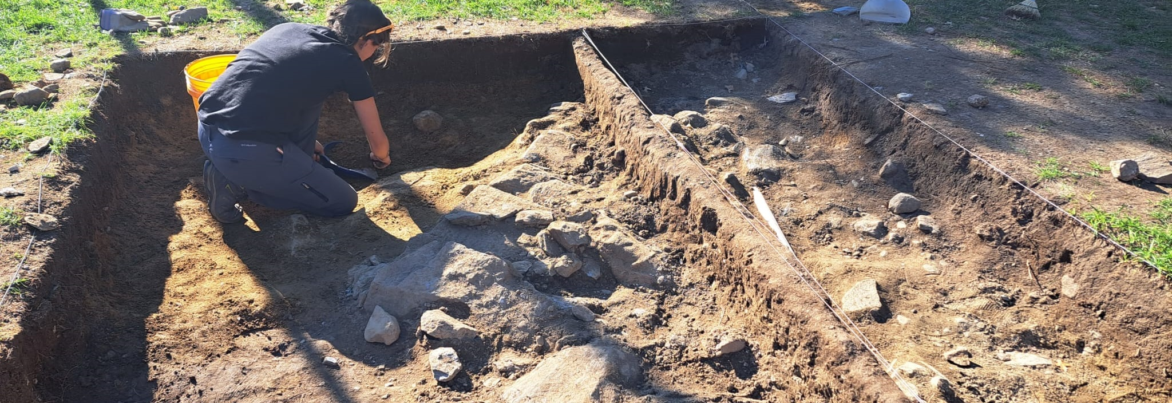
But what about archaeology?
brown university community archaeology day, October 22, 2022

Slide 13
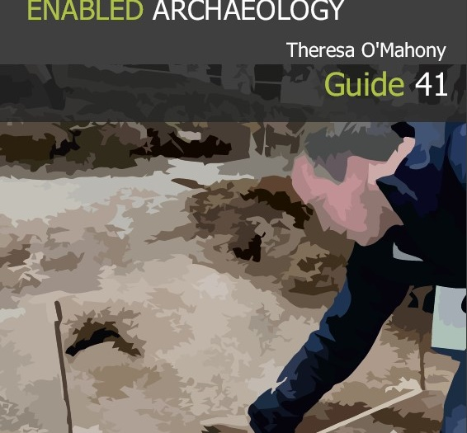
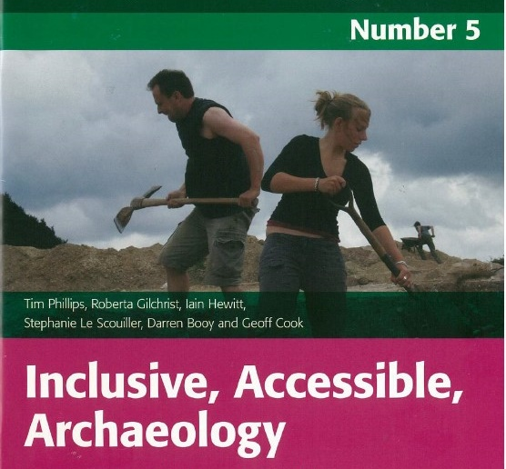
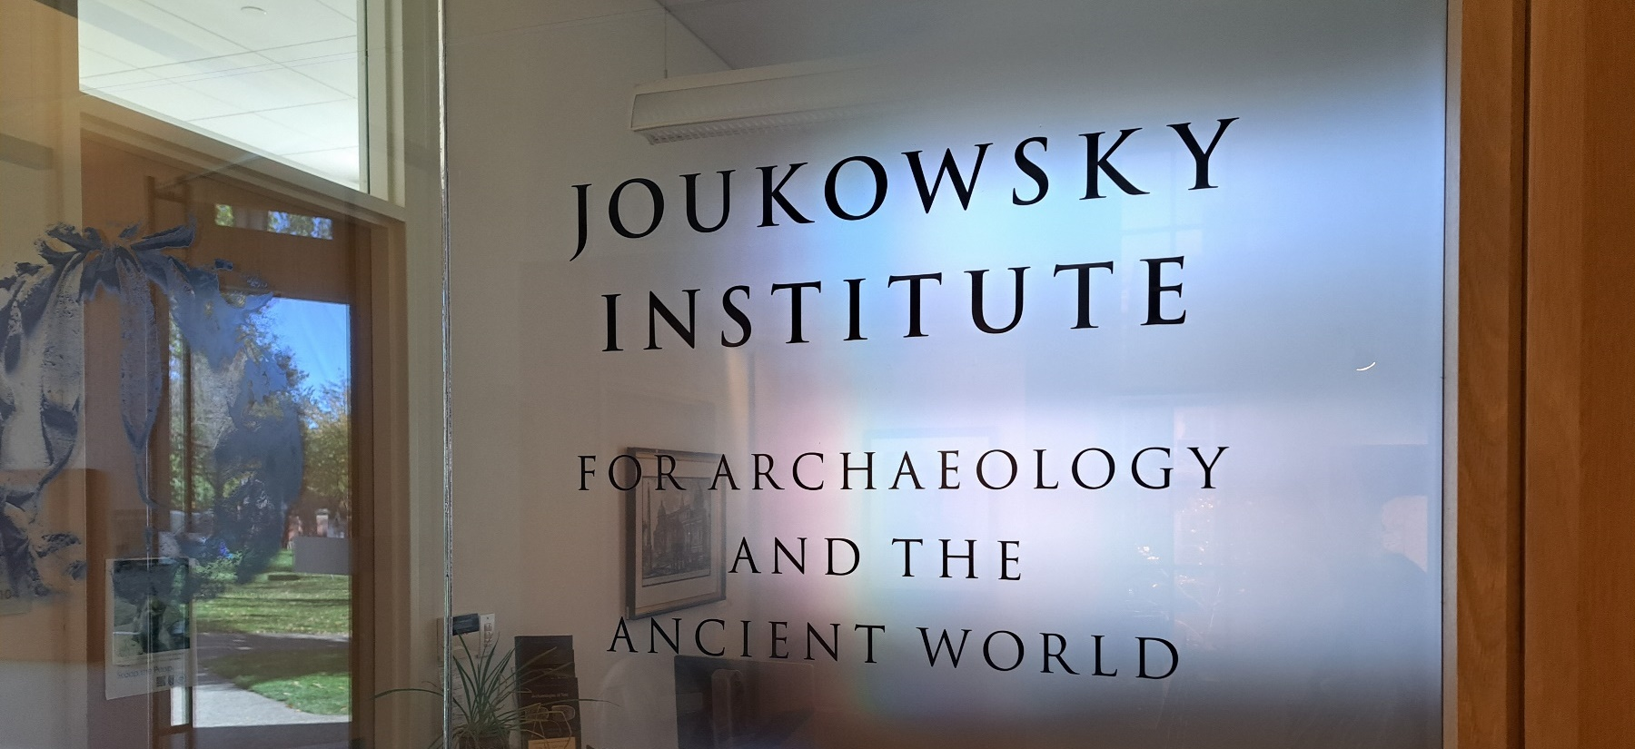
Information is limitless when you ask…
Attending the community archaeology day opened a door of communication for me and granted valuable insight and information from instructors and students
Elizabeth (Liza) Davis, PhD student, Joukowsky Institute for Archaeology and the Ancient World, was exceedingly accommodating and provided publications related to archaeology for persons with disabilities
Ms. Davis was quick to offer and provide future assistance as needed

Slide 14


“Archaeology fieldwork which is accessible for all participants no matter their current physical or mental circumstances can be achieved with only a few minor adjustments and often add little or no financial cost to the organiser or contractor. Of course, some manual teamwork is required prior to commencement of the excavation, this should always be the case, with individuals, working together to support each other to the benefit of the team. This guide provides a general overview and offers a brief insight into what is possible with a little thought and consideration.”
“Just as every excavation member makes a valuable contribution to a dig, disabled archaeologist/people are no different, by being enabled through being totally involved with all choices for their participation, attitudinal acceptance (Phillips et al, 2007, 18) in the following methods.”
-Theresa O’Mahony, disabled Archaeologist, University College, London
COLLABORATION!

Slide 15
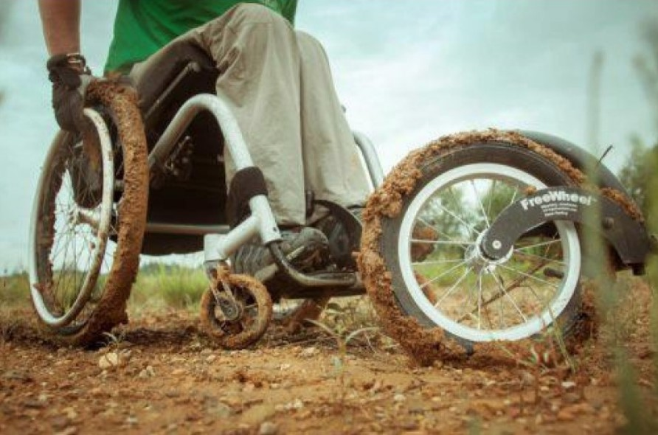
FreeWheel = Freedom
In the publications I found there are inexpensive ways to enable ALL to be inclusive
An example is the pictured attachment that facilitates a wheelchair to roll on any type of landscape
This piece transforms a wheelchair into a 3-wheel, all terrain chair

Slide 16
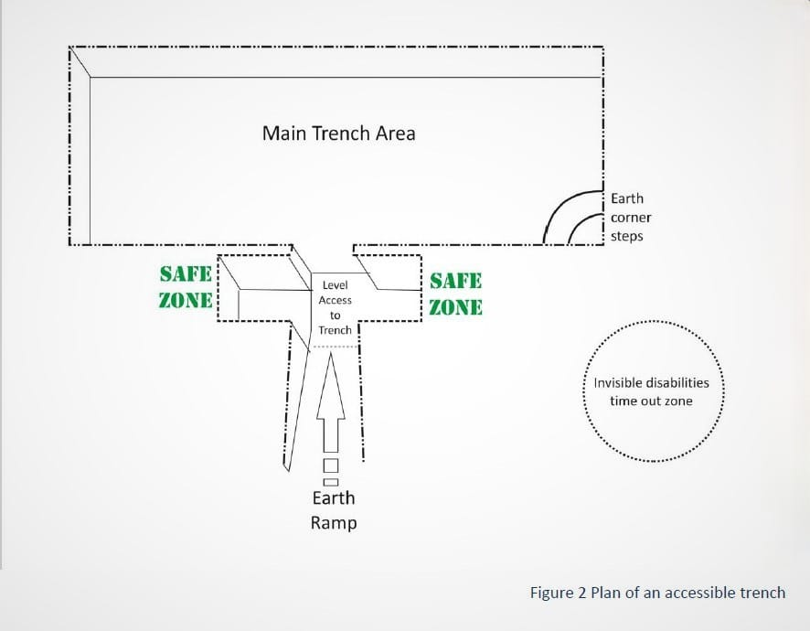
Archaeology Made Easy
Access to trenches can be made by building an earth ramp which ends in the trench approximately a meter before the start of the excavation, where wheelchairs and equipment can be left in one of the safe zones or taken back up on the ramp. Enabled participants can self-propel, use a helper to wheel down the slope or physically roll down the ramp without a wheelchair

Slide 17
Not all archaeology is done within the trenches!
Examples of Archaeology Positions:
lab technician
collections curator
historical preservation specialist
technical writer
archaeological site surveyor
cultural heritage assessor
GIS specialist
program director
forensic analyst
community relations coordinator
crime scene investigator
exhibit designer
geoarchaeologist
historical interpreter
librarian
There are numerous options: working in a Lab museum or an office

Slide 18
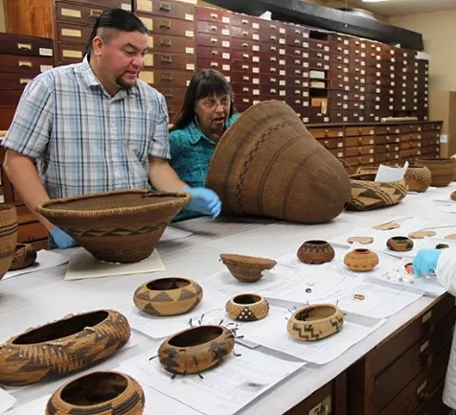
Native American Graves Protection and Repatriation Act
NAGPRA states that human remains, and cultural items must be returned to the lineal descendants, Indian Tribes and Native Hawaiian organization

Slide 19
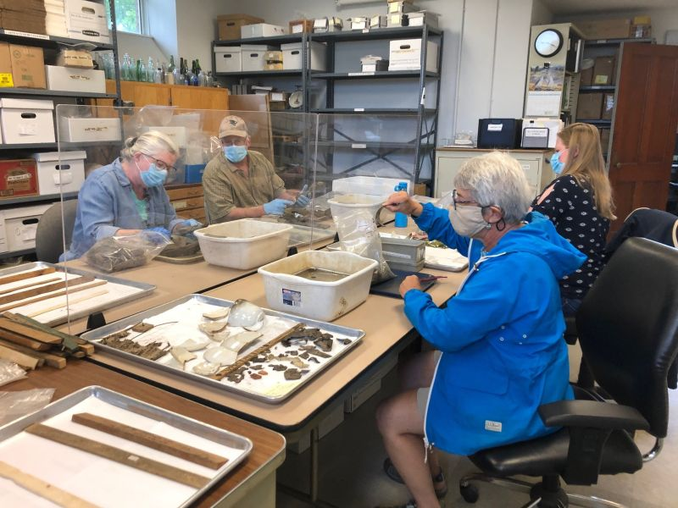
NAGPRA has increased the demand for Archaeology jobs in the United States
There is a need to manage historic places of archaeological, architectural, and historical interests. There must be compliance with environmental and historic preservation laws.

Slide 20
Avenues of Archaeology
Private Sector
Government
Academia
Many archaeologists are hired by private businesses or Cultural Resource Management firms (CRM)

Slide 21
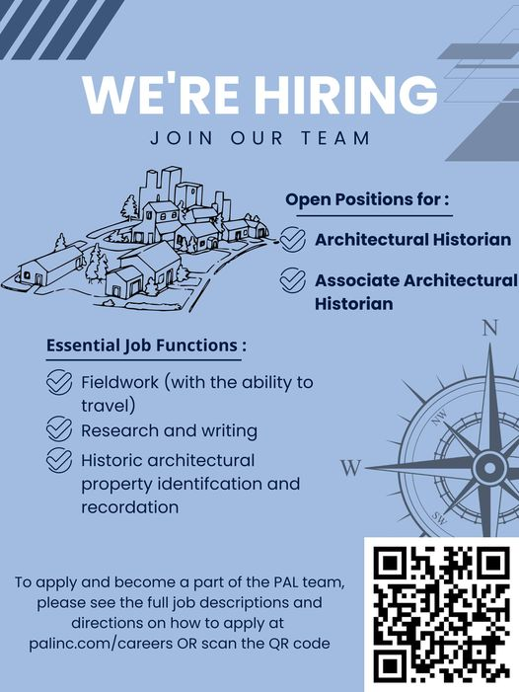
The Public Archaeology Laboratory, Inc. (PAL)
The Public Archaeology Laboratory, Inc. (PAL) is an equal opportunity employer committed to Diversity, Equity, Inclusion, and Belonging (DEIB) in the workplace. We prohibit discrimination or harassment of any kind.
Please submit interest via email:
employment@palinc.com
We promote equity and inclusion in regard to race, ethnicity, sex, gender/self-identity, sexual orientation, national origin, native language, religion, age, disability, veteran status, marital status, and citizenship. Need Assistance?
If you are a qualified individual with a disability and are limited in your ability to apply for a job opening, you may call the PAL office at 401-728-8780 to request a reasonable accommodation. You may also contact us via fax at 401-728-8784.

Slide 22



ROADBLOCK
Despite the information on their website (previous slide) indicating Their inclusion regarding disabilities, President of Public Archeology Laboratory inc. in Pawtucket, RI, Deborah C. Cox stated to me that an archaeologist position is a labor-intensive effort with requirements of lifting fifty pounds and walking at least a mile, therefore a person with a physical disability would not qualify and does not meet the job description
When questioned if a disabled person would qualify for lab work instead of fieldwork Ms. Cox replied that the requirements are still the same

Slide 23
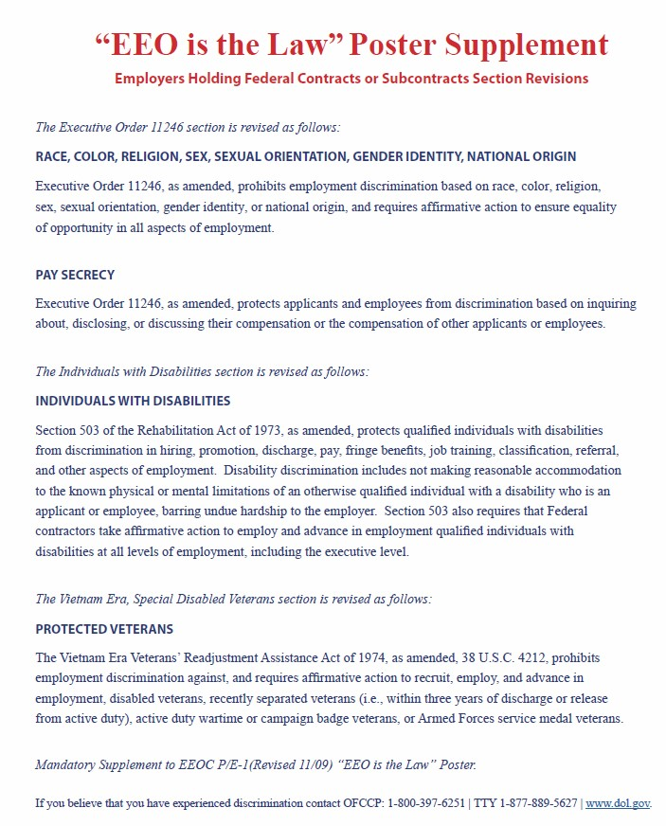
EEO is the Law
Although equal employment opportunity is the law and provisions and modifications are available for disabled people, I found that some local companies, such as PAL, do not provide these opportunities for disabled archaeologists

Slide 24
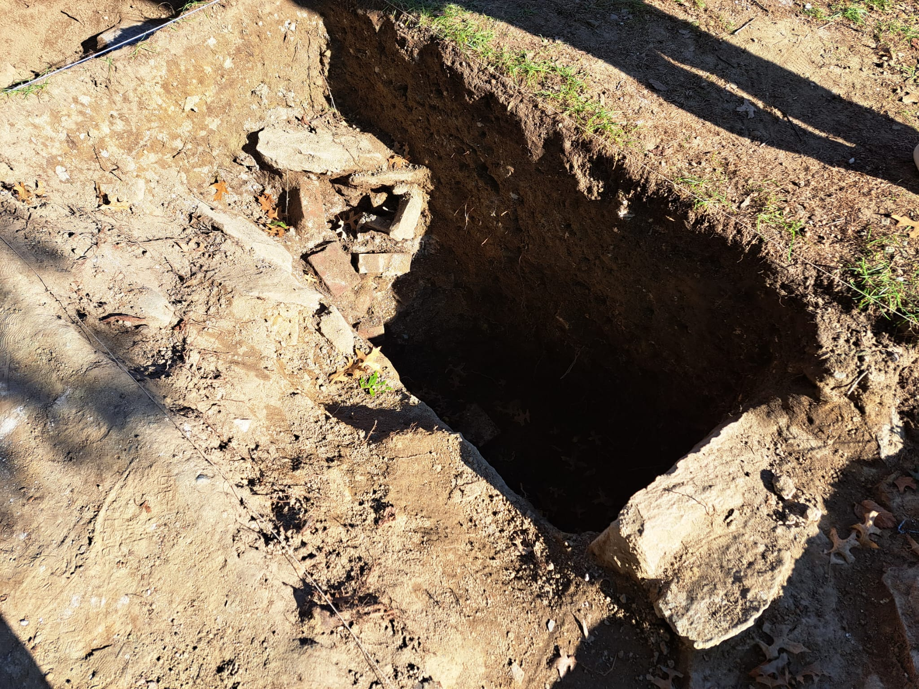
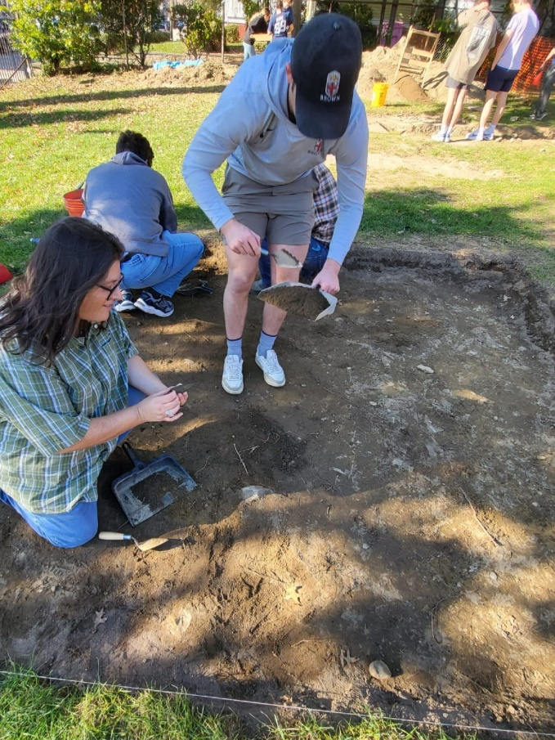
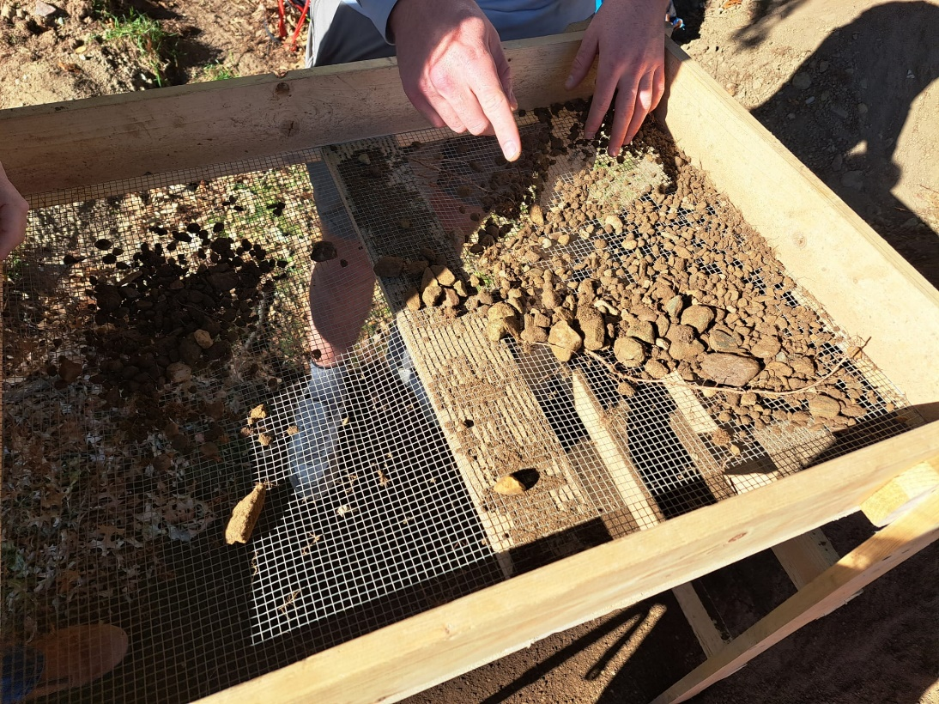
When One Door Closes, Another Opens
Alexander Graham Bell
Keep Digging and Sift Out MORE Information!

Slide 25
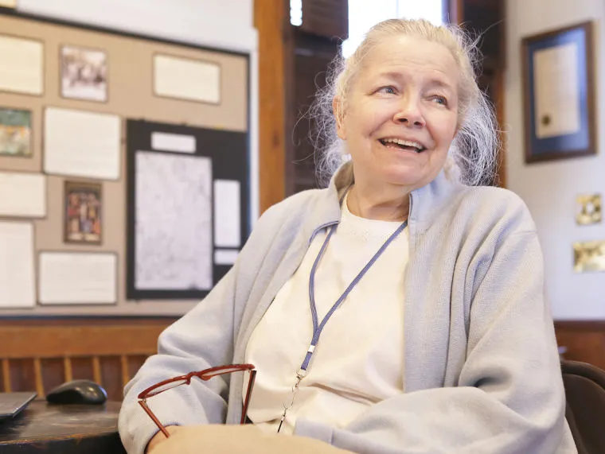
“Just Don’t Let Anyone Tell You No”
D.K Abbass, Ph.D. had words of wisdom including the encouraging quote above
She was a pioneer for women breaking into the social sciences
Her vast experience allows her insight that facilitates accommodations for ALL that have interest in Archaeology—it CAN be done!

Slide 26
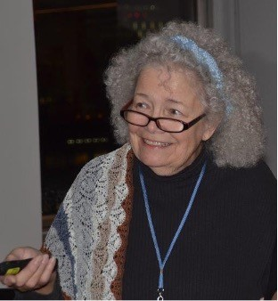
Marine archaeology is a consideration for some types of physical handicaps, as there is weightlessness in water
Land archaeology can be performed while sitting on the ground and there are always people to help, and other obstacles can be accommodated
Fieldwork is only about ten percent of what goes on in any archaeological study. There is background research, organizing of a team, training, reports that need to be written, data to be analyzed and then, one must treat the artifacts

Slide 27

The Ugly Truth
Commercial companies (CRM jobs) are not usually archaeological firms, but environmental or engineering companies interesteD in their bottom line (making money) therefore, they are not always able or willing to be as flexible as organizations or academia, as it affects their profits

Slide 28

In Conclusion But Not the End
As a society we have progressed many steps forward in finding ways to be inclusive. Laws have been written, groups have been formed, action has been taken.
Although my findings show a definite need for improvement, I will persevere in my own pursuit of conquering obstacles to become the best version of me. I foresee a future that implements inclusive policies and the utilization of ideas and products created so that each person can follow their dreams and not let our differences separate us but unify us for a better tomorrow. I will be a part of that change.
“one nation, indivisible, with liberty and justice for all."
Kelly A. Grace

Slide 29
With appreciation
Thank You to D.K. Abbass, Ph.D., a woman to whom speaking with is like suddenly finding yourself surrounded by your favorite books.
Many thanks to Professor Carol Panaccione who has encouraged my progress over the semester and has been a guiding force inspiring me to ride my chariot towards the battle head on!
A special thanks to Mr. James Dahlen, Brown University Student ‘23 for taking the time out of his busy schedule to answer questions, conduct a tour of Joukowski Hall, and introduce me to his archaeology classmates and his instructors: Elizabeth (Liza) Davis and erynn Bentley both of whom also contributed valuable input to my learning experience at Brown University.
“There can be no greater gift than that of giving one’s time and energy to help others without expecting anything in return.”
— Nelson Mandela

Slide 30
Credits and Resources
All photographs property of Kelly A. Grace ©2022 unless otherwise noted
Slide 7: Brown University Student accessibility Information provided by Jennifer agudelo, m.a., accommodation specialist
Slide 11: https://dps.brown.edu/crime-prevention/blue-light-phones-yellow-jackets
Slides 13, 14: Theresa O'Mahoney , “Enabled archaeology” and inclusive, accessible archaeology , Tim Phillips, Roberta Gilchrist, kindly supplied by Elizabeth (Liza) Davis, ma, doctoral student in archaeology and the ancient world, Brown University
Slide 15: photo credit: Freewheel: https://www.draftwheelchairs.com/shop/free-wheel.html?___SID=U#prettyPhoto
Slide 16: Diagram information credit: (Defence Archaeology Group (D.A.G.), 2015 O’Mahoney, 2015)
Slide 18: https://www.nps.gov/subjects/nagpra/index.htm , Photo Courtesy of San Diego Museum of man via: https://www.nps.gov/subjects/nagpra/compliance.htm

Slide 31
Credits and Resources
Slide 19: courtesy of the Friends of the Little Red House; https://www.linkedin.com/company/public-archaeology-lab?trk=public_profile_topcard-current-company
Slides 21, 22: information provided by Deborah C. Cox, (President of PAL, Pawtucket, RI) and by their website; https://www.palinc.com/careers
Slide 23: “EEO is the Law Poster”; https://www.dol.gov/sites/dolgov/files/ofccp/regs/compliance/posters/pdf/OFCCP_EEO_Supplement_Final_JRF_QA_508c.pdf
Slide 25: Photo of D.K Abbass, Ph.D.: The Newport Daily News Daily News File Photo:
https://www.newportri.com/story/news/local/2022/02/03/newport-ri-james-cooks-ship-endeavor-found-newport-harbor/6646426001/
Slide 25: “Just Don’t let anyone tell you no”: Quote by D.K. (Kathy) Abbass , Ph.D.
Slide 26: Photo of D.K. Abbass, Ph.D.: Mystic Seaport Museum: https://www.mysticseaport.org/events/shipwrecks-of-rhode-island-in-the-revolution-an-update-for-their-250th-anniversaries/
Quote from the Pledge of Allegiance written in 1885 by Captain George Thatcher Balch, a Union Army officer in the Civil War: Wikipedia; https://en.wikipedia.org/wiki/Pledge_of_Allegiance

Slide 32
