Slide 1
How Germany’s Geographical History Affects Culture
Katharina

Slide 2
Language and German Roots
The name Germany comes from the Latin word Germania.
Germania- used during the Gallic War (58-51 BCE) to describe people east of the Rhine.
History of the word Deutschland!

Slide 3
Before it was Germany
Who ruled what became known as Deutschland?
When did these people start to rule?
How did “Germany” keep its individuality/distinguish itself from Rome?
What comes next?

Slide 4
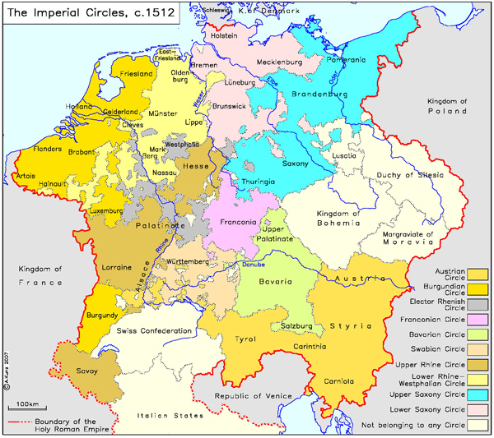
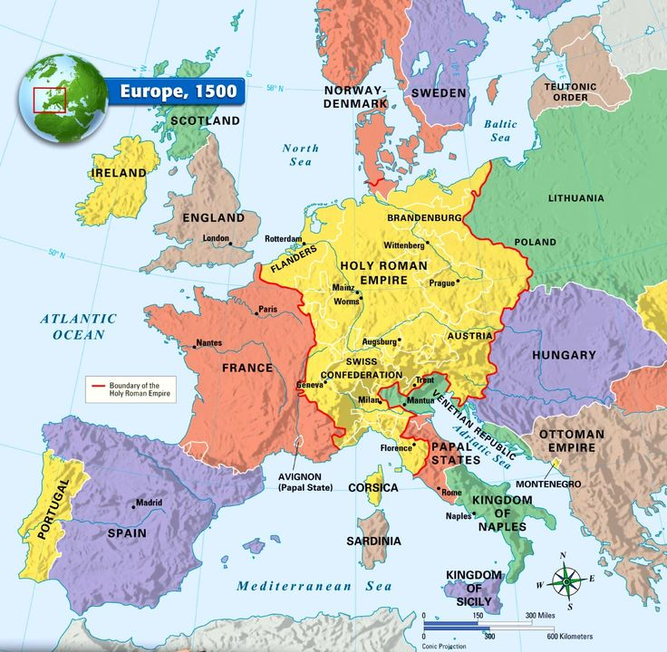
“Germany” as Part of the Roman Empire

Slide 5
The Beginning of Germany as an Individual
When was the nation-state founded?
What was this nation-state called?
Were there territories you may have heard of?
What were some “historical landscape” territories?

Slide 6
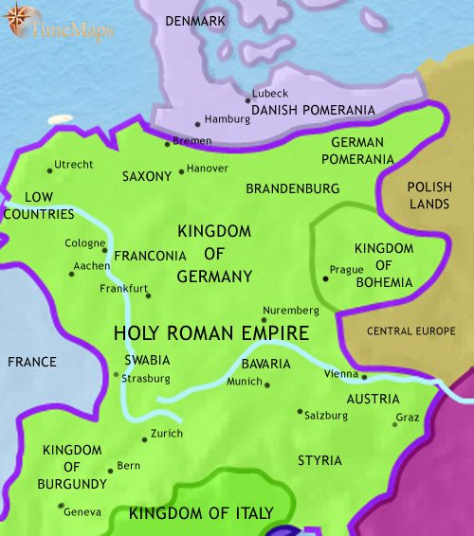
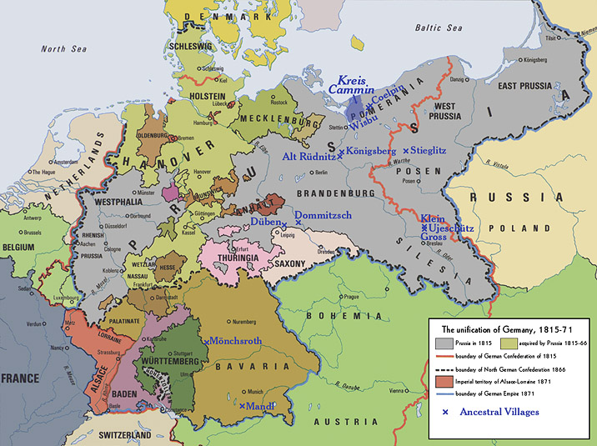
Germany Before & After Unification

Slide 7
Who is Germany Now? 1949-Present Day
The Federal Republic of Germany.
What did it consist of in 1949?
The German Democratic Republic (GDR).
How did they merge in 1990?
Germany has consisted of 16 federal states since then.

Slide 8
The Sixteen Federal States Germany has Consisted of
The 16: Baden-Württemberg, Bavaria, Berlin, Brandenburg, Bremen, Hamburg, Hesse, Lower Saxony, Mecklenburg-West Pomerania, North Rhine-Westphalia, Rhineland-Palatinate, Saarland, Saxony, Saxony-Anhalt, Schleswig-Holstein, and Thuringia.

Slide 9
Location, Location, Location
Where is Germany located?
Germany shares boundaries with NINE other countries:
  Austria, Belgium, The Czech Republic, Denmark, France, Luxembourg, The Netherlands, Poland, and Switzerland.
Other land- renounced.

Slide 10
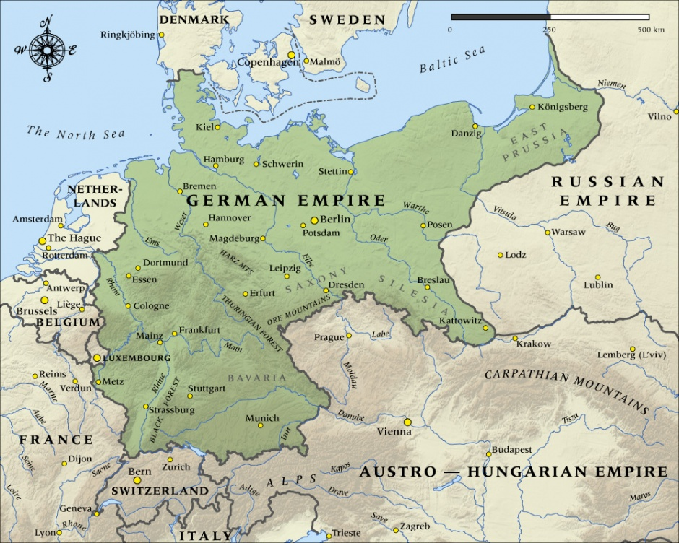
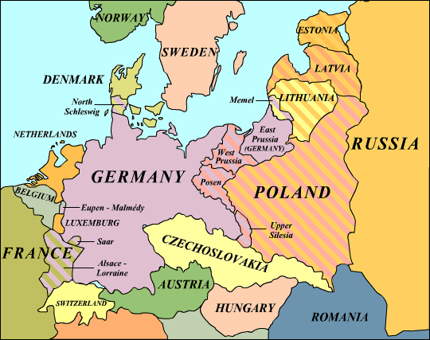
Germany Pre/during WWI & Post WWI

Slide 11
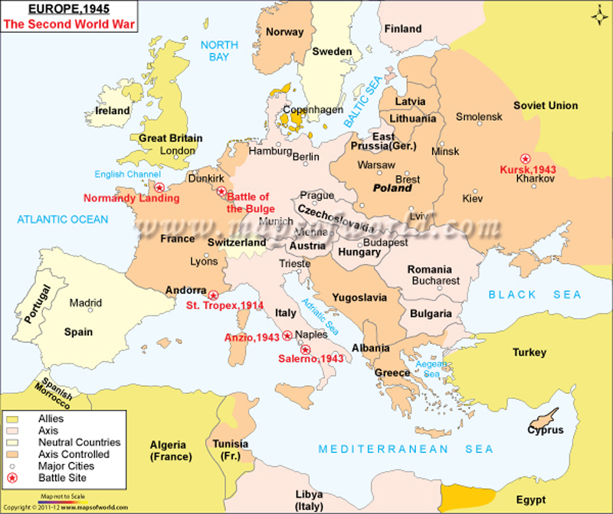
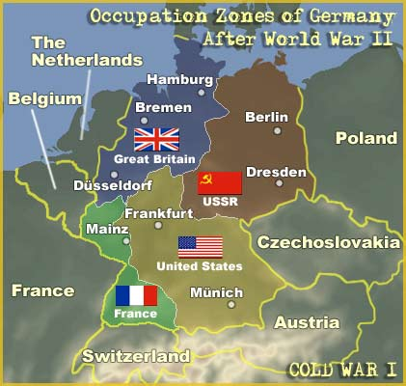
Germany During & Post WWII

Slide 12
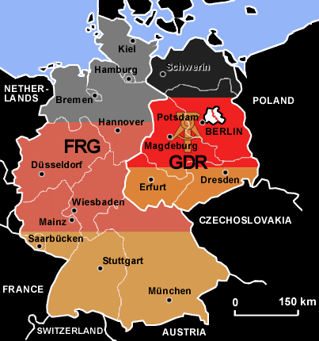
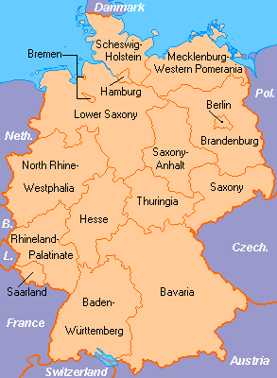
Germany Before & After 1990

Slide 13
How Germany Has Been Run Since 1871
Who was the last king of Germany?
  Wilhelm II (1/27/1859-6/4/1941)
  Last German Emperor & King of Prussia
  Ruled from 6/15/1888-11/9/1918
How is Germany led today?
  A Parliamentary system of government.
  Head of State: the President.
  Leading political figure: the Chancellor.

Slide 14
How Did WWI & WWII Change German Geography?
The Treaty of Versailles
  Concede territory to Belgium, Czechoslovakia, and Poland.
  Returned territory to France from the Franco-Prussian War.
The Marshall Plan
  Allied occupied regions combines to spread Capitalism.
  Stalin wanted a weak, communist Germany to the USSR’s western border.
All territories lost in the World Wars constituted 33% of the former German Empire.

Slide 15
Other Fun Geographical Melting Pot Facts!
German dialect is very interesting. It’s an Indo-European language. German dialects are very similar to Dutch,
High German was also based on/influenced by geographical location.
Many people immigrate to Germany and bring much language and culture to the nation. Some languages due to geography.
Examples of languages spoken: Greek, Turkish, Spanish, French, etc.

Slide 16
Other Fun Geographical Melting Pot Facts!
1939- What would become East and West Germany did not have equal populations.
East Germany’s population was approx. 17 million.
West Germany had a whopping 43 million people (thanks to much immigration).

Slide 17
Food For Thought on Expansion
Is there a possibility for the future expansion of Germany?
German borders were defined naturally by rivers, so could they be redefined in another natural way?
Would the further expansion for Germany end badly, even if (unlike the past) it was negotiated appropriately?

