Slide 1
Introduction to IOS 15 CLI Licensing Commands
A. Peter Anderson
Associate Professor
August 4, 2013

Slide 2
Introduction to IOS 15 CLI Licensing Commands (Verification, Activation, Uninstall)

Slide 3
License Management Commands
Display License Info
Enable / Disable Technology Package Licenses
Additional Resources:
Cisco IOS Software Activation Command Reference
Software Activation Configuration Guide, Cisco IOS Release 15M&T
Yes Officer, I have a License.
Notes:
New section:

Slide 4
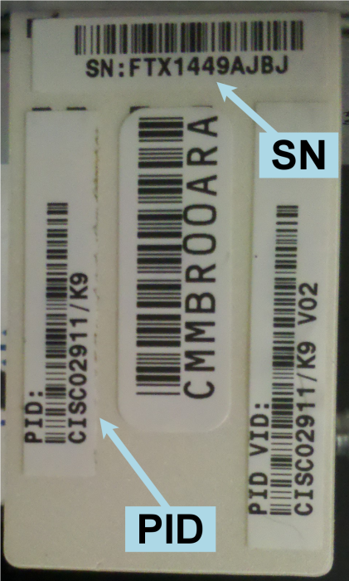
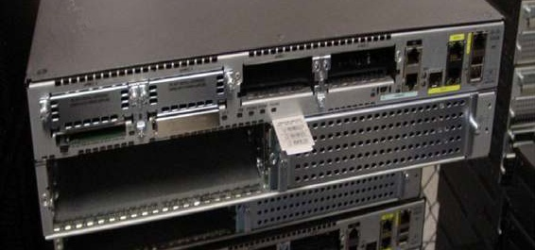
Command: show license udi
Displays all the unique device identifier (UDI) values that can be licensed on the system
Notes:
The locations to find UDI information on the router
CLI command: show license udi
CLI command: show version
On the plastic tab directly attached to the router
This information is needed to purchase upgrades at a later time, transfer licenses, and lookup licenses.

Slide 5
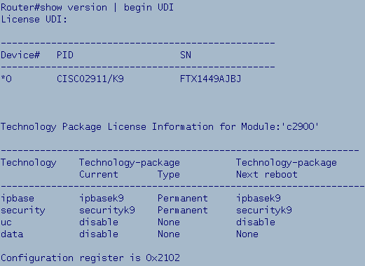
Command: show version
Displays the hardware and Technology Package License information.
Determine Technology license Type.
Determine Technology license status at Next Boot.
Determine Technology Package Status.
Notes:
Show version now has additional information pertaining to licensing. Several ways to show this data.
Allows the identification of:
Current Technology Package Status.
Current Technology Package License Type.
Technology Package License Status at Next Boot.

Slide 6
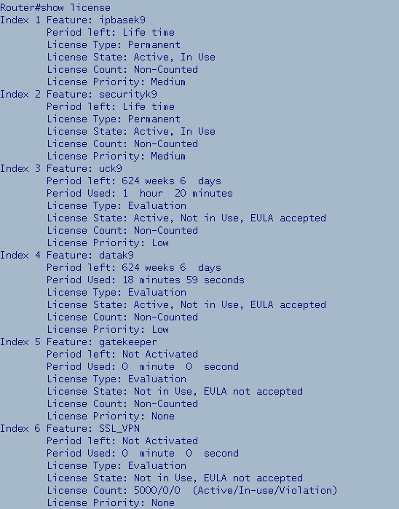
Command: show license
Displays detailed information
about all feature licenses.
Type of license
Evaluation or Permanent
Actual usage time of the license
Time used and left in the evaluation
Notes:
Shows all feature licensing. Technology & Feature inclusive.
First animation: ipbasek9 has permanent license, no expiration date
Screen below shows that the temporary data Technology License has been used for 18min 59 sec.
Other show license commands:
show license all
show license detail

Slide 7
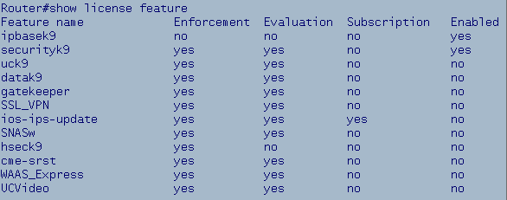
Command: show license feature
Lists the available licenses on the device
Lists the status of the licenses
Notes:
Displays the current list of all features on the router & which are enabled.

Slide 8
Activate/Deactivate Technology Package Licenses
Available Technology Package Licenses:
Data, Unified Communications and Security
Enable:
Router(config)# license boot module C2900 technology-package datak9
<Model> <Package>
Disable:
Router(config)# no license boot module C2900 technology-package datak9 [disable]
OR
Notes:
Before activating a license (if you want it to be permanent) you need to upload the license (.lic) file to flash.
To Enable: license boot module <Model> technology-package <Package>
To Disable: no license boot module <Model> technology-package <Package> OR
license boot module <Model> technology-package <Package> disable

Slide 9
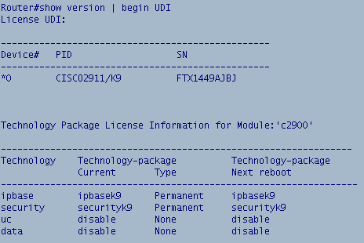
Verifying A Technology Package License
Step 1: Issue show version | begin UDI (verify data license is disabled)
Notes:
This command is issued to verify that the Technology Package is not enabled already!

Slide 10
Activating A Technology Package License
Step 2: Activate the data technology package license
Router(config)# license boot module c2900 technology-package datak9
Notes:
Note the output after issuing the license boot module command:
Issue the “write” or “do write” command
Technology Package will be active after next Router Reboot
Issue the show version | begin UDI command to verify

Slide 11
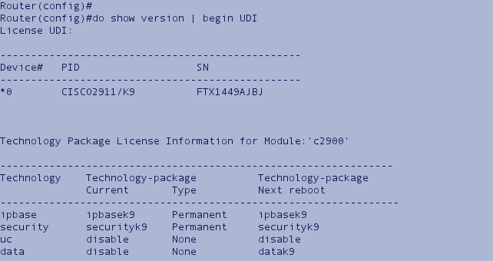
Verify A Technology Package License Status after Next Reboot
Step 3: Verify activated license:
Router(config)# do show version | begin UDI
Notes:
Verify that after the next router reboot the “Data” Technology Package will be Active.

Slide 12
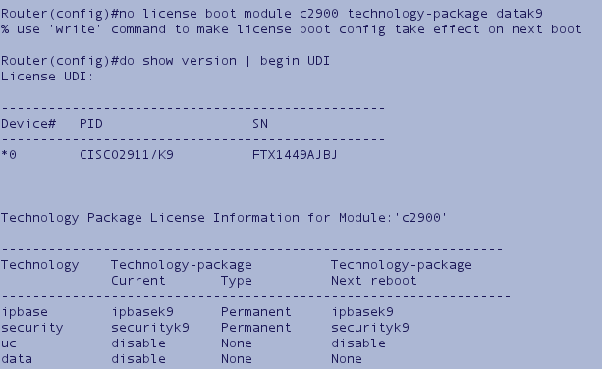
Uninstalling A Technology Package License
Step 1: no license boot module c2900 technology-package datak9 OR
license boot module c2900 technology-package datak9 disable
Step 2: show version | begin UDI to verify that the license is disabled
Notes:
Note that there are two ways to disable a Technology Package:
no license boot module <Model> technology-package <Package>
OR
license boot module <Model> technology-package <Package> disable

